Slide 1
Maximizing Your QAD Enterprise Investment with Integrated Automated Data Collection (ADC)
Kerry White – IT Manager, Sugar Foods Corporation

Slide 2
Safe Harbor Statement
Integrated Automated Data Collection (ADC)
The following is intended to outline QAD’s general product direction. It is intended for information purposes only, and may not be incorporated into any contract. It is not a commitment to deliver any material, code, functional capabilities, and should not be relied upon in making purchasing decisions. The development, release, and timing of any features or functional capabilities described for QAD’s products remains at the sole discretion of QAD.

Slide 3
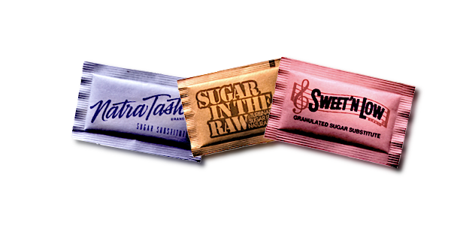
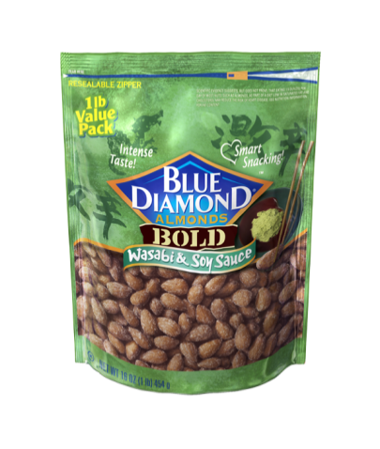
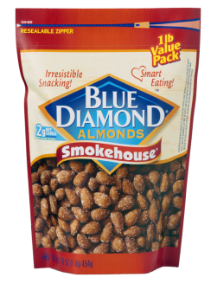
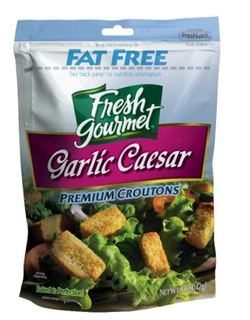
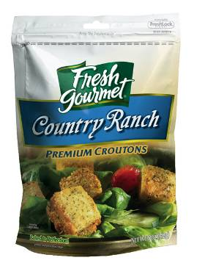
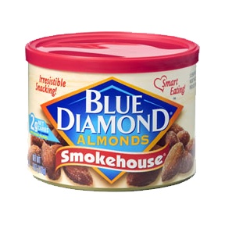
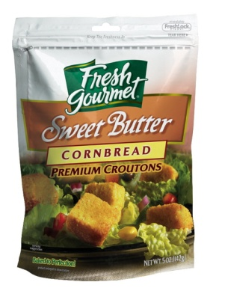
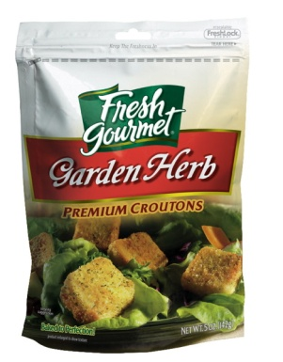
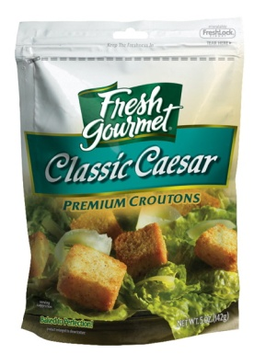
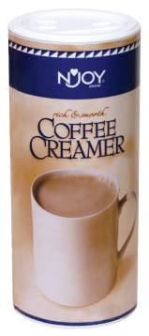
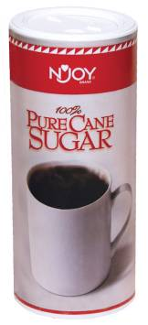

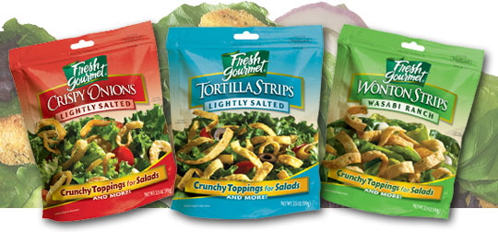
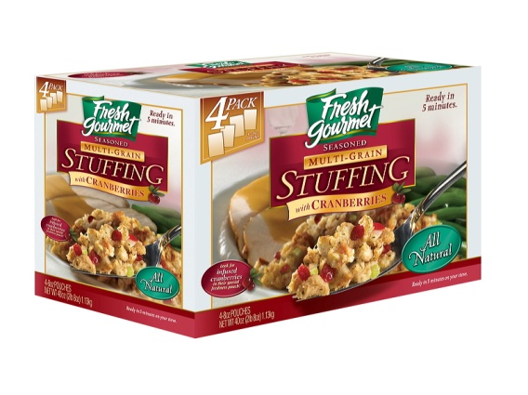
#1 Supplier of sugar substitutes
SUGAR FOODS PRODUCTS ARE CONSUMED
80 MILLION TIMES PER DAY!
#1 Supplier of almonds
#1 Supplier of croutons and crunchy salad toppings
#1 Supplier of powdered,
non-dairy creamer

Slide 4

Commercial Food Service Providers
Retail and
Consumer
Non-Commercial Food Service Providers
Restaurants
Hotels
Warehouse clubs
Supermarkets
Mass merchandisers
Colleges
Health Care Facilities
SUGAR FOODS PRODUCTS ARE DISTRIBUTED TO MORE THAN
850,000 OPERATORS

Slide 5
Company Background
Integrated Automated Data Collection (ADC)
Corporate offices located in new york city
Five manufacturing/distribution facilities
  Sun valley, CA (180,000 sq. Feet)
  Commerce, CA (250,000 sq. Feet)
  Villa rica, GA (340,000 sq. Feet)
  Mazatlan, mexico ( 70,000 sq. Feet)
  Levittown, PA ( 33,000 sq. Feet)
750 employees AND GROWING
Mission statement:
The Customer is KING

Slide 6
Challenges
Integrated Automated Data Collection (ADC)
Less than acceptable inventory accuracy
Limited granularity in transaction history
Unidentifiable products with similar characteristics
Wish to:
Maximize efficiency and profitability
Meet compliance requirements for lot traceability
Position for future growth.

Slide 7
Meeting the Challenges: Phase 1
Integrated Automated Data Collection (ADC)
Implemented QAD Eb2.1in 2006
  QAD recognized Sugar Foods with its “Rapid Implementation Award” at Explore 2007
  Discovery to GO-LIVE in 77 days

Slide 8
Known Challenges – Specific to ADC
Integrated Automated Data Collection (ADC)
Lack of inventory accuracy or a single location called “OT”; that is:
  Inventory that’s “out there” somewhere
Lack of real-time information
Need to eliminate manual logging of raw materials
Lack of ability to track materials from receiving through production and then shipping by means of an automated system that provides full lot traceability.

Slide 9

The Right Solution for Sugar Foods
Integrated Automated Data Collection (ADC)
Sugar Foods chose Eagle’s RF Express™ for QAD Enterprise Applications
Chose Intermec Corporation’s CK31 RF handheld devices
Chose Zebra Technologies 105SL bar code label printers for the shop floor

Slide 10
Why Eagle?
Strategic QAD Partner since 1992
Seamless integration with QAD EA
Progress-based solution
99% data accuracy or better
Real-time data capture without changes to QAD code
Personal experience with Eagle’s solution
  Ease of implementation and use
  Hardware and device flexibility

Slide 11
Phase 2: Leveraging QAD EA with an Automated Data Collection Solution
Integrated Automated Data Collection (ADC)
“ERP system implementations have 50% higher benefits when integrated with an Automated Data Collection System.”
  Gartner Group 2001
Began ADC of raw material data in Villa Rica facility in July 2007
  Receiving
  Material transfer
  WIP production
Completed rollout of raw material in Sun Valley in September 2007
Completed rollout of raw material in Commerce in December 2007

Slide 12
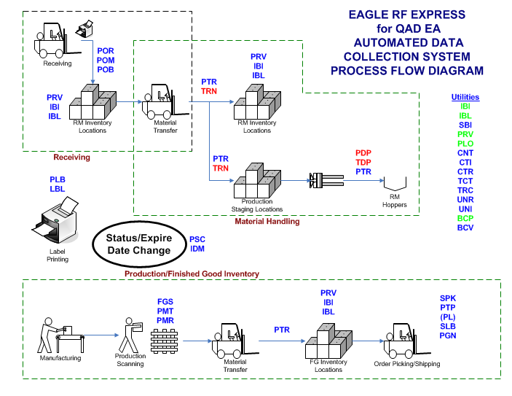

Slide 13
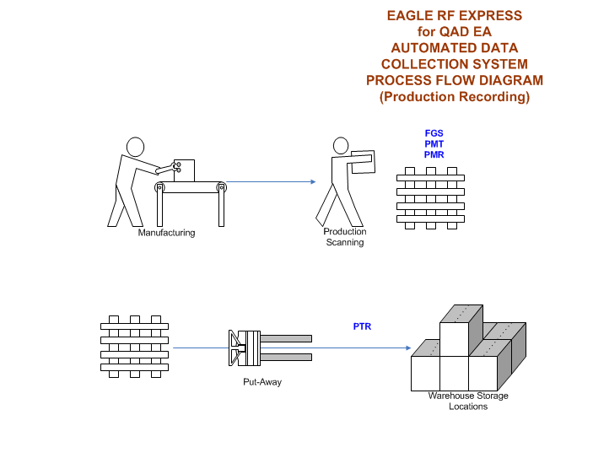

Slide 14
Where Are We Now?
Integrated Automated Data Collection (ADC)
All production in all four US facilities is recorded via scanning and pallet tags are assigned
All finished goods movement is scanned
All sales order picking is performed utilizing scanners
All finished goods inventory receives a lot code at the time of production
Inventory rotation rules are in place by customer/item

Slide 15
What About the Challenges?
Integrated Automated Data Collection (ADC)
Improve production recording accuracy
Improve picking efficiency
Reduce picking errors
  Over picking
  Wrong item
Reduce inventory obsolescence
  Implement FIFO logic
  Implement picking rotation
  Rules by item/customer
Meet compliance requirements for lot traceability
Position for future growth

Slide 16
How We Met These Challenges
Integrated Automated Data Collection (ADC)
Improved production recording accuracy
      Utilization of pre-printed pallet tags on cornerboards
      Utilization of “order quantity” to enforce full pallet quantity
    Improved picking efficiency
      Sort items to pick by weight (heaviest first)
      Warehouse locations sort by closest to dock
      Streamlined prompts by pallet tag
    Reduced picking errors
      Streamlined prompts by pallet tag
      Restricted pick quantity to order quantity
      Only items on the order can be picked

Slide 17
How We Met These Challenges (cont’d)
Integrated Automated Data Collection (ADC)
Reduced inventory obsolescence
  Items to pick are in FIFO order
  Rotation rules are set up by customer/item
  Utilization of short shelf life reports
  Generalized codes dictate minimum shelf life
Met compliance requirements for lot traceability
  Achieved remaining shelf life requirement for customers
  Absolute rotation as per customer requirements
Positioned for future growth
  Built-in flexibility through generalized codes
  Sub-routines called by eagle to support business rules

Slide 18
DEMO

Slide 19
Keys to Success
Integrated Automated Data Collection (ADC)
Know your business requirements (rules)
Simplify the process for the end user
Provide as many tools as necessary
Reduce keypad entry
Review the process periodically
Utilize your skill set and available resources

Slide 20
Metrics Affected
Integrated Automated Data Collection (ADC)
Process | Benefit | Value
Bin Level Location Mgt | Reduced labor cost Improved fill rate Reduced Inventory level Improved Inventory accuracy Less warehouse space | -20 to 30% +10 to 40 pts -10 to 30% To 99.9% -20 to 50%
Real Time Put Away, Product Slotting | Labor reduction Inventory accuracy improved | -20 to 30% To 99.9%
Paperless Receiving – PO scanning, pallet/tote fill, label printing; Real Time Put Away | Administrative labor reduced Fill rate improved Improved pick accuracy and perfect order percentage | -50 to 80% +10 to 40 pts To 95%
Mobile Device Based Order Fulfillment | Administrative labor savings Inventory accuracy improved On-time delivery improvement | -50 to 80% To 99.9% To 99.9%

Slide 21
Next Steps
Integrated Automated Data Collection (ADC)
Stop by the Eagle booth in the EXPO to learn how data collection can improve your bottom line

Slide 22
Questions & Answers
Integrated Automated Data Collection (ADC)
Kerry White
IT Manager, Villa Rica Facility
KWhite@SugarFoods.com
Bill Paone
Executive VP, Sales and Marketing
BPaone@EagleConDev.com
Ray Agrusti
Senior Product Consultant / Project Manager
Ragrusti@EagleConDev.com
RF Express™ for QAD Enterprise Applications is a trademark of Eagle Consulting and Development.
“QAD” is a registered trademark of QAD Inc.
All other products or Company names herein may be trademarks of their respective owners.

Slide 23
www.qad.com
© QAD Inc

