Slide 1
Trade Activity Management (Adaptive UX)
Training Guide

Slide 2
This document contains proprietary information that is protected by copyright and other intellectual property laws. No part of this document may be reproduced, translated, or modified without the prior written consent of QAD Inc. The information contained in this document is subject to change without notice.
QAD Inc. provides this material as is and makes no warranty of any kind, expressed or implied, including, but not limited to, the implied warranties of merchantability and fitness for a particular purpose. QAD Inc. shall not be liable for errors contained herein or for incidental or consequential damages (including lost profits) in connection with the furnishing, performance, or use of this material whether based on warranty, contract, or other legal theory.
QAD and MFG/PRO are registered trademarks of QAD Inc. The QAD logo is a trademark of QAD Inc.
Designations used by other companies to distinguish their products are often claimed as trademarks. In this document, the product names appear in initial capital or all capital letters. Contact the appropriate companies for more information regarding trademarks and registration.
Copyright © 2021 by QAD Inc.
QAD Inc.
100 Innovation Place
Santa Barbara, California 93108
Phone (805) 684-6614
Fax (805) 684-1890
http://www.qad.com

Slide 3
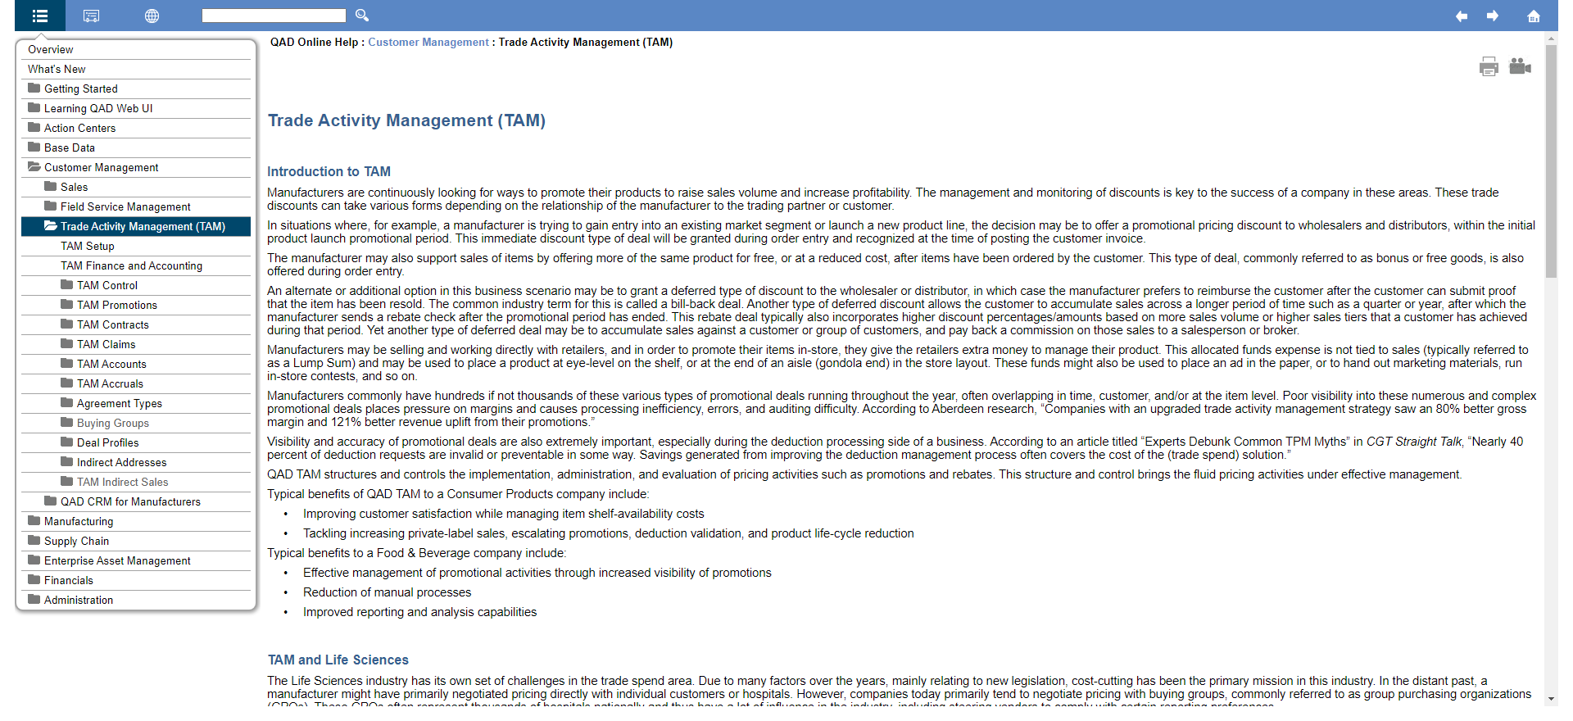
Trade Activity Management - QAD Online Help
Trade Activity Management
Notes:
This training guide is intended to supplement the robust QAD Online Help area for Trade Activity Management. The slides that follow refer to the appropriate sections in the online help for each topic; please regard the online help as you would a user guide and take the time to review each section where every field and feature has been covered in detail and depth. Consider the online help a valuable resource for understanding QAD TAM and refer to it as needed.
To pass the multiple choice certification for QAD TAM, a thorough review of each area of this product as described in the online help will be necessary to achieve a passing score.

Slide 4
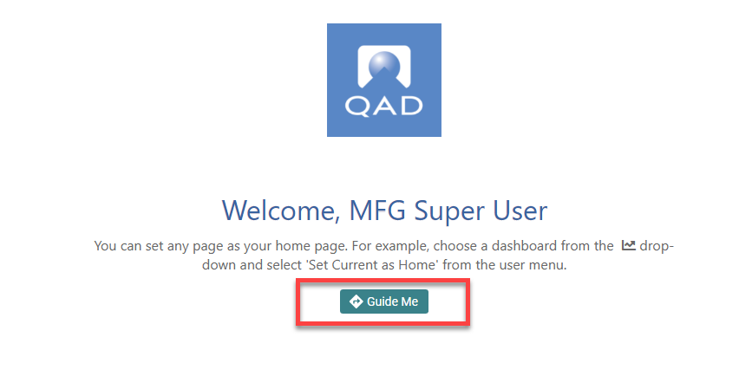
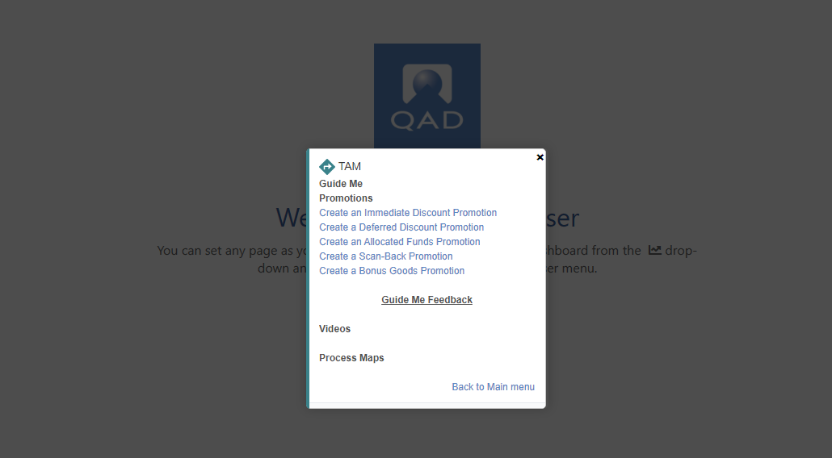
GuideMe
Trade Activity Management
4
Notes:
You can access GuideMe from the home screen for a guided walkthrough of all promotion types discussed in the slides that follow. It is highly recommended that you utilize these for a step-by-step tutorial of these processes.

Slide 5
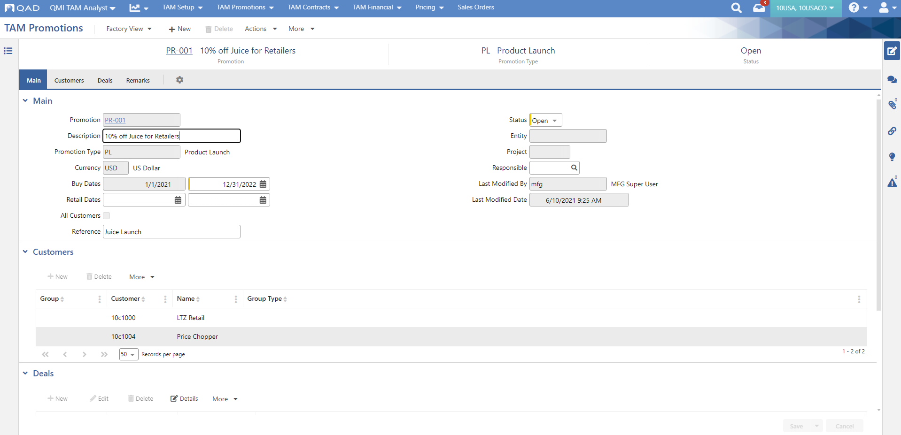
Training Environment
Trade Activity Management
5
Notes:
If you have accessed this training guide from the LMS, then a training environment has been provided to you which you can use to complete the exercises associated with this training.

Slide 6
TAM Promotions Overview

Slide 7
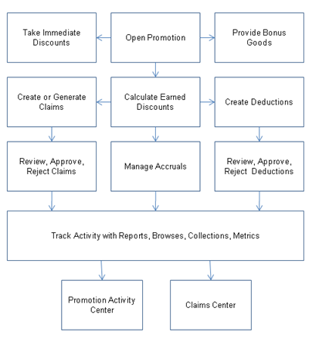
Promotion Process Flow
Trade Activity Management
Notes:
Promotions are agreements with customers to provide discounts during or after a specified period of time, allocate funds for promotional activities, or offer bonus goods at a discounted rate or for free.
Depending on how the promotion is set up, discounts can be taken immediately during sales order/quote entry, deferred and claimed later based on actual sales, or given as required for promotional activity.

Slide 8
Terminology
Trade Activity Management
Promotion - The definition of the type of deal, date ranges, customers, items, etc. that completely describes the offer with the customer/retailer/distributor/wholesaler.
Promotion (Agreement) Type – Promotion grouping. Typical examples may include shows, contests, inventory reduction, slotting.
Deal – This reflects the parameters surrounding the promotional discount.

Slide 9
Deal Categories - Promotions
Trade Activity Management
Deal groupings with common functions:
Immediate Discount – Discount during Sales Order Entry
  Line Level / Order Level
  Discount %, Discount Amount, Net Price, Credit Terms, Freight Terms
Bonus Goods – Additional goods given for free or discounted based on quantity or amount purchased of same or other goods during Sales Order Entry
Allocated Funds – Fixed Money given on a defined schedule based on criteria other than sales activity
Deferred Discount – Discount based on sales activity given after sales are invoiced via credit note or supplier payment
Scan-backs – Accrue on planned sales, claim on reported scanned sales activity

Slide 10
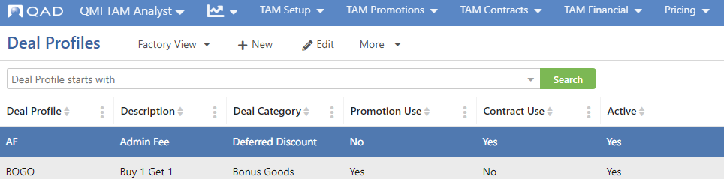
Deal Profiles
Trade Activity Management
Variations of Deal Categories allowing users to name deals consistent with their business and industry
Provides a template which defaults values onto Promotions
Deal profiles (along with promotion type) also help delineate accounting
Notes:
Deal profiles are general templates for deals to be placed onto TAM promotions and contracts.
There are five deal categories that can be used on TAM Promotions, as defined here:
Immediate discounts
Bonus goods
Allocated funds
Deferred discounts
Scan-backs

Slide 11
Promotion Discount timing
Trade Activity Management
Order Entry/Invoice Post
  Price Lists for immediate discounts
  Bonus Goods
Accruals
  Unclaimed deferred discounts, allocated funds and scan-backs
  Monthly, reversing journal entries
Claims
  Manual claim entry upon customer request
  Automated Claim Generation for promotions based on setting in promotional deal
  Customer Credit Notes/ Supplier Invoices

Slide 12
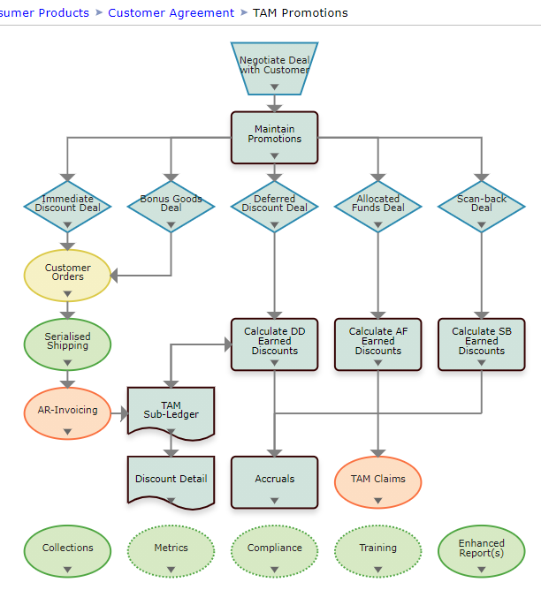
Process Review - Promotions
Trade Activity Management
12
Notes:
This process map can be accessed via the help icon in the QAD Web UI.

Slide 13
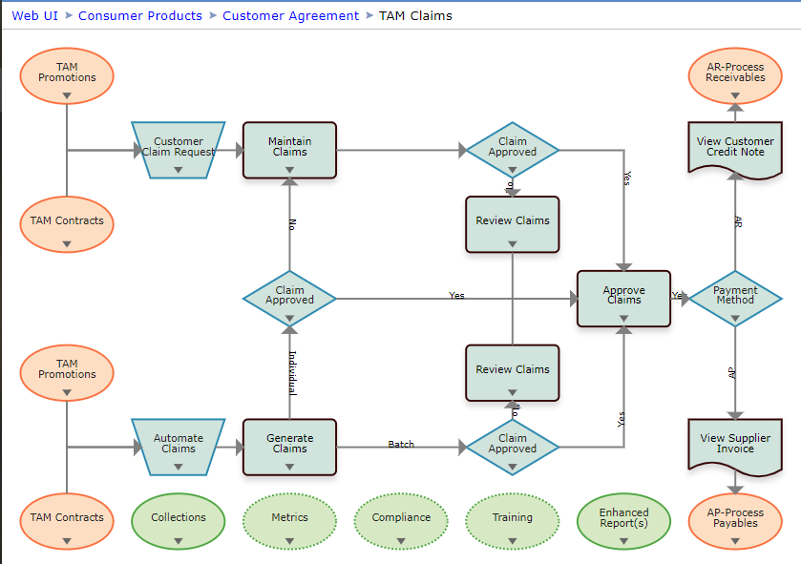
Process Review - Claims
Trade Activity Management
13
Notes:
This process map can be accessed via the help icon in the QAD Web UI.

Slide 14
TAM Promotional Key Functionality
Trade Activity Management
Foundation
Item and Customer Attributes
Item and Customer Groups
Promotions/Rebates
Promotion Types
Deal Categories
Deal Profiles
TAM Promotions
Promotion Copy
Sales Orders/Invoicing
Immediate Discounts
Selecting Free/Bonus Goods
Order Level Discounts
TAM Subledger
Earned Discount Calculation
Settlement
Claim Entry
Claim Generation
Claim Review
Accounting
Promotion expense & accrual accounts
Link to sub accounts & cost centers
Credit notes & supplier invoices
Accruals
Analysis & Reporting
Browses & Collections
Operational Metrics
Various Reports

Slide 15
TAM Reporting Strategy
Trade Activity Management
Reports
  Promotions
  Contracts
  Accruals
  Price List reports
Drill down
  From promotions and claims
Operational Metrics
  Promotions, Claims by Status
  Promotions/Contracts by Type
  Claims by Status
  Approved vs. Rejected Claims

Slide 16
Advanced Pricing Features
Trade Activity Management
Replaces Best Pricing
  Like “best pricing on steroids”
Installs with TAM
  Attributes
  Analysis groups
  Volume Discounts
  Pricing enhancements
16
Notes:
Various enhancements have been made around pricing to accommodate the new Advanced Pricing features introduced by TAM.
Highlights of the enhancements include:
Advanced pricing enhancements allow for item/customer item attribute definition, definition of static/dynamic item/customer group within analysis codes using these attributes. Dynamic pricing routines replace the best pricing.
New Volume Discount order-level price lists support the ability to provide discounts based on multiple lines of an order, including a discount percentage, discount amount, and freight or credit terms. A new version of Volume Discounts has been created to support the new price list type. (Note that you cannot manually edit TAM-generated price lists.)
A Ship Date field has been added to price lists to support a TAM feature that lets you apply a ship date to Immediate Discount deals. During order pricing, the system compares the sales order line due date and the ship date on the price list. If the due date is later than the ship date on the price list, then that price list will not be considered.
An Override feature on price lists supports the ability to define deals that prevent the system from applying Best Pricing logic. Instead, when Override is selected, the system applies the list created based on the associated TAM deal under all circumstances.
A new Max Orders field on price lists supports a TAM feature that lets you specify the maximum number of times that a deal can be used on orders for the same customer. For example, a one-time deal has Max Orders set to 1 in TAM Promotions and in the resulting price list. After a given customer has ordered one time, the system no longer selects the price list for that customer on future orders.
Existing Price Break Category functionality has been extended to support the way in which TAM determines discounts based on dynamic item groups.
Using the new logic:
-- All lines on the sales quote/order containing an item with the specified item attribute/field are totaled to determine the discount tier.
-- All lines on the sales quote/order containing an item with the specified item attribute/field will receive the discount (or the discount can be applied to all lines on the order)
Note: For TAM Contracts, Contract Pricing logic still also applies.
For a more detailed description of these enhancements, please review the “Advanced Pricing and TAM Pricing Functionality Changes” section of Price Lists in the online help.

Slide 17
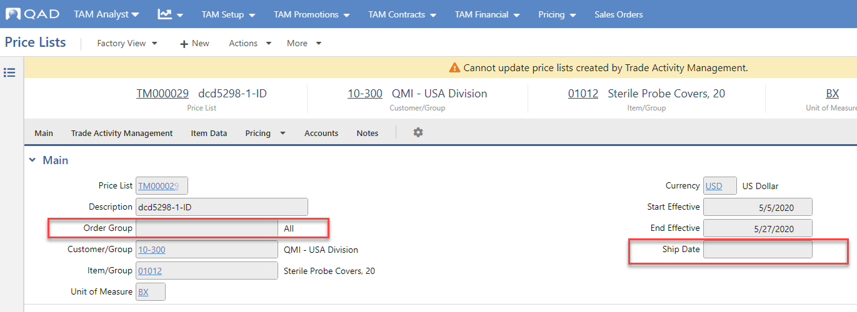
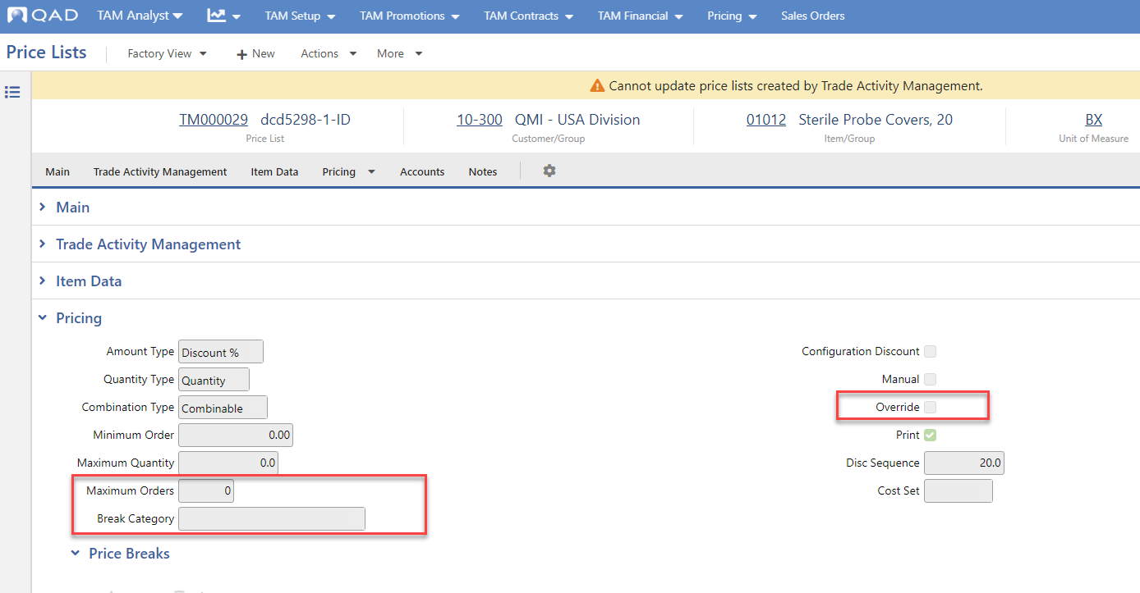
Pricing Enhancements
Trade Activity Management
17
Notes:
For a more detailed description of these enhancements, please review the “Advanced Pricing and TAM Pricing Functionality Changes” section of Price Lists in the online help.

Slide 18
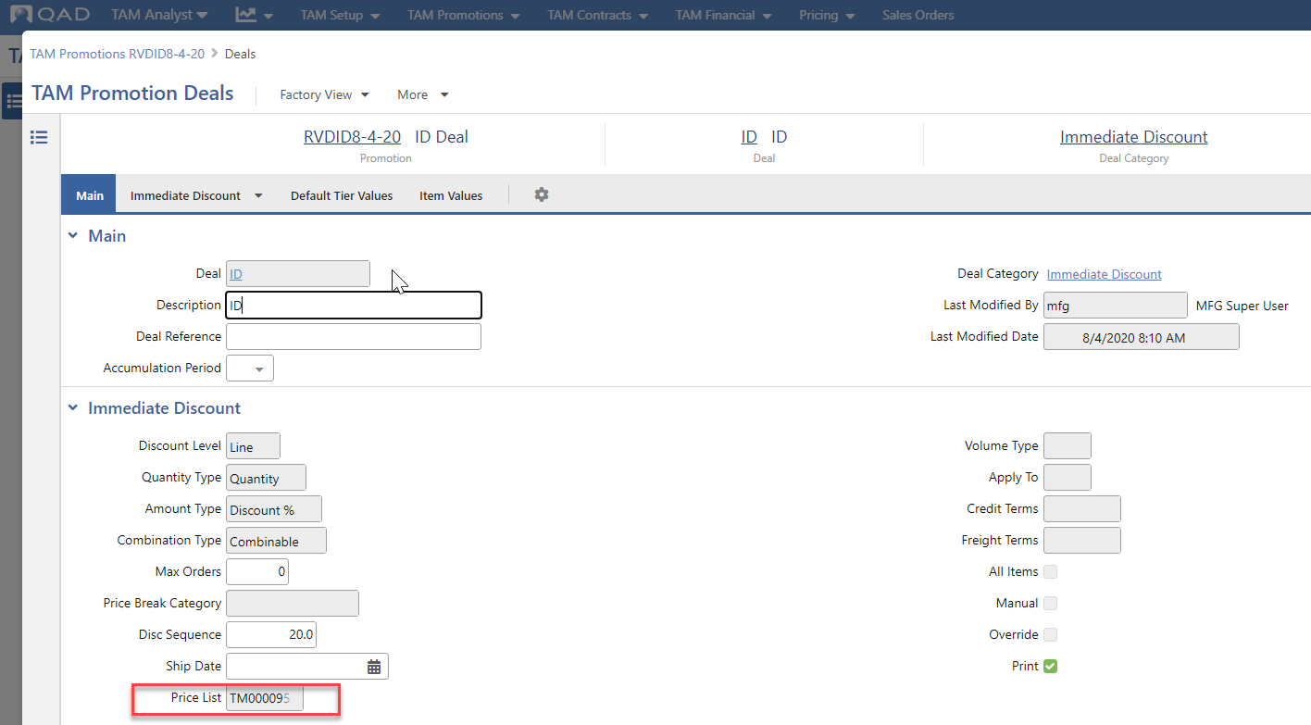
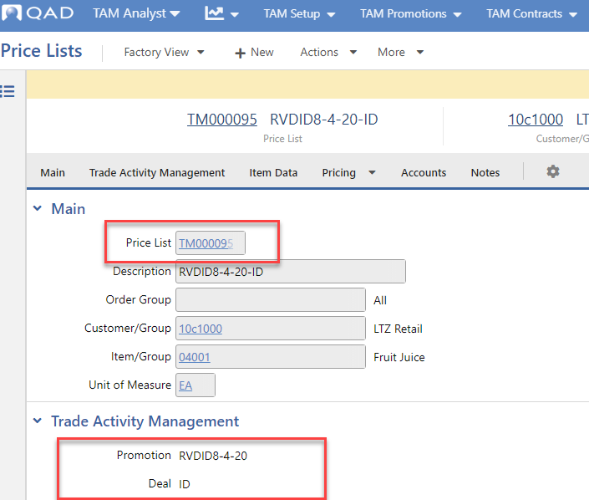
Immediate Discounts - Price Lists Creation
Trade Activity Management
18
Notes:
For Immediate Discount type deals, the system automatically generates the required price lists when users set the status to Open and successfully save the promotion.
These price lists will signify the associated promotion in the Trade Activity Management panel in Price Lists.
Note: Price Lists created from Immediate Discount deals cannot be modified using the Price Lists hybrid view.

Slide 19
Pricing Enhancements
Trade Activity Management
Ship Date
Max Orders
Override
Break Category
19
Notes:
The standard Pricing capabilities of Enterprise Edition have been enhanced to accommodate the new Advanced Pricing features introduced by TAM.
Highlights of the enhancements include:
Advanced pricing enhancements allow for item/customer item attribute definition, definition of static/dynamic item/customer group within analysis codes using these attributes. Dynamic pricing routines replace the best pricing.
New Volume Discount order-level price lists support the ability to provide discounts based on multiple lines of an order, including a discount percentage, discount amount, and freight or credit terms. A new version of Volume Discounts has been created to support the new price list type. (Note that you cannot manually edit TAM-generated price lists.)
A Ship Date field has been added to price lists to support a TAM feature that lets you apply a ship date to Immediate Discount deals. During order pricing, the system compares the sales order line due date and the ship date on the price list. If the due date is later than the ship date on the price list, then that price list will not be considered.
An Override feature on price lists supports the ability to define deals that prevent the system from applying Best Pricing logic. Instead, when Override is selected, the system applies the list created based on the associated TAM deal under all circumstances.
A new Max Orders field on price lists supports a TAM feature that lets you specify the maximum number of times that a deal can be used on orders for the same customer. For example, a one-time deal has Max Orders set to 1 in TAM Promotions and in the resulting price list. After a given customer has ordered one time, the system no longer selects the price list for that customer on future orders.
Existing Price Break Category functionality has been extended to support the way in which TAM determines discounts based on dynamic item groups.
Using the new logic:
-- All lines on the sales quote/order containing an item with the specified item attribute/field are totaled to determine the discount tier.
-- All lines on the sales quote/order containing an item with the specified item attribute/field will receive the discount (or rhe discount can be applied to all lines on the order)

Slide 20
TAM Foundation Overview

Slide 21
Foundation Overview
Trade Activity Management
Attributes
Analysis Groups
Reason Codes
TAM Control
Number Ranges
21
Notes:
For more detailed information on setting up these features for TAM, refer to the TAM Setup section of the online help.

Slide 22
Item and Customer Attributes
Trade Activity Management
Define attributes using Attribute Definitions
Define attribute values (Generalized Codes, Attribute Validations)
Attach item attributes using Items
Attach customer attributes using Customers
22
Notes:
Attributes provide optional flexibility in selecting items and customers that TAM deals apply to.
Specify attributes on items and customers, then define analysis groups based on selected attributes.
Note: Attribute is a general concept used elsewhere in the system. Not all the attribute-related programs, setups, and fields apply to TAM.
Some common attribute examples include choosing to differentiate customers by attributes such as industry, region, number of employees, or any other characteristics. For items, attributes might include color, size, seasonality, and so on.

Slide 23
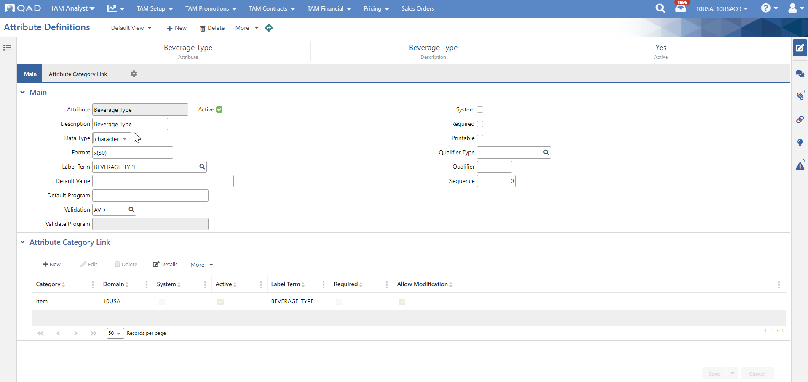
Attribute Definitions
Trade Activity Management
23
Notes:
Attributes allow users to define additional qualifiers which further differentiate and categorize both Items and Customers. Attributes can then be used to filter on reports, browses and when defining Customer and Item Groups.
Use Attribute Definitions to first define an attribute for customer or item usage.
Set up attributes using Attribute Definitions, then associate them with customers or items as needed.

Slide 24
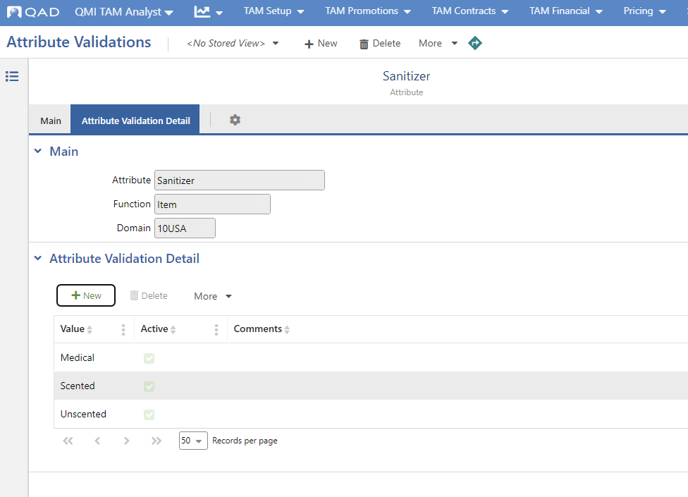
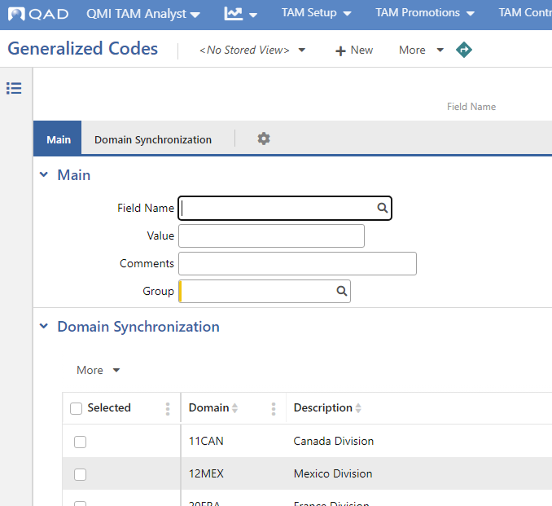
Attribute Validations/Generalized Codes
Trade Activity Management
24
Notes:
Once Attribute Definitions have been set up, specify the values available for that attribute using the appropriate program (typically using either Attribute Validations or Generalized Codes).
Once the attributes and values are defined, then attach them to items using Items and to customers using Customers > Domain Settings.

Slide 25
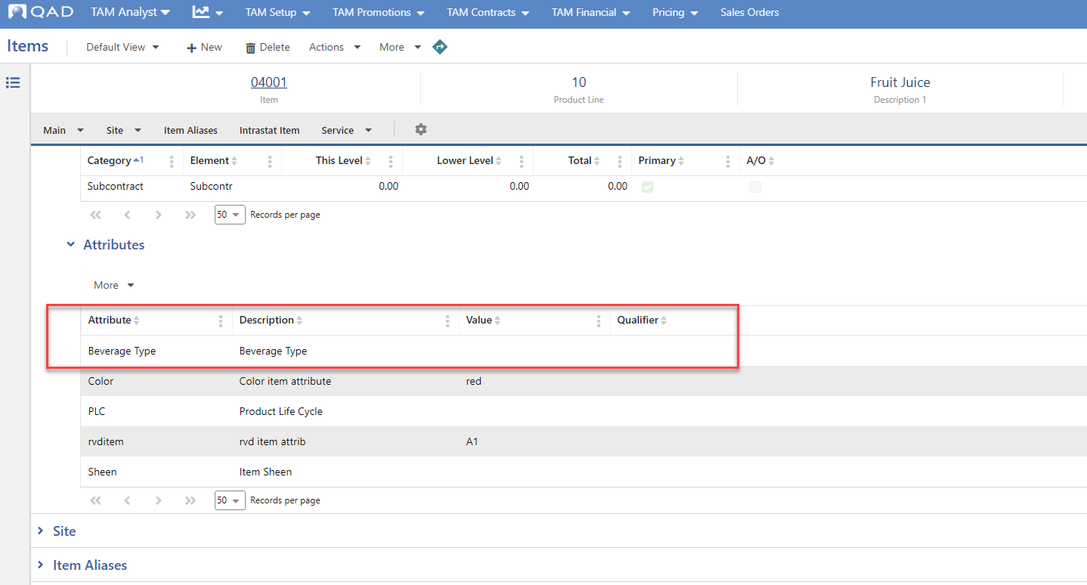
Item Attributes
Trade Activity Management
25
Notes:
Item attribute data can be maintained within the Items > Main > Attributes Panel.
The system displays default values set up in Attribute Definitions. You can update the Value field only if the Allow Modification option is selected in the Attribute Category Link panel of the definition.

Slide 26
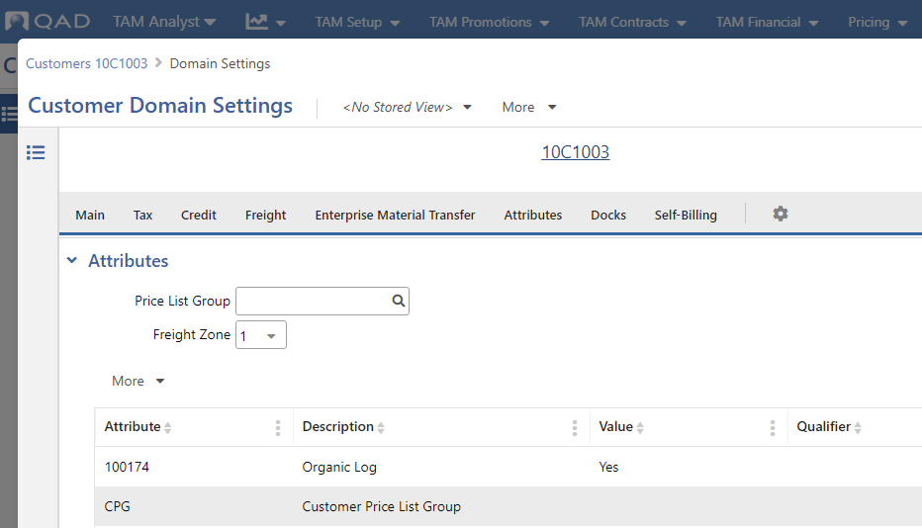
Customer Attributes
Trade Activity Management
26
Notes:
Customer attribute data can be maintained within the Customers > Customer Domain Settings > Details > Attributes Panel.
The system displays default values set up in Attribute Definitions. You can update the Value field only if the Allow Modification option is selected in the Attribute Category Link panel of the definition.

Slide 27
Analysis Groups
Trade Activity Management
Define item and customer groups using Analysis Groups
Dynamic vs Static groups
Static membership, date-driven
Dynamic membership, value driven
Utilize attributes
27
Notes:
Use Analysis Groups to define groups of customers and/or items that TAM promotions or contracts can apply to. Attaching a group provides an efficient means to define a promotion or contract for many customers/items; as membership fluctuates in the group, so then do the customers/items that apply to a promotion or contract that references that group.
Analysis group membership can be static (composed of a specific list of items or customers with stated start and end membership dates) or dynamic (based on attributes that are applied to the item/customer master records). The analysis groups are used to filter group membership.
Be careful that you do not define dynamic groups as wide open (all items, all customers); otherwise, expect potential performance issues at run-time price calculation.

Slide 28
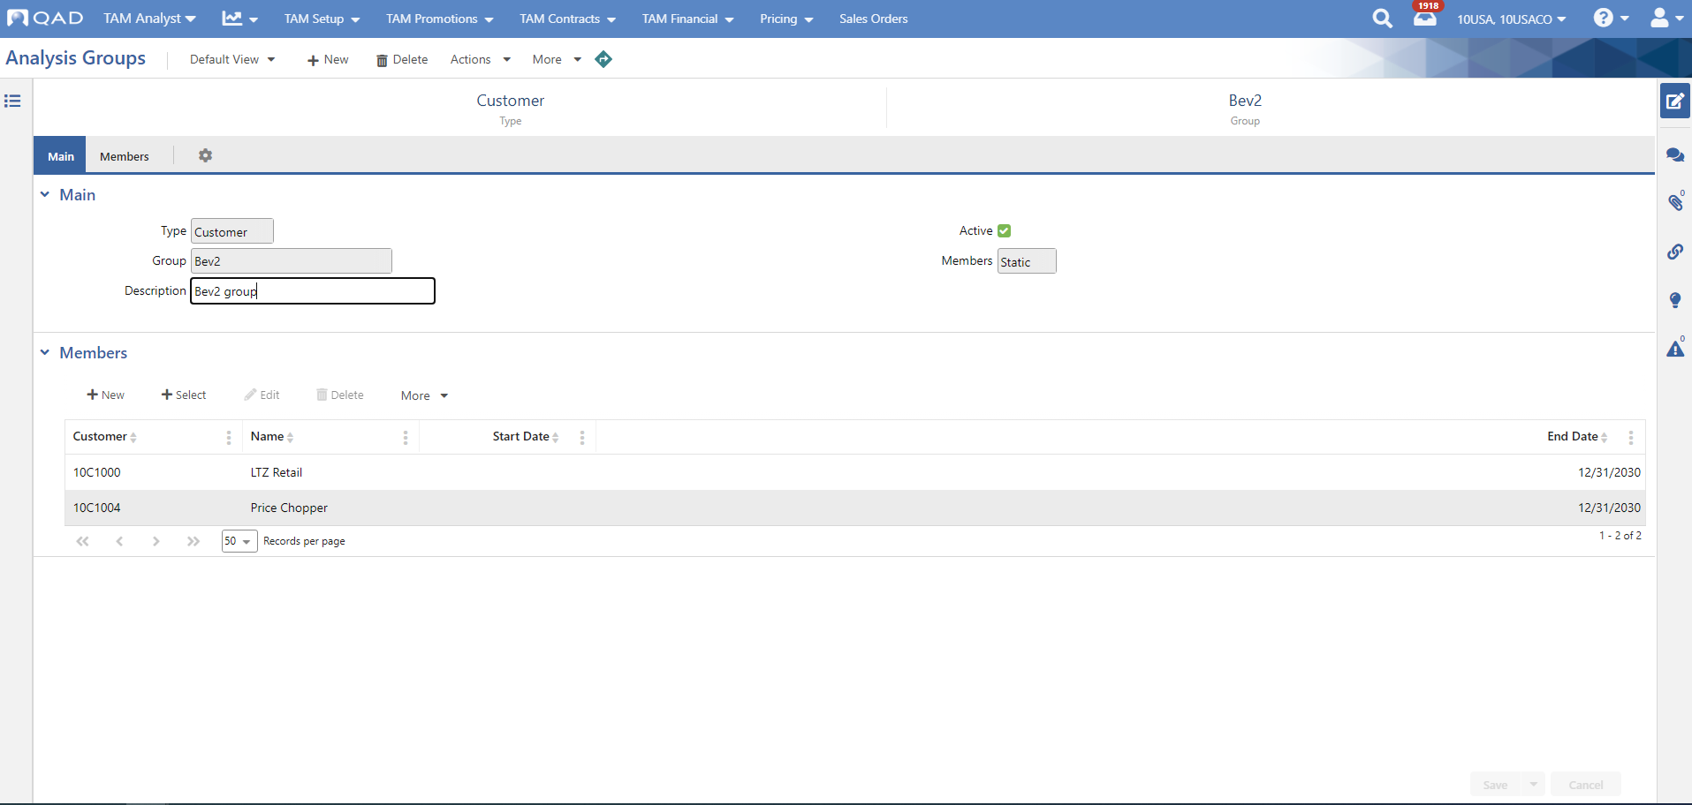
Analysis Groups - Item and Customer Groups
Trade Activity Management
Notes:
Browse selection on ‘standard’ fields and attributes
Static Group Members may have a Start and End Date defining membership effectivity
Groups can either be Static or Dynamic

Slide 29
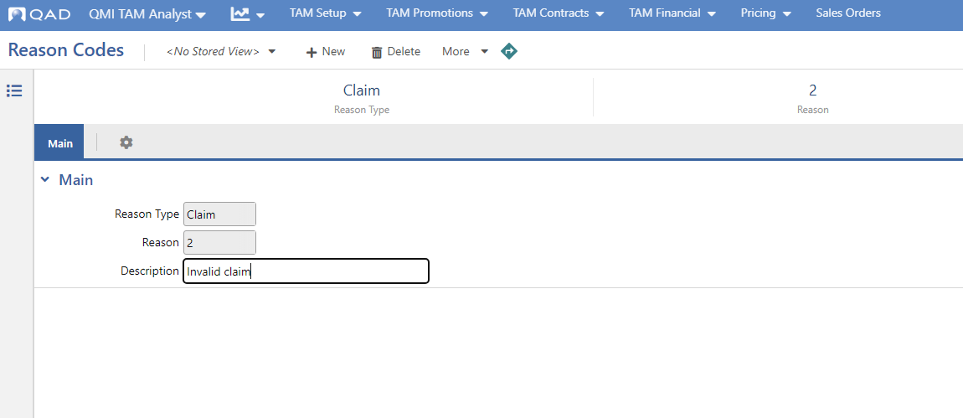
Reason Codes
Trade Activity Management
Notes:
When rejecting TAM claims, a reason code must be attached. Define valid claim reason codes in Reason Codes.
Note: If you do not want to define specific reason codes, then at a minimum, you must define a <blank> value for a claim reason code. To do so, access Reason Codes and create a record where Reason Type = Claim, and Reason = <blank>.

Slide 30
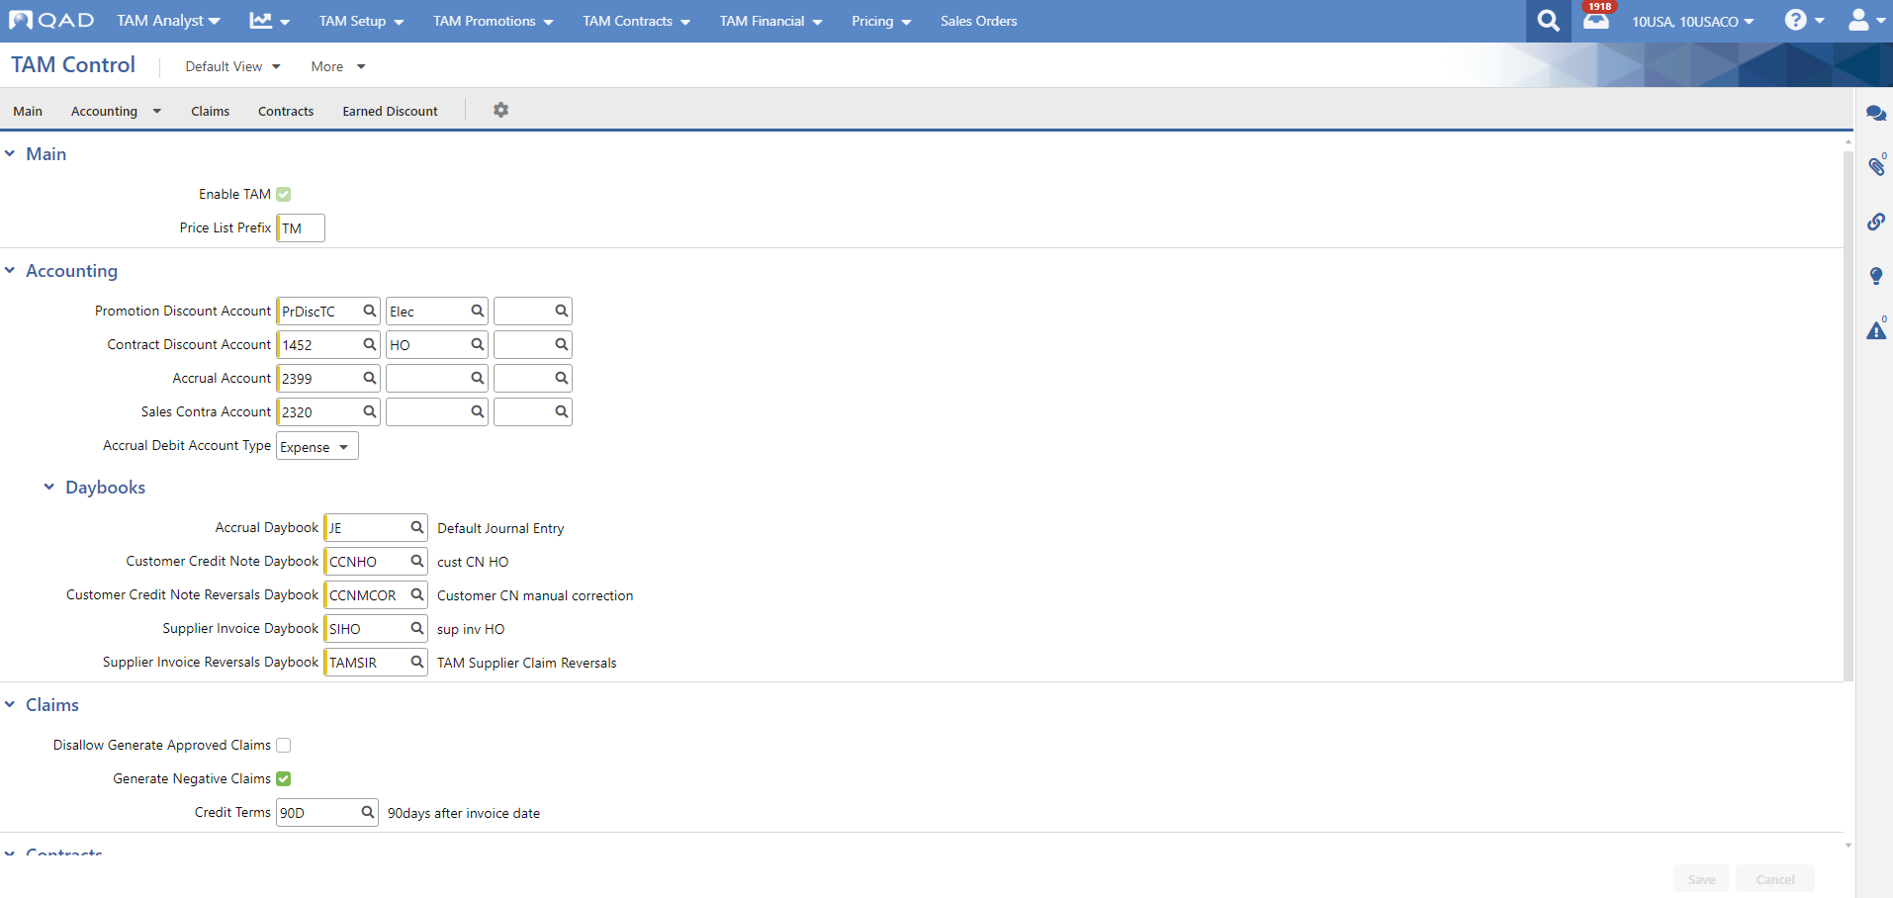
TAM Control
Trade Activity Management
30
Notes:
You must enable TAM in order to successfully use it. Use TAM Control to enable the functionality on the domain level, control some elements of system behavior, and specify daybooks and default account information used in transaction processing.
If you have upgraded data from an environment without TAM, the Enable button will convert existing pricing data to the advanced pricing format. Once enabled within your system, it cannot be manually disabled.
Once TAM is enabled via the Enable TAM field, the system uses Advanced Pricing instead of Best Pricing logic.
Note: TAM must be enabled in order to save a TAM promotion or contract in an Open status.
For more information on the fields seen here, please refer to the online help documentation for TAM Control.

Slide 31
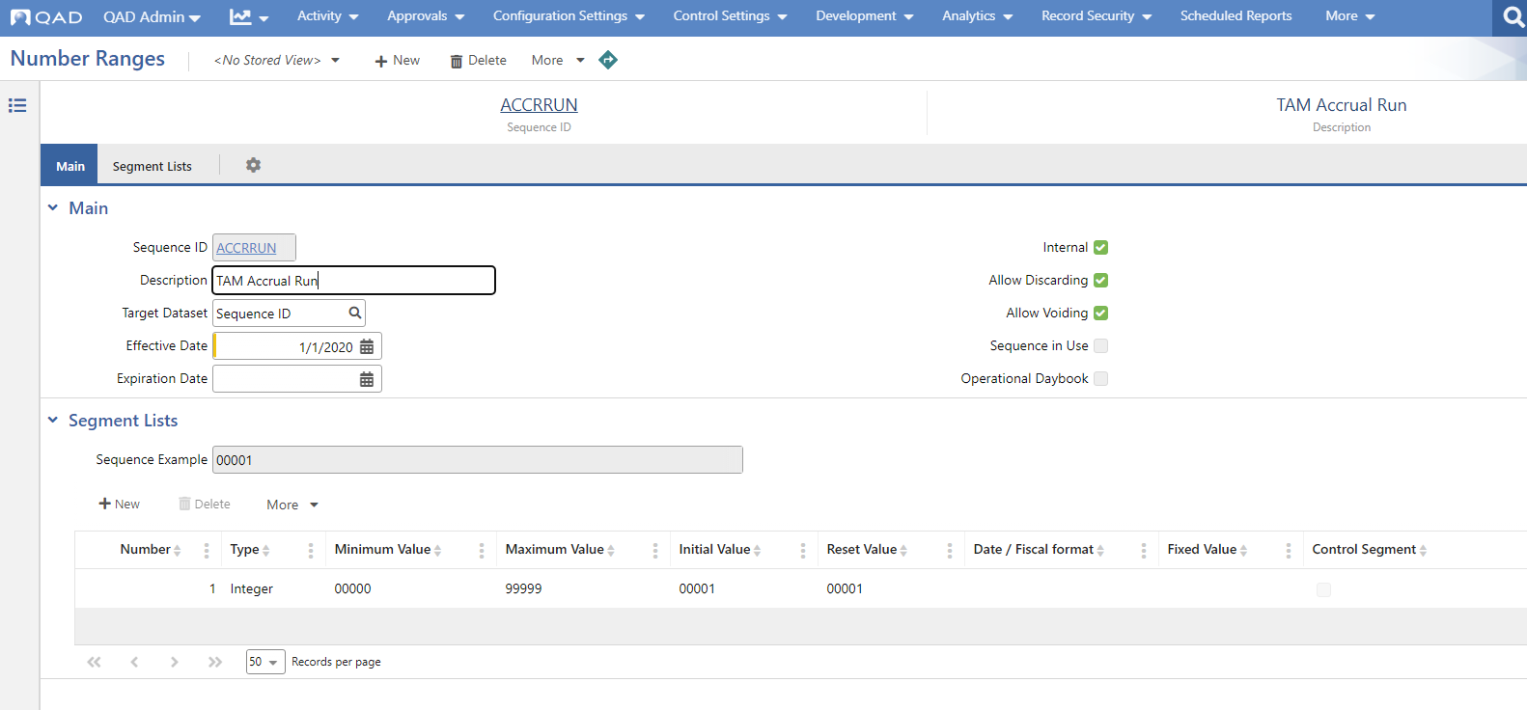
Number Ranges
Trade Activity Management
31
Notes:
Define TAM Sequences in Number Ranges for:
1.ACCRRUN - TAM Accrual Run code
2.CLAIM - TAM Claim code
3.CLAIMRUN - TAM Claim Run code (used when generating TAM claims)
4.CONTRACT - TAM Contract code
5.INDADDR - Indirect Address code
6.INDSALES - TAM Indirect Sales trace code
7.PROMO - TAM Promotion code

Slide 32
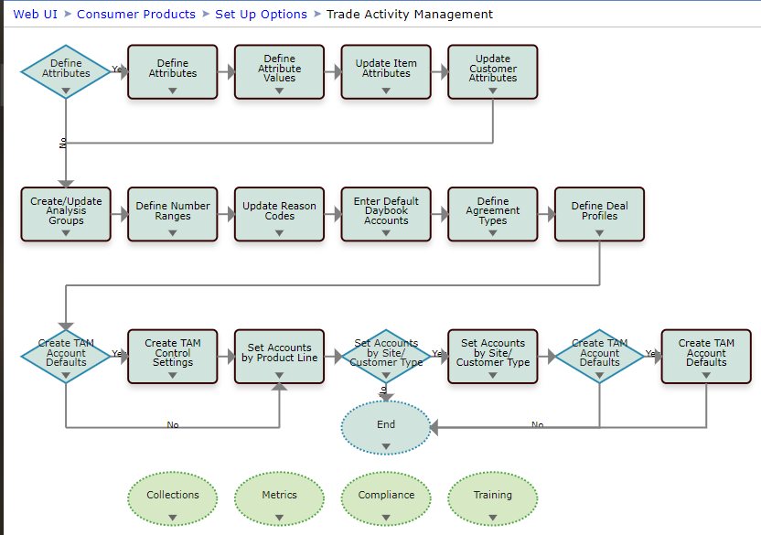
Setup Review
Trade Activity Management
32
Notes:
This process map can be accessed via the help icon in the QAD Web UI.
For more details on the TAM setup process, refer to TAM Setup in the online help.

Slide 33
TAM Data Setup
Trade Activity Management

Slide 34
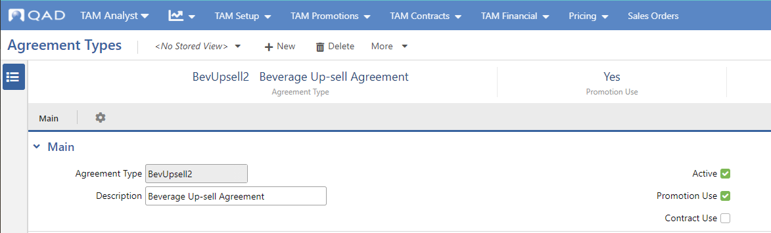
Agreement Types
Trade Activity Management
34
Notes:
Agreement types are a way to assign TAM promotions and contracts a top-level specification; for example, promotions defined for seasonal launch. They are optionally associated with deal profiles in TAM Accounts in order to further delineate accounting information.
Every Promotion requires a promotion type set up in Agreement Types. They are:
Used to differentiate TAM promotions and contracts by type.
Optionally associated with accounting information, in combination with deal profiles, using TAM Accounts.
Mandatory on both TAM promotions and TAM contracts.
For more information, refer to the section on Agreement Types in the online help.

Slide 35
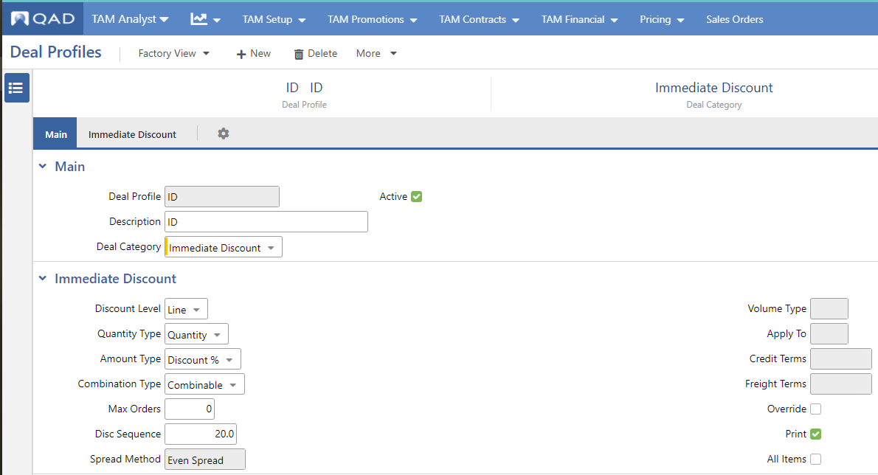
Deal Profiles
Trade Activity Management
35
Notes:
Use Deal Profiles to create generalized templates for deals. Use the most common settings that your company associates with deals of a specific type. Then, apply the deal profile to a promotion or a contract by selecting it on the Deals tab in TAM Promotions or TAM Contracts.
You can then update fields copied from the deal profile with promotion/contract-specific values and add eligible customers and items, discount percentages, item prices, contract pricing tiers, and so on.
The main panel of the screen includes fields that identify the profile and associate it with a category. The fields in the panel below relate directly to the indicated Deal Category field.
Some fields within this panel are relevant only when another field has a specific value; for example, the Freight Terms field applies only when Amount Type is Freight Terms. When a field does not apply, it displays in gray and cannot be updated.
See Deal Profiles in the online help for more information on fields seen here.

Slide 36
Immediate Discounts
Trade Activity Management

Slide 37
Promotion categories
Trade Activity Management
Five main deal categories for promotions:
  Immediate discounts
  Bonus goods
  Allocated funds
  Deferred discounts
  Scan-backs
37
Notes:
Immediate Discount deals represent discounts that are found immediately during sales order/quote entry and are recorded into the general ledger once invoices post.
They result in a price list being written into the system when the promotion is saved as status Open, and are visible in the Price Lists hybrid browse and Price Lists report (both filterable by Promotion code and Promotion Deal code), as well as other pricing-related browses and reports such as the Sales Item Pricing (What-if) report.

Slide 38
Concept
Trade Activity Management: Immediate Discounts
Immediate Discount deals:
  Price list creation when Promotion status Open
  Seen immediately during order entry
  Dynamic pricing engine
    Price lists via Price Lists hybrid view
    Price lists via Immediate Discount deals
    Group membership evaluation depends on type
  Visible within reports such as Pricing report and Sales Item Pricing (What-If) report
  Recognized within GL after Invoice Post
38
Notes:
Why use an immediate discount deal on a promotion, instead of just creating a price list?
Invoice lines which utilize ID deals create their own history records, and TAM accounting allows greater flexibility for ID deals than what Price Lists currently offers.

Slide 39
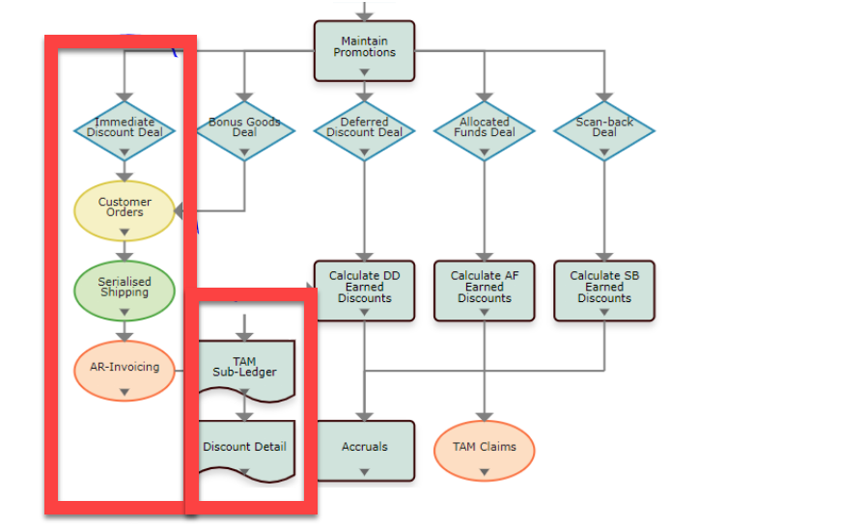
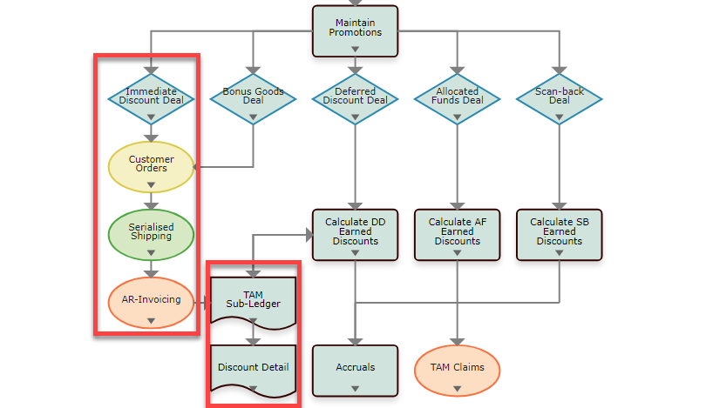
Trade Activity Management: Immediate Discounts
39

Slide 40
Deal Profiles
Trade Activity Management: Immediate Discounts
40
Notes:
Ensure a deal profile is set up to use for your immediate discount promotion.
See the Immediate Discount Panel section of Deal Profiles in the online help for more information on fields seen here.

Slide 41
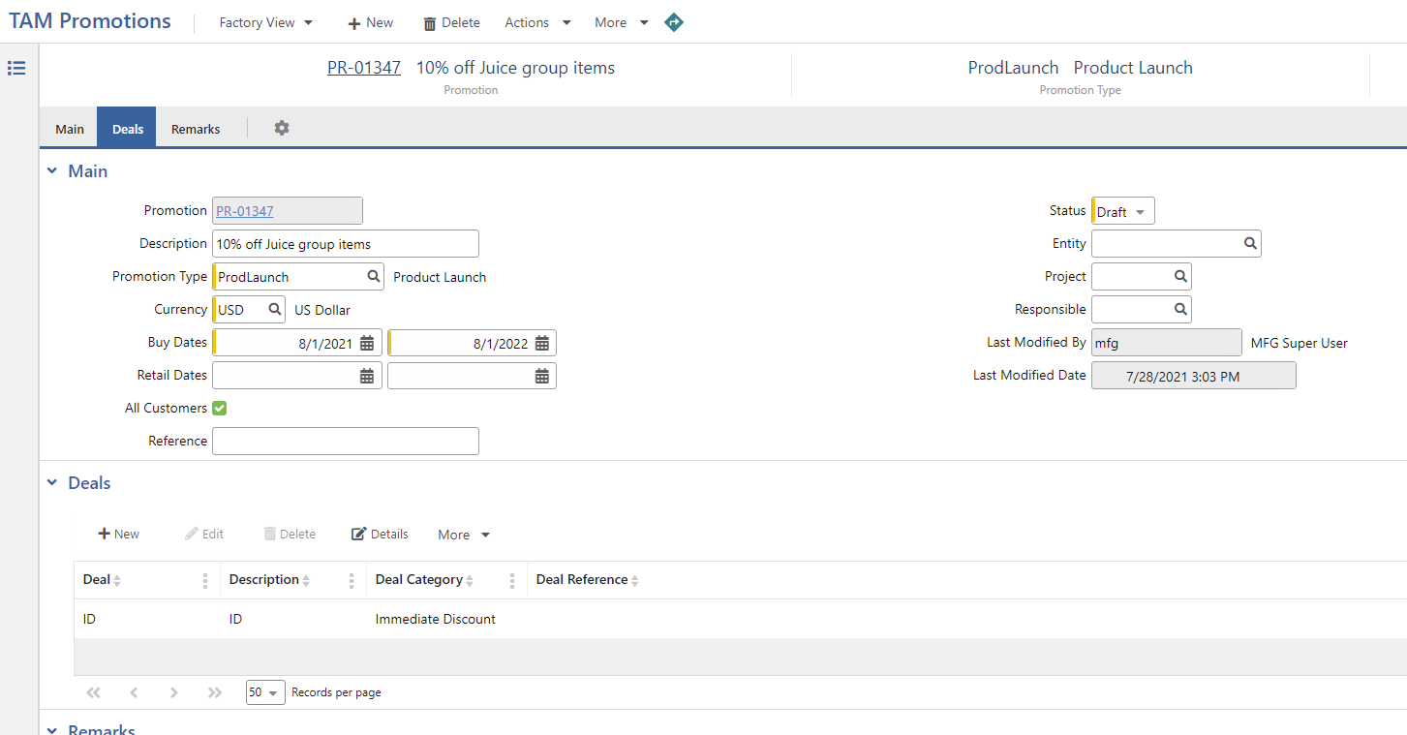
Promotion Deal
Trade Activity Management: Immediate Discounts
41
Notes:
Use TAM Promotions to define promotions in terms of type, effective date range, eligible customers and items, and the deals that are available.
Deals are specified in the Deals panel. In this case, an Immediate Discount deal is specified.
Once the promotion has been created, make sure to set the Status to Open to signify the promotion is available for use.

Slide 42
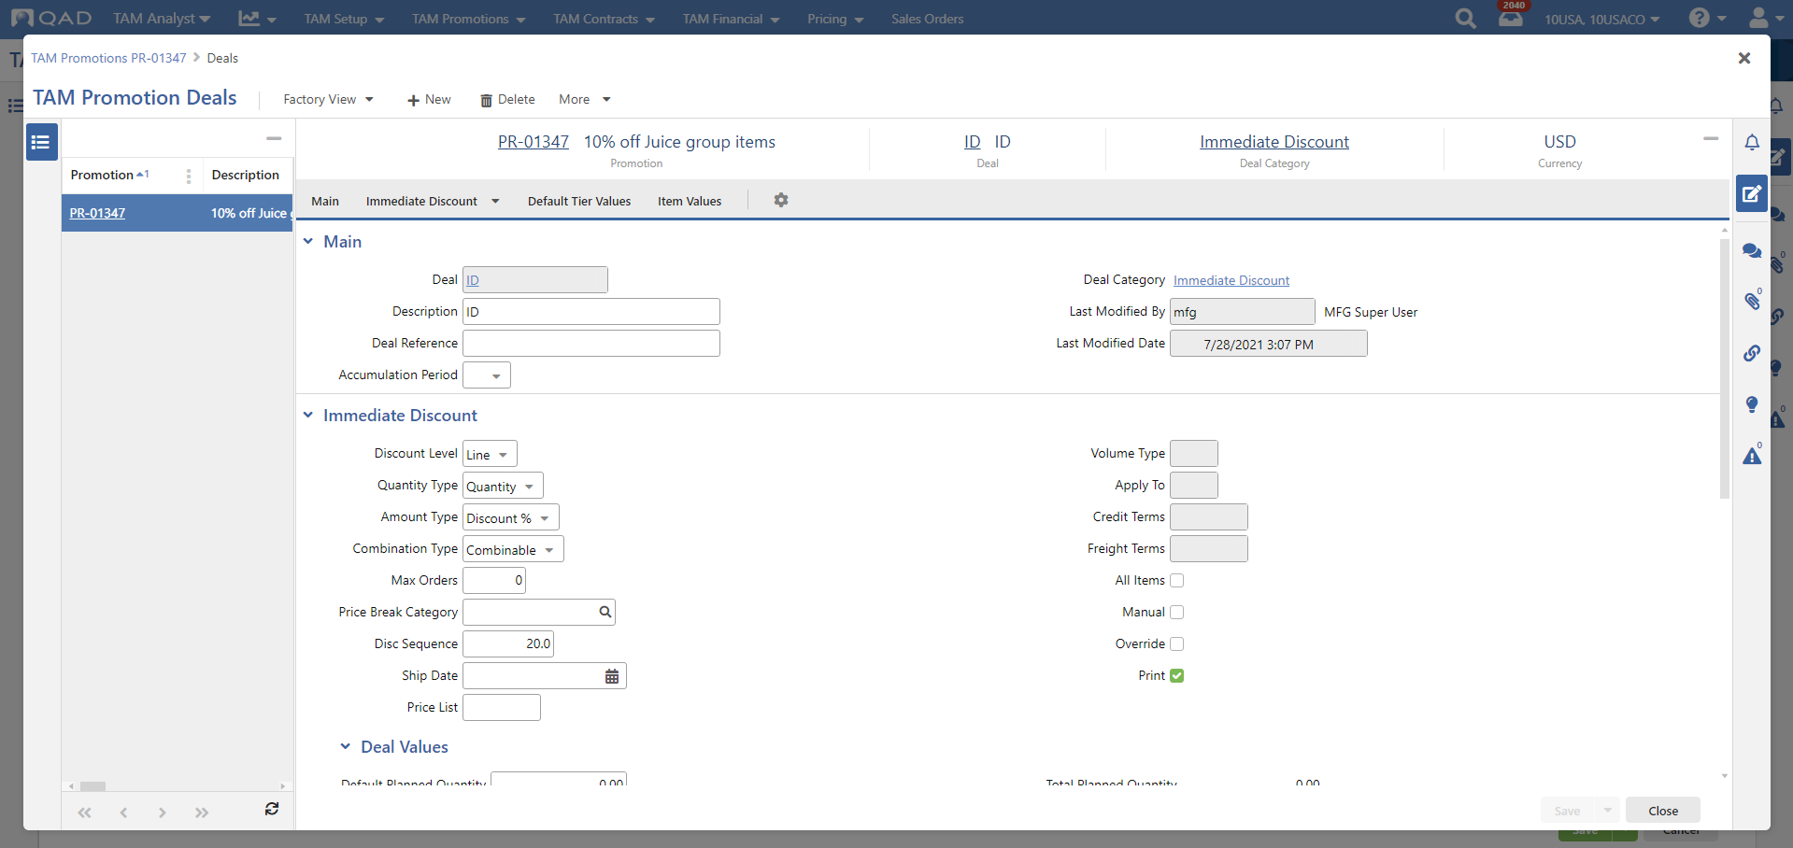
TAM Promotion Deals Detail
Trade Activity Management: Immediate Discounts
42
Notes:
Click Details in the Deal panel to open the TAM Promotion Deals window. Here, you can further define immediate discount deal information.
Many of the fields and functions found in Immediate Discount deals are similar in name and behavior to those found in the Price Lists hybrid browse, and are subject to the Adaptive Pricing logic, including the ability to be viewed as exclusive, or as combinable with other price lists.
For more information on the fields seen here, refer to the “Immediate Discount Deal Category” section within TAM Promotions in the online help.

Slide 43
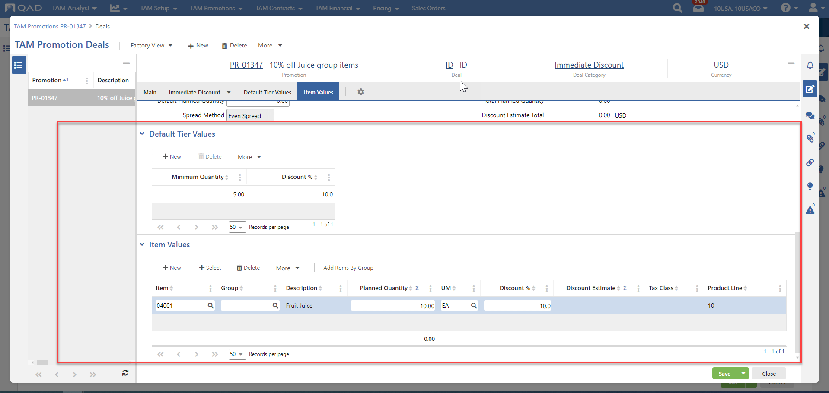
Default Tier Values and Item Values Panels
Trade Activity Management: Immediate Discounts
43
Notes:
Use the Default Tier Values panel to maintain pricing tier and discount information.
Add items and/or item groups, depending on the promotional deal category, onto the deal using the Item Values panel. A grid record may either contain an individual item or item group, not both.
Note: When Immediate Discount deals are defined as Order level, no items may be attached to the deal, since an order level discount is evaluated against the total sales amount of an order.
You can add multiple items at once onto the deal, for certain deal categories, using either the +Select or the Add Items By Group button.
The +Select function brings you to an item lookup screen where you can filter items based on various item-related fields, including any user-defined item attributes. Select or deselect items as desired. When you choose the OK button, the selected items are returned into the Item Values grid all at once.
For more information on the fields seen here, refer to the “Default Tier Values” and “Item Values” sections within TAM Promotions in the online help.

Slide 44
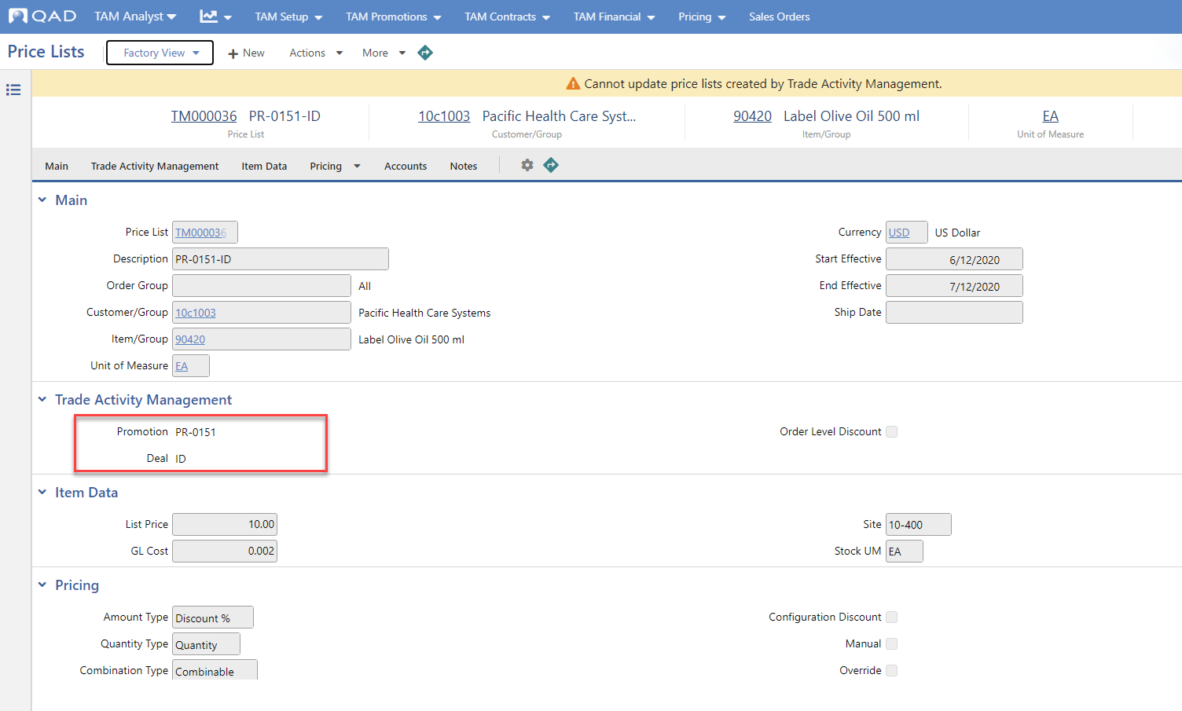
Price Lists
Trade Activity Management: Immediate Discounts
44
Notes:
Immediate Discount deals represent discounts that are found immediately during sales order/quote entry and are recorded into the general ledger once invoices post.
They result in a price list being written into the system when the promotion is saved as status Open, and are visible in the Price Lists hybrid browse and Price Lists report (both filterable by Promotion code and Promotion Deal code), as well as other pricing-related browses and reports such as the Sales Item Pricing (What-if) report.
Note: Even though they are visible in the various pricing programs, TAM promotional price lists are read-only as they are strictly managed through the promotional deal.
Many of the fields and functions found in Immediate Discount deals are similar in name and behavior to those found in the Price Lists hybrid browse, and are subject to the advanced Pricing logic, including the ability to be viewed as exclusive, or as combinable with other price lists.

Slide 45
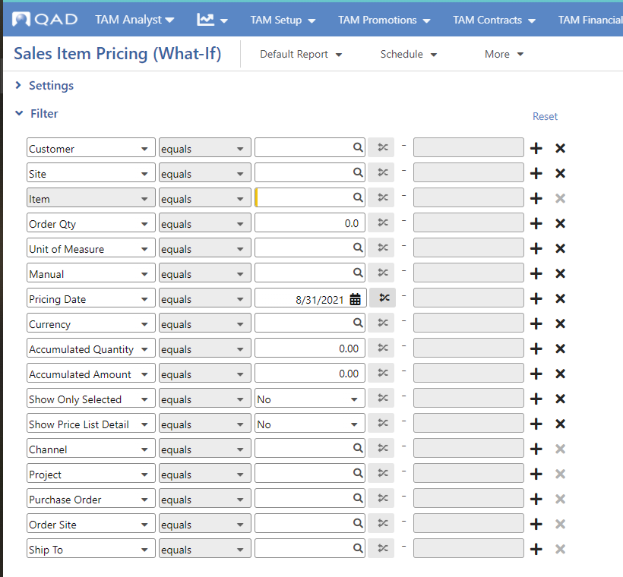
Sales Item Pricing (What-If)
Trade Activity Management: Immediate Discounts
45
Notes:
Price lists created via immediate discount promotions will be visible when using the Sales Item Pricing (What-if) report.

Slide 46
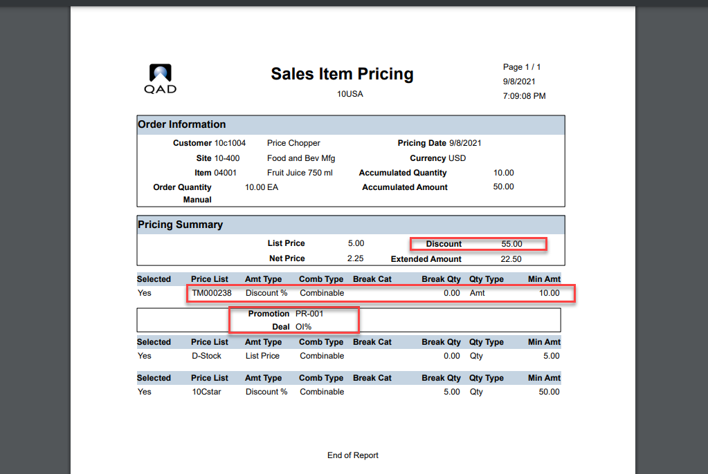
Pricing What-If Inquiry
Trade Activity Management: Immediate Discounts
46

Slide 47
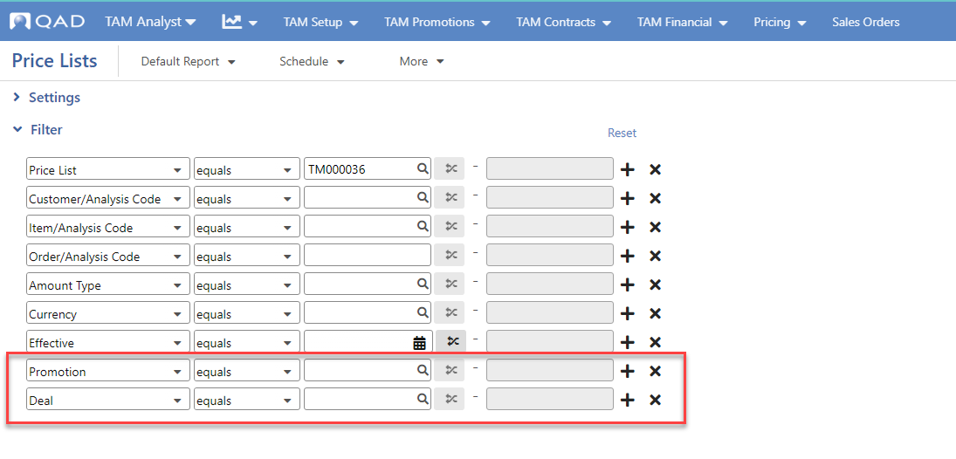
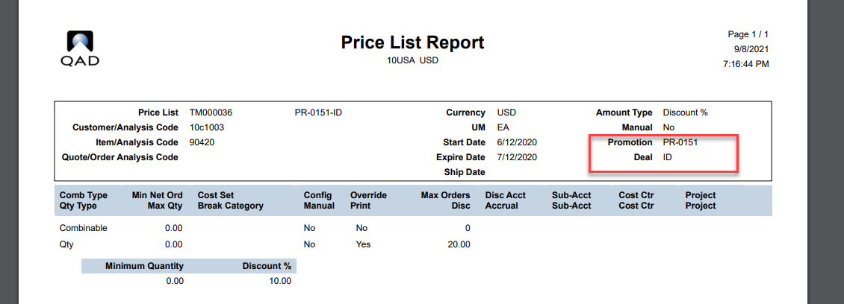
Price Lists Report
Trade Activity Management: Immediate Discounts
47

Slide 48
Immediate Discounts: Accounting
Trade Activity Management
TAM Accounts
  Promotion Type + Deal combination
  Promotion Discount account
  Higher SA+CC
  SAFs per Deal Profile / Agreement Type (but not system SAF codes)
Sales Accounts
  Promotion Discount Acct/SA/CC (if no match found within TAM Accounts)
Product Lines
  Promotion Discount Acct/SA/CC (if not found within TAM Accounts and Sales Accounts)
48
Notes:
Promotion Accounting
Immediate Discount Deals
Immediate Discount (ID) deals may be attached to TAM Promotions. Once the Promotion is set to status Open, price lists are created behind the scenes matching the information found within the promotional deal. When sales orders are created, these price lists are considered by the best pricing routine.
If the discount is a result of a TAM Immediate Discount promotion, then we look to TAM Accounts for the promotion “Agreement Type + Deal Profile” combination. If found, then accept the Promotion Discount account from here. Also take the Sub-Account (SA) + Cost Center (CC) from here if the “Higher SA+CC” field is not turned on. If the “Higher SA+CC” field is turned on, then TAM will pull the (SA) + (CC) from Sales Accounts based upon match of Product Line, Site, Channel, Customer Type combinations (based upon existing Enterprise Edition search logic). If no matching record is found in Sales Accounts, then pull the (SA) + (CC) from Product Lines based upon match on Product Line.
Note that TAM Accounts grants users the ability to specify a different Promotion Discount account for every combination of Agreement Type and Deal, while still allowing you to vary the Sub-Account and/or Cost Center at a lower level such customer type, provided the “Higher SA+CC” field is turned on.
If the “Agreement Type + Deal Profile” combination is not found within TAM Accounts, then pull the Promotion Discount Account + Sub-Account + Cost Center from the matching Sales Accounts based upon the invoice channel and customer type, order line site and item product line values (search logic based upon existing functionality). If no matching record is found in Sales Accounts, then pull the Promotion Discount Account + Sub-Account + Cost Center from Product Lines based upon match on Product Line.
Users may also wish to define a SAF concept in the system to differentiate types of Immediate Discount deals, and then within TAM Accounts, attach that SAF Concept and assign a specific SAF code depending on Agreement Type and Deal Profile code combination. When the Invoice is posted, the SAF code will be attached to the Journal entry (JE) line for the Promotion Discount account posted to the general ledger.
If a TAM Immediate Discount deal price list is used to help determine the pricing on an order line or order, then a journal entry (JE) is created within the general ledger after Invoice Post and Print is run, debiting the appropriate Promotion Discount Account + (SA) + (CC) and optional SAF code(s):
DR Accounts Receivable
DR Promotion Discount
CR Sales

Slide 49
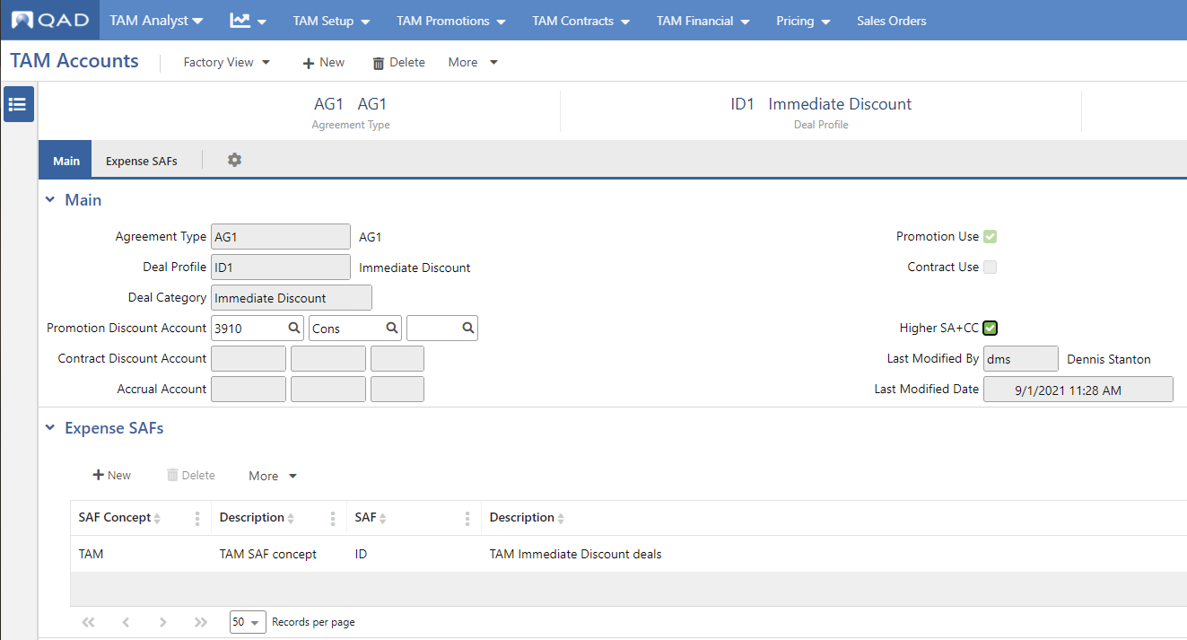
Immediate Discounts: Accounting
Trade Activity Management
49
Notes:
For more information on accounting with immediate discount promotions and in general, see the section on TAM Finance and Accounting in the online help.
For more information on the fields here, refer to TAM Accounting in the online help.

Slide 50
Suggested Hands-On Exercise: Immediate Discounts
Trade Activity Management
Hands-on
  Create an Immediate Discount Promotion
    Promotion Type = Product Launch
    Buy Start/End Dates = Current date/Three months ahead
    All Customers = Yes
    In Deal Detail:
      Default Tier Values: Minimum Quantity: 5, Discount %: 10%
      Item Values: Item 04001, Planned Quantity 100, Discount 10%
  View the newly created Price List
50
Notes:
Tip: You can use Create an Immediate Discount Promotion from the GuideMe menu to walk you through the process of creating this promotion.

Slide 51
Bonus Goods
Trade Activity Management

Slide 52
Promotion categories
Trade Activity Management
Five main deal categories for promotions:
  Immediate discounts
  Bonus goods
  Allocated funds
  Deferred discounts
  Scan-backs
52

Slide 53
Concept
Trade Activity Management: Bonus Goods
Bonus Goods are deals used during order entry to give items away for free or at an additional discount.
Deals are located based upon qualifying order lines previously entered.
When selected, the bonus lines are automatically added onto the order by TAM.
53

Slide 54
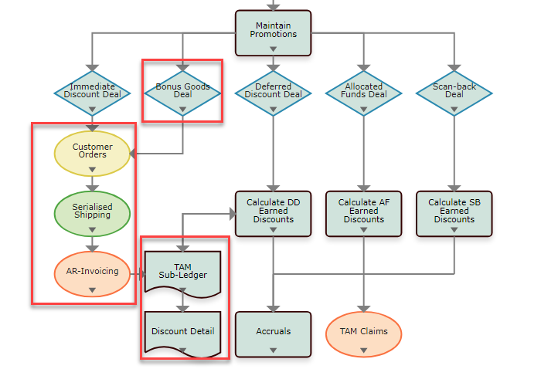
Trade Activity Management: Bonus Goods
54

Slide 55
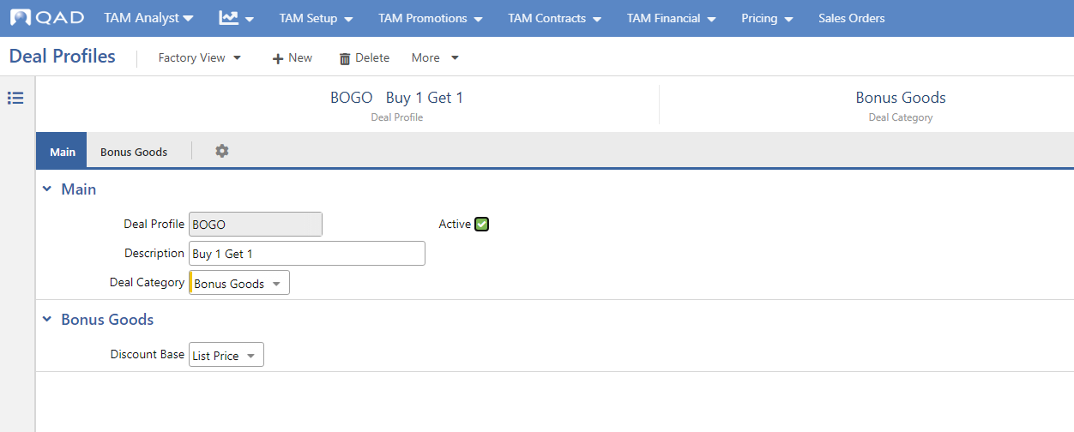
Deal Profiles
Trade Activity Management: Bonus Goods
55
Notes:
For more information on the fields seen here, refer to the “Bonus Goods” section within Deal Profiles in the online help.

Slide 56
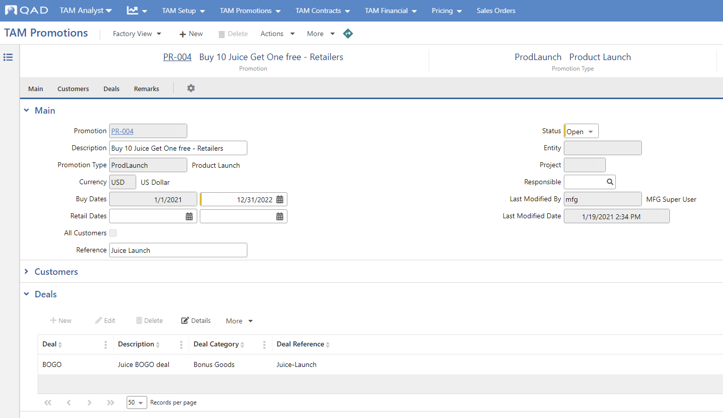
Promotion Deals
Trade Activity Management: Bonus Goods
56
Notes:
Use TAM Promotions to define promotions in terms of type, effective date range, eligible customers and items, and the deals that are available.
Deals are specified in the Deals panel. In this case, a Bonus Goods deal is specified.

Slide 57
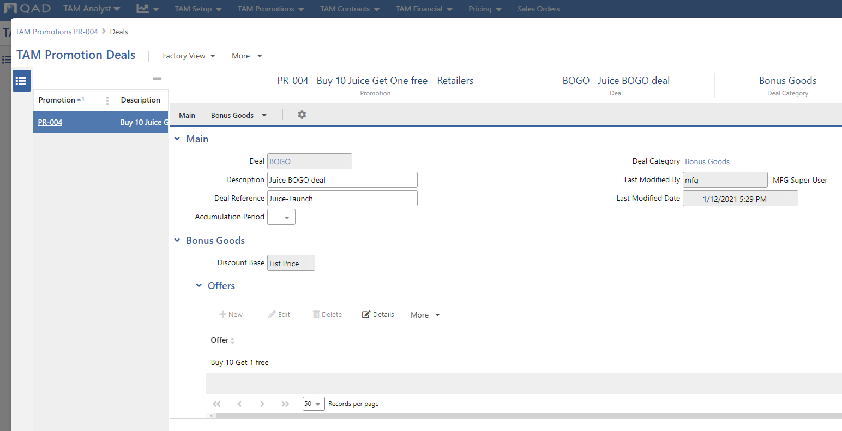
TAM Promotion Deals Detail
Trade Activity Management: Bonus Goods
57
Notes:
Click Details in the Deal panel to open the TAM Promotion Deals window. Here, you can further define deal information.
For more information on the fields seen here, refer to the “Bonus Goods Deal Category” section within TAM Promotions in the online help.

Slide 58
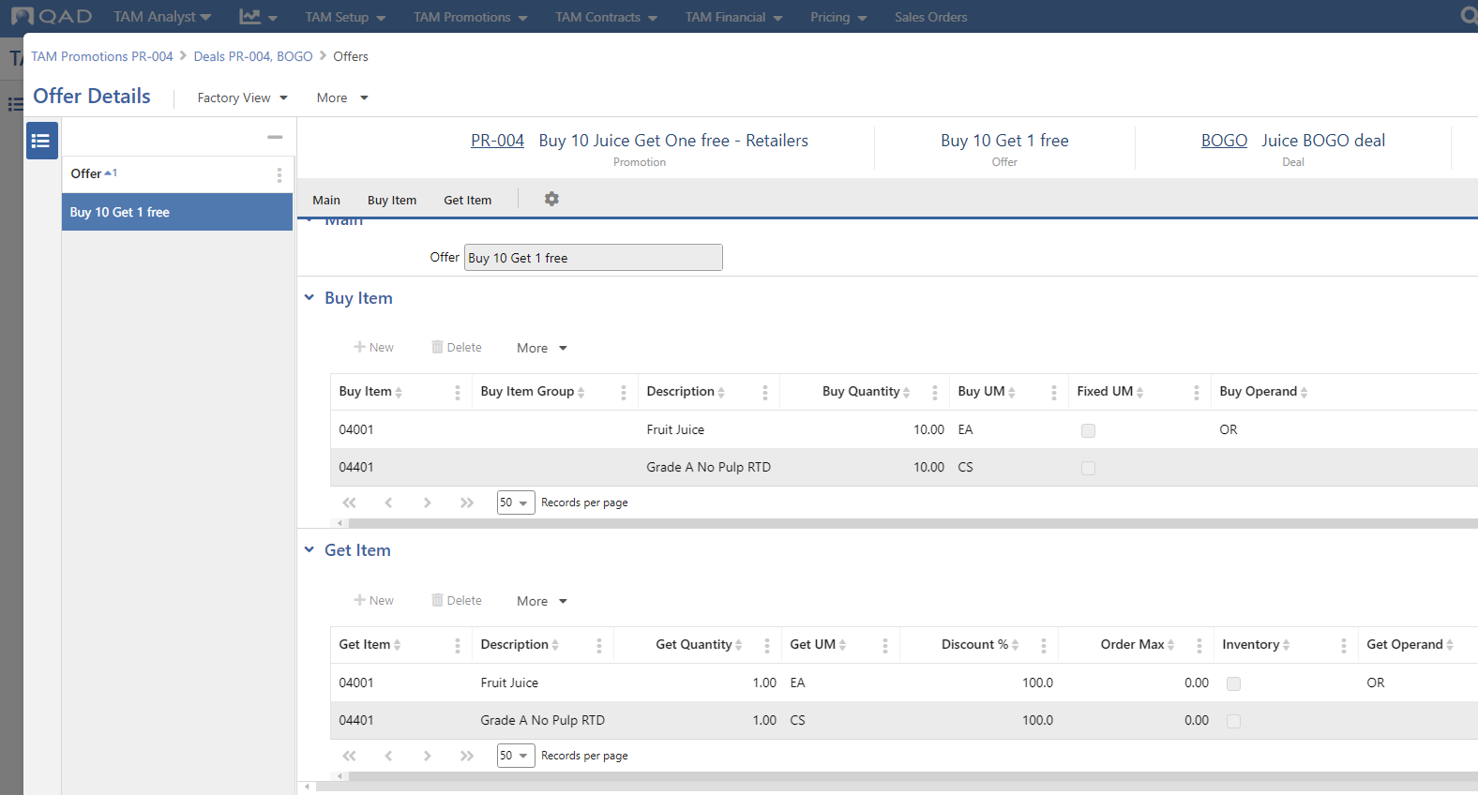
Offer Details
Trade Activity Management: Bonus Goods
58
Notes:
Use the Buy Item panel to specify the items to be bought to qualify for the Get deal. Any individual item can be entered only once in the Buy Item panel of an offer.
Use the Get Item panel specify the items to be given away for free or at a discount. At least one get item must be specified to save the deal. Any individual Item may be entered only once in the Get Item panel of an offer. You can add multiple lines to the grid.
For more information on the fields seen here, refer to the “Bonus Goods Deal Category” section within TAM Promotions in the online help.

Slide 59
Accounting
Trade Activity Management: Bonus Goods
Same logic as Immediate Discount deal
TAM Accounts
  Promotion Discount Acct + Higher SA/CC
  SAFs
Sales Accounts
  Promotion Discount Act/SA/CC (if no match found within TAM Accounts)
Product Lines
  Promotion Discount Act/SA/CC (if not found within TAM Accounts and Sales Accounts)
59
Notes:
Promotion Accounting - Bonus Goods Deals
Bonus Goods deals are attached to Promotions, and when set to status ‘Open’ are available where applicable to sales orders/pending invoices during entry. Taking advantage of a Bonus Goods deal may result in items being given away for free, or at a discounted value. The search logic to determine the appropriate Promotion Discount account is the same as outlined earlier for Immediate Discounts. You are optionally allowed within TAM Accounts to specify an existing SAF Concept and assign a specific SAF code depending on Agreement Type and Deal Profile code combination.
If the discount is a result of a TAM BG promotion, then we look to TAM Accounts for the promotion “Agreement Type + Deal Profile” combination. If found, then accept the Promotion Discount account from here. Also take the Sub-Account (SA) + Cost Center (CC) from here if the “Higher SA+CC” field is not turned on. If the “Higher SA+CC” field is turned on, then TAM will pull the (SA) + (CC) from Sales Accounts based upon match of Product Line, Site, Channel, Customer Type combinations (based upon existing Enterprise Edition search logic). If no matching record is found in Sales Accounts, then pull the (SA) + (CC) from Product Lines based upon match on Product Line.
Note: TAM Accounts grants users the ability to specify a different Promotion Discount account for every combination of Agreement Type and Deal, while still allowing you to vary the Sub-Account and/or Cost Center at a lower level such customer type, provided the “Higher SA+CC” field is turned on.
If the “Agreement Type + Deal Profile” combination is not found within TAM Accounts, then pull the Promotion Discount Account + Sub-Account + Cost Center from the matching Sales Accounts based upon the invoice channel and customer type, order line site and item product line values (search logic based upon existing functionality). If no matching record is found in Sales Accounts, then pull the Promotion Discount Account + Sub-Account + Cost Center from Product Lines based upon match on Product Line.
Users may also wish to define a SAF concept in the system to differentiate types of Immediate Discount deals, and then within TAM Accounts, attach that SAF Concept and assign a specific SAF code depending on Agreement Type and Deal Profile code combination. When the Invoice is posted, the SAF code will be attached to the Journal entry (JE) line for the Promotion Discount account posted to the general ledger.
If a TAM Immediate Discount deal price list is used to help determine the pricing on an order line or order, then a journal entry (JE) is created within the general ledger after Invoice Post and Print is run, debiting the appropriate Promotion Discount Account + (SA) + (CC) and optional SAF code(s):
DR Accounts Receivable
DR Promotion Discount
CR Sales

Slide 60
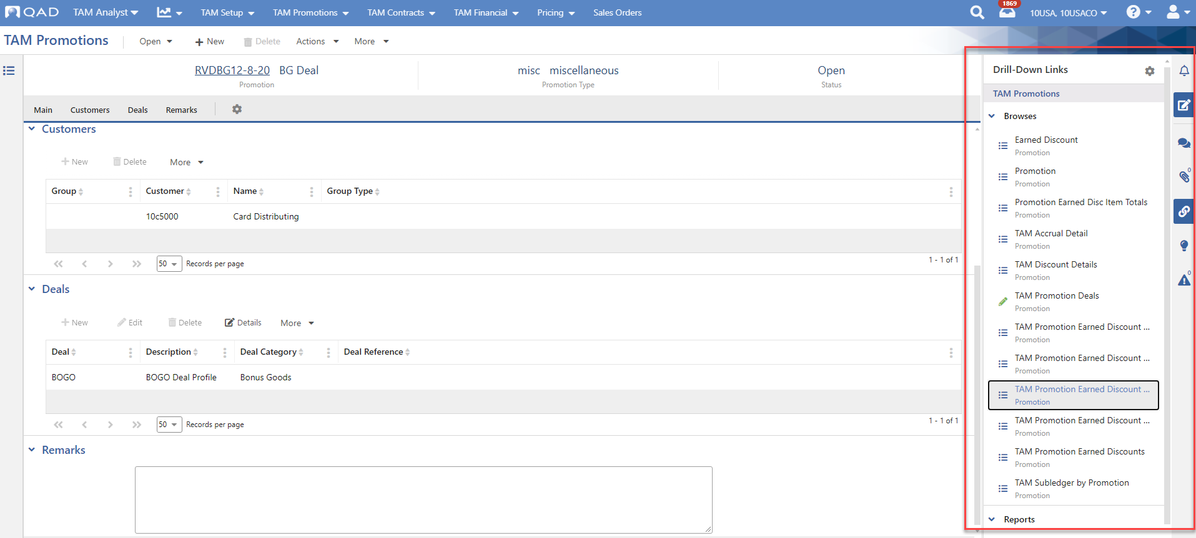
Drill-Down Links
Trade Activity Management: Bonus Goods
60
Notes:
Use the associated drill-down links available on saved TAM promotions for easy access to relevant promotion and deal browses and reports in regard to this Bonus Goods deal.

Slide 61
Suggested Hands-On Exercise: Bonus Goods
Trade Activity Management
Hands-on
  Create a Bonus Goods Promotion
    Promotion Type = Product Launch
    Buy Start/End Dates = Current date/Three months ahead
    Add Customer = 11c5000
    In Offer Details:
      Offer = “Buy 10 get 1 free”
      Buy Item = 04001, Qty = 10
      Get Item = 04001, Qty = 1, Discount = 100%
  Once saved and set to Open, drill down to TAM Discount Details directly from the promotion
61
Notes:
Tip: You can use Create a Bonus Goods Promotion from the GuideMe menu to walk you through the process of creating this promotion.

Slide 62
Allocated Funds
Trade Activity Management

Slide 63
Promotion categories
Trade Activity Management
Five main deal categories for promotions:
  Immediate discounts
  Bonus goods
  Allocated funds
  Deferred discounts
  Scan-backs
63

Slide 64
Concept
Trade Activity Management: Allocated Funds
Fixed amounts of money, to be paid to customer(s)
Defined Promotional period
Not based upon invoiced sales, used on a discretionary basis
Typically used for programs such as slotting, market development, or new product lines
Common names: “Co-op”, “General Expense”, “Lump Sum”
64

Slide 65
Concept
Trade Activity Management: Allocated Funds
The timing of Claims payments may vary for Allocated Fund Deals:
Up front in the first promotion period
Evenly over promotion periods
Last promotion period
User-specified amounts across promotion periods
65

Slide 66
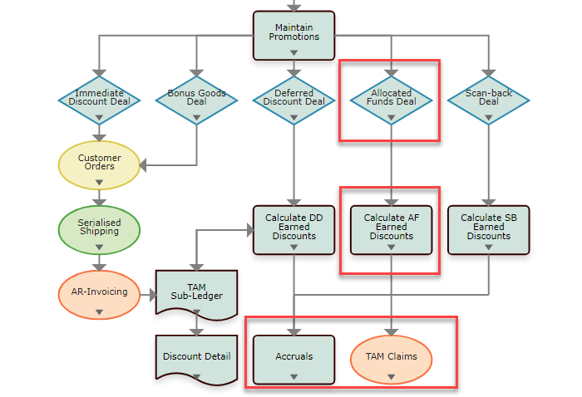
Trade Activity Management: Allocated Funds
66

Slide 67
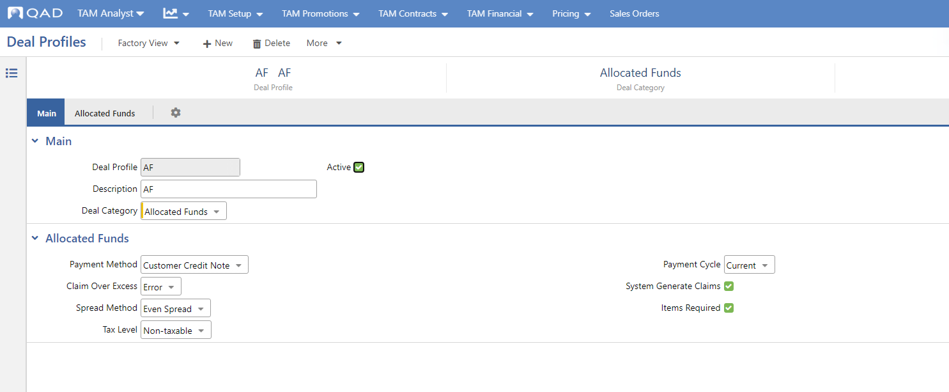
Deal Profiles
Trade Activity Management: Allocated Funds
67
Notes:
For more information on the fields seen here, refer to the “Allocated Funds” section within Deal Profiles in the online help.

Slide 68
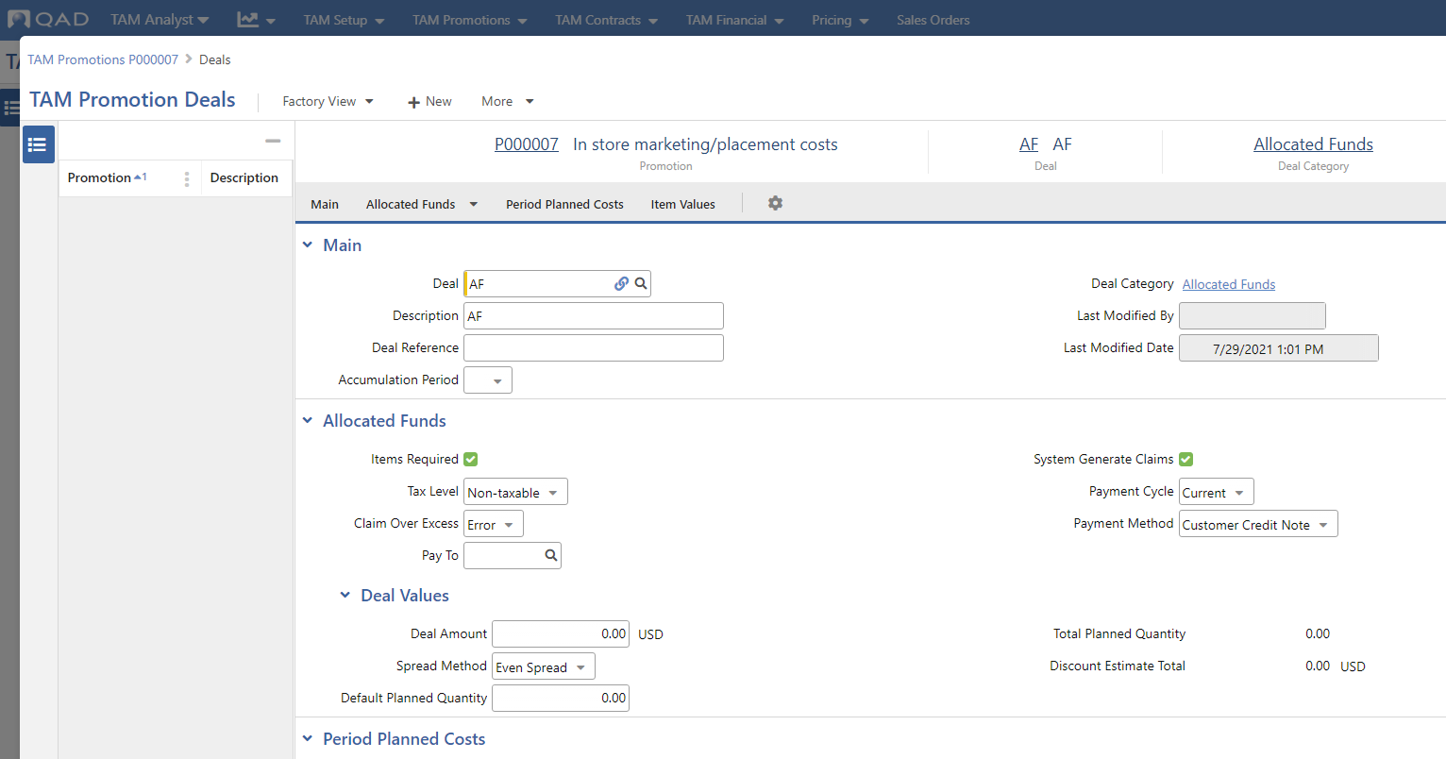
TAM Promotion Deals Detail
Trade Activity Management: Allocated Funds
68
Notes:
You can define an Allocated Funds deal on a TAM promotion by entering an existing Deal Profile of category Allocated Funds. The deal default values appear based upon the profile selected, at which time you can update as needed.
Note: Only one allocated fund deal can be attached to a single promotion.
Allocated Funds deals involve fixed amounts of money to be paid to the customer or group of customers for a defined promotional period and are used on a discretionary basis. Promotions cannot be defined as "All Customers" with an Allocated Funds deal attached. Some common terms associated with allocated funds deals are “General Expense” and “Lump Sum.” They can be used for programs such as slotting, market development, or new product lines. There are no discount tiers for these types of deals.
Click Details in the Deal panel to open the TAM Promotion Deals window. Here, you can further define deal information.
For more information on the fields seen here, refer to the “Allocated Funds Deal Category” section within TAM Promotions in the online help.

Slide 69
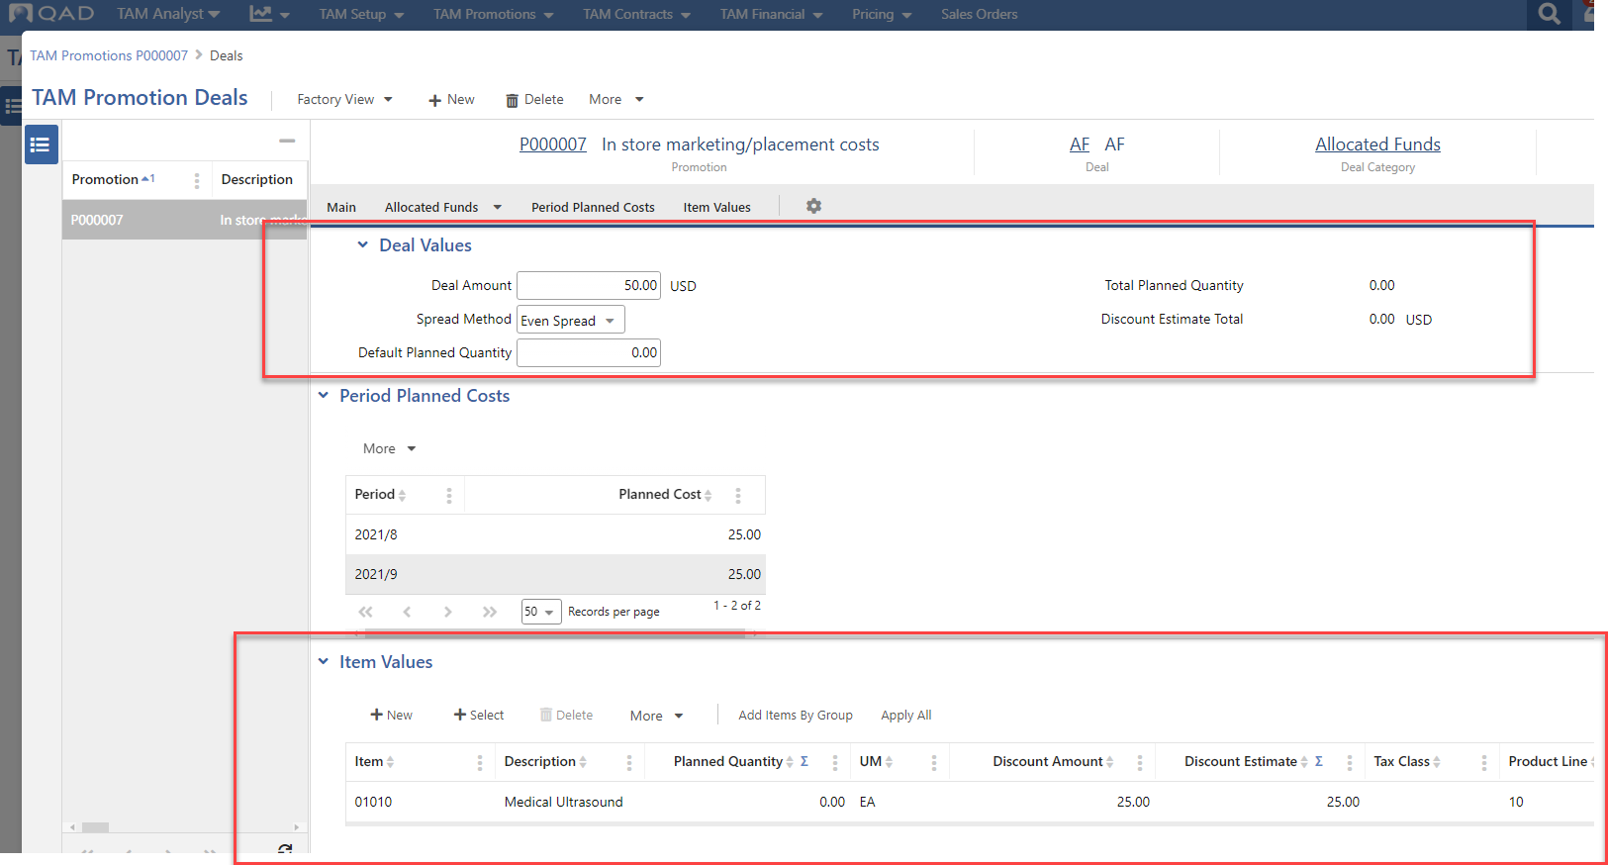
Deal Values and Items Values Panels
Trade Activity Management: Allocated Funds
69
Notes:
Use the Deal Values to specify deal amount information.
Use the Item Values panel to add items and/or item groups to this deal. A grid record can contain either an individual item or item group, but not both.
You can add multiple items at once onto the deal, for certain deal categories, using either the +Select or the Add Items By Group button.
For more information on the fields seen here, refer to the “Deal Values” and “Item Values” under the “Allocated Funds Deal Category” section within TAM Promotions in the online help.

Slide 70
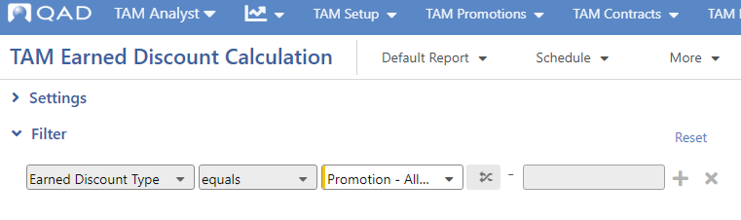
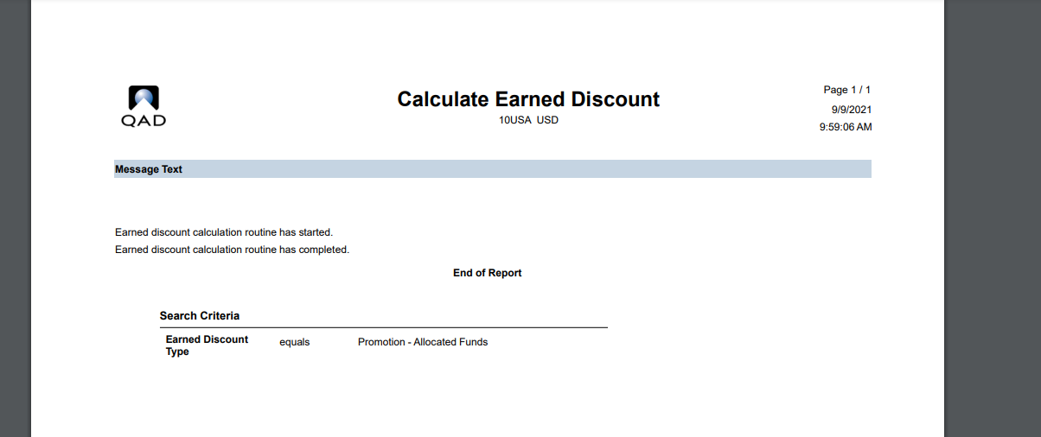
Earned Discounts
Trade Activity Management: Allocated Funds
TAM Earned Discount Calculation
70
Notes:
For Allocated Funds deals on backdated promotions, earned discount records will be created for the periods in the past by TAM Earned Discount Calculation for type Promotion-Allocated Fund.
Running TAM Earned Discount Calculation is the only way to create/update earned discounts in the QAD Adaptive UX.

Slide 71
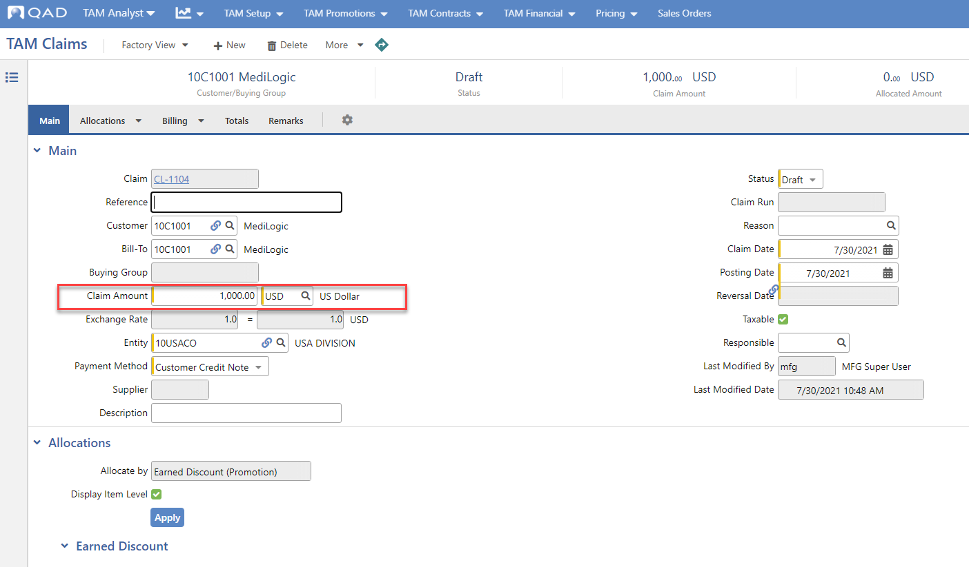
TAM Claims
Trade Activity Management
Notes:
Use TAM Claims to formally grant TAM earned discounts owed to customers and buying groups.
After earned discounts have been accumulated for open TAM promotions and contracts, you can create claims to give back the discounts earned to the appropriate customer/supplier. Use TAM Claims to achieve this by allocating against open earned discounts at the promotion or contract deal level, or at the deal/item level for promotional deals. The system automatically updates balances across the various levels of allocation records in the grids as users modify the amounts to allocate. The Balance field clearly indicates the ongoing unallocated amount of a claim.
Within TAM Claims, the claim code populates upon successful save, based on the CLAIM sequence defined in Number Ranges.
For more information on the fields seen here, see TAM Claims in the online help.

Slide 72
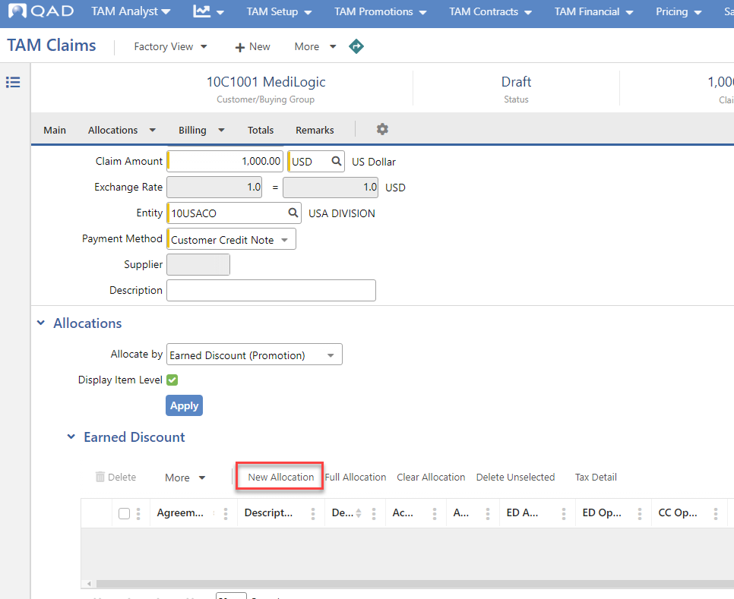
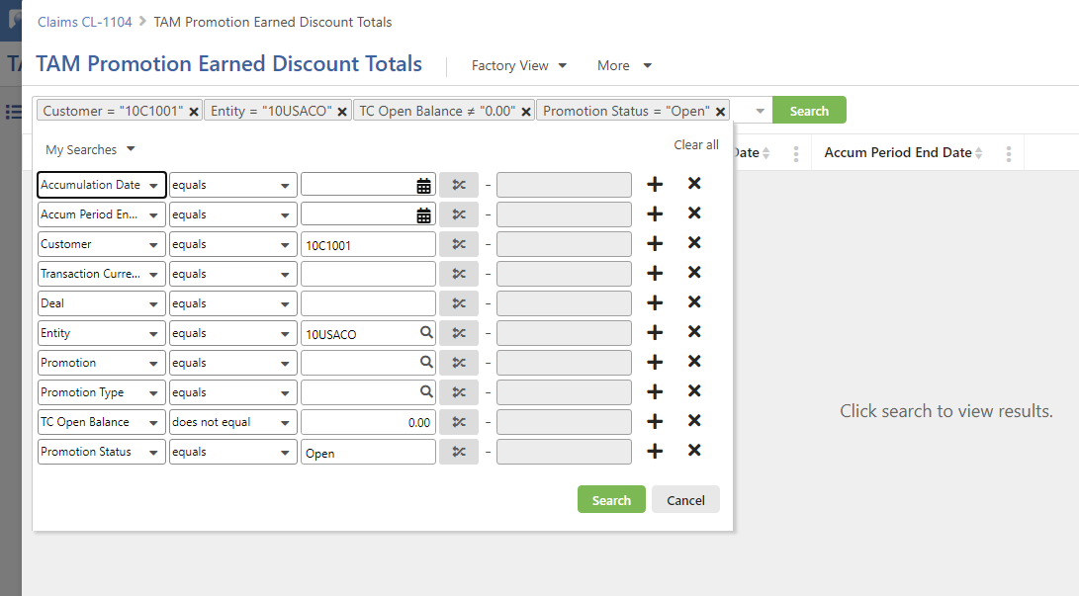
TAM Claims - Allocations
Trade Activity Management
Notes:
The Allocations panel allows you to search for available Earned Discounts, by either Promotion or Contract, and claim against them as needed. For Promotions, you can also allocate by invoice.
Use the New Allocation function to launch a screen where you can search for and return earned discounts you wish to allocate portions of the claim amount to.
For more information on the fields seen here, see the “Allocations Panel” section within TAM Claims in the online help.

Slide 73

TAM Claims > Generate Claims bulk action
Trade Activity Management
Notes:
Choose Actions > Bulk > Generate to have TAM generate claims based on customers’ open Earned Discount balances.
Generating claims mimics the behavior found in TAM Claims when a user allocates an amount against an ED total record in the allocations grid for allocated by Earned Discount (Promotion) or Earned Discount (Contract) - Totals grid. That amount is prorated across the open balance item records, and the taxes are calculated per the deal settings. One major difference with Generate Claims is that the defaults for the tax and allocated item amounts will be used as is, while in TAM Claims a user can modify these defaults before saving.
Deals may be defined so that claims can be run wide open, or for subsets of criteria.
Status of System Claims determined by TAM Control value.
Claims may be de-selected/re-selected before Submit.
For more information on this action, see the “Generate Action” section within TAM Claims in the online help.

Slide 74
Claim Approval
Trade Activity Management
Claims may require approval
  TAM Control setting
Approved status claims result in a Customer Credit Note or Supplier Invoice
When financial documents are created, the daybooks from the TAM Control are used and the postings are made to the accounts previously determined in Earned Discount calculation

Slide 75


TAM Claims Edit bulk action
Trade Activity Management
Notes:
TAM Claim records can be reviewed and updated via the Edit bulk action in TAM Claims.
Use the Options panel to determine the field you want updated. In the Claims panel, select/deselect individual claim records as needed, or select/deselect all using the checkbox at the top left.
Upon Submit, any messages are displayed within a popup using a summarized approach to errors/warnings, rather than showing an error/warning per claim.
Upon completion of the Edit bulk action, users are returned to the hybrid browse where records displayed will now have been updated based upon the latest values.
For more information on this action, see the “Edit Action” section within TAM Claims in the online help.

Slide 76

TAM Promotions - Drill-Down Links
Trade Activity Management: Allocated Funds
76
Notes:
Use the associated drill-down links available on saved TAM promotions for easy access to relevant promotion and deal browses and reports in regard to the Allocated Funds deal.

Slide 77
Accounting without items
Trade Activity Management : Allocated Funds
Items are optional on Allocated Funds.
If no items are on the deal:
TAM Accounts
  Promotion Discount account
  Accrual account
  SAFs (optional)
Accounts pulled from TAM Control if not found within TAM Accounts
77

Slide 78

Accounting
Trade Activity Management: Allocated Funds
78
Notes:
TAM Accounts lets you define accounting for a specific combination of agreement type and deal profile, which allows for greater granularity in the general ledger as needed.
For more information on the fields seen here, see TAM Accounts in the online help.

Slide 79

Allocated Funds: Accounting
Trade Activity Management
79
Notes:
If not found in TAM Accounts, nor Sales Accounts or Product Lines, accounts come from TAM Control settings.

Slide 80
Accounting with items
Trade Activity Management : Allocated Funds
TAM Accounts
  Promotion Type + Deal combination
  Promotion Discount account
  Higher SA+CC (if items required)
  SAFs
Sales Accounts
  Promotion Discount Act/SA/CC (if no match found within TAM Account)
Product Lines
  Promotion Discount Act/SA/CC (if not found within TAM Accounts and Sales Accounts)
80
Notes:
Allocated Funds deals represent a fixed amount of money going out on a certain payment schedule. These amounts are defined on a Promotion within the Allocated Funds deal detail. When the Promotion is set to status ‘Open’, Earned Discount records are generated against the deal via the TAM Earned Discount Calculation program when run for Promotion-Allocated Funds. These open Earned Discount amounts contain the appropriate Promotion Discount Account + Sub-Account + Cost Center to expense on resulting general ledger Journal Entries.
The determination of which Promotion Discount Account + Sub-Account + Cost Center to use depends on if the Allocated Funds deal is set up with or without items (Items Required: Yes/No).
If the Allocated Funds deal is set up with items:
Search TAM Accounts using the promotion “Agreement Type + Deal Profile” combination. If a matching record is found within TAM Accounts, then pull the Promotion Discount Account from here. Also take the Sub-Account (SA) + Cost Center (CC) from here if the “Higher SA + CC” field is not turned on. If the “Higher SA + CC” field is turned on, then TAM will pull the Promotion Discount (SA)+ (CC) from Sales Accounts based upon match of item Product Line, Customer Type and the Site found within the customer record. If no matching record is found in Sales Accounts, then pull the (SA) + (CC) from Product Lines based upon match on item Product Line.
If the “Agreement Type + Deal Profile” combination is not found within TAM Accounts, then pull the Promotion Discount Account + Sub-Account + Cost Center from the matching Sales Accounts based upon match of item Product Line, Customer Type and the Site found within the customer record. If no matching record is found in Sales Accounts, then pull the Promotion Discount Account + Sub-Account + Cost Center from Product Lines based upon match on item Product Line.
If the Allocated Funds deal is not set up with items:
Look to TAM Accounts for the promotion “Agreement Type + Deal Profile” combination. If found within TAM Accounts, then accept the Promotion Discount Account + Sub-Account + Cost Center from here.
If the “Agreement Type + Deal Profile” combination is not found within TAM Accounts, then pull the Promotion Discount Account + Sub-Account + Cost Center from TAM Control.
An approved Claim will result in general ledger transactions.
Claims against Allocated Funds Deals, with a saved Approved status generate the following JE:
DR Promotion Discount (TAM Accounts: Agreement Type/Deal Profile combination, if not found then use Promotion Discount Account from TAM Control)
CR Accounts Receivables (If paying by Credit Note – Customer Control Account) or
CR Accounts Payable (If paying by Supplier Invoice – Supplier Control Account)
You are optionally allowed within TAM Accounts to specify an existing SAF Concept and assign a specific SAF code depending on Agreement Type and Deal Profile code combination. This SAF concept and code will then be appended to the JE line for the Promotion Discount account related to an approved Claim.

Slide 81

TAM Accruals
Trade Activity Management
81
Notes:
You can use TAM Accruals to accrue earned discount balances in the general ledger for open-status TAM promotion and contract deals.
Typical accounting practices dictate that companies must log open liabilities on their accounting books at the end of every period or quarter. TAM allows you to view accruals related to promotion and contract deals at any time, with the optional ability to save the accrual, print the accrual via a report, export the accrual numbers to Excel, and post those accrual numbers to the general ledger when saved as status Approved.
For promotions, the deal categories whose earned discount open balances may accrue include Allocated Funds, Deferred Discounts, and Scan-backs.
For contracts, the deal categories include Deferred Discounts and Contract Pricing deals that have the Chargeback field selected.
Note: Only TAM contracts and promotions with status set to Open are available to generate accruals.
Important: Earned discount records must be up-to-date for all promotion and contract deals to ensure that accrual calculations are accurate. Be sure that TAM Earned Discount Calculation has been run for all relevant earned discount types before generating accruals.
For more information on the TAM Accruals process, please review the section on TAM Accruals in the online help.

Slide 82
Suggested Hands-On Exercise: Allocated Funds
Trade Activity Management
Hands-on
  Create an Allocated Funds Promotion
    Promotion Type = Product Launch
    Buy Start/End Dates = Current date/Three months ahead
    Entity = 10USACO
    Customer = 11C5000
    In Deal Detail:
      Deal Amount = $50
      In Item Values, Item = 01010. Click Apply All
  Run the TAM Earned Discount Calculation program for earned discount type Promotion-Allocated Funds.
  View the Claim
  Drill down to Earned Discounts
82
Notes:
Tip: You can use Create an Allocated Funds Promotion from the GuideMe menu to walk you through the process of creating this promotion.

Slide 83
Deferred Discounts
Trade Activity Management

Slide 84
Promotion categories
Trade Activity Management
Five main deal categories for promotions:
  Immediate discounts
  Bonus goods
  Allocated funds
  Deferred discounts
  Scan-backs
84

Slide 85
Deferred Discounts: Concept
Trade Activity Management: Deferred Discounts
Deferred Discounts are based on invoiced sales within the Buy Date range
Sometimes called Bill-Backs, Rebates, Commissions or Incentives
Discount is either an amount per unit sold or a percentage of sales
Discount rate structure can be either tiered or a flat rate
  Tiered discounts optionally apply current tier to previous sales
85

Slide 86

Trade Activity Management: Deferred Discounts
86

Slide 87

Deal Profile
Trade Activity Management: Deferred Discounts
87
Notes:
You define a Deferred Discount deal on a TAM promotion by entering an existing deal from Deal Profiles defined as category Deferred Discount, with the Promotion Use option selected. The deal default values appear based on the profile selected; you can modify them as needed.
Deferred Discount deals on promotions involve discounts based on actual sales across the buy period, as an amount per unit sold or a percentage of sales. These deals are sometimes called Bill-Backs, Rebates, or Commissions.
For more information on the fields seen here, refer to the “Deferred Discount” section within Deal Profiles in the online help.

Slide 88

Promotion Deal
Trade Activity Management: Deferred Discounts
88
Notes:
Create your promotion using TAM Promotions.

Slide 89

TAM Promotion Deals Detail
Trade Activity Management: Deferred Discounts
89
Notes:
Click Details in the Deal panel to open the TAM Promotion Deals window. Here, you can further define deal information.
For more information on the fields seen here, refer to the “Deferred Discount Deal Category” section within TAM Promotions in the online help.

Slide 90

TAM Promotion Deals - Default Tier Values and Item Values Panel
Trade Activity Management: Deferred Discounts
90
Notes:
Use the Deal Values to specify deal amount information.
Use the Item Values panel to add items and/or item groups to this deal. A grid record can contain either an individual item or item group, but not both.
You can add multiple items at once onto the deal, for certain deal categories, using either the +Select or the Add Items By Group button.
For more information on the fields seen here, refer to the “Deal Values” and “Item Values” under the “Deferred Discount Deal Category” section within TAM Promotions in the online help.

Slide 91

Invoice Post
Trade Activity Management: Deferred Discounts
91
Notes:
Use the Post action in Pending Invoices to post invoice amounts to Accounts Receivable, where they remain open until customer payments are received.
Optionally, you also can print copies of posted invoices by setting Print Invoice to Yes when shipping.
If you choose not to do so, you can print copies of posted invoices later using Invoice Print or Reprint.

Slide 92


Earned Discounts
Trade Activity Management: Allocated Funds
TAM Earned Discount Calculation
92
Notes:
For Deferred Discount deals, when TAM Earned Discount Calculation for type Promotion-Deferred Discount is run the first time after the promotion is set to Open status, TAM will look into prior processed TAM history records to create earned discounts for prior posted activities.
No impact to GL.
Running TAM Earned Discount Calculation is the only way to create/update earned discounts in the QAD Adaptive UX.

Slide 93

Balance Report
Trade Activity Management: Deferred Discounts
93
Notes:
TAM Promotions Earned Discount Balances report

Slide 94
Accounting
Trade Activity Management: Deferred Discounts
TAM Accounts
  Promotion Type + Deal combination
  Promotion Discount account
  Higher SA+CC
  SAFs
Sales Accounts
  Promotion Discount Act/SA/CC (if no match found within TAM Accounts)
Product Lines
  Promotion Discount Act/SA/CC (if not found within TAM Accounts and Sales Accounts)
94
Notes:
Deferred Discount deals attached to Promotions represent deals that are to be calculated off of relevant posted sales information. After the Invoice Post and Print program has been run and completed, invoiced sales order lines are matched against open Deferred Discount deals and Earned Discounts are accumulated appropriately via the TAM Earned Discount Calculation program for earned discount type Promotion-Deferred Discount. The Promotion Discount Account, Sub-account, Cost Center and optional SAF code(s) is recorded onto the Earned Discount record during the earned discount calculation process. The determination of these values follow the similar rules outlined for the Immediate Discount deal category outlined below.
If the discount is a result of a TAM Deferred Discount promotion, then we look to TAM Accounts for the promotion “Agreement Type + Deal Profile” combination. If found, then accept the Promotion Discount account from here. Also take the Sub-Account (SA) + Cost Center (CC) from here if the “Higher SA+CC” field is not turned on. If the “Higher SA+CC” field is turned on, then TAM will pull the (SA) + (CC) from Sales Accounts based upon match of Product Line, Site, Channel, Customer Type combinations (based upon existing Enterprise Edition search logic). If no matching record is found in Sales Accounts, then pull the (SA) + (CC) from Product Lines based upon match on Product Line.
NOTE: TAM Accounts grants users the ability to specify a different Promotion Discount account for every combination of Agreement Type and Deal, while still allowing you to vary the Sub-Account and/or Cost Center at a lower level such customer type, provided the “Higher SA+CC” field is turned on.
If the “Agreement Type + Deal Profile” combination is not found within TAM Accounts, then pull the Promotion Discount Account + Sub-Account + Cost Center from the matching Sales Accounts based upon the invoice channel and customer type, order line site and item product line values (search logic based upon existing functionality). If no matching record is found in Sales Accounts, then pull the Promotion Discount Account + Sub-Account + Cost Center from Product Lines based upon match on Product Line.
Users may also wish to define a SAF concept in the system to differentiate types deals, and then within TAM Accounts, attach that SAF Concept and assign a specific SAF code depending on Agreement Type and Deal Profile code combination.

Slide 95

Accounting
Trade Activity Management: Deferred Discounts
95
Notes:
TAM Accounts lets you define accounting for a specific combination of agreement type and deal profile, which allows for greater granularity in the general ledger as needed.
For more information on the fields seen here, see TAM Accounts in the online help.

Slide 96
Suggested Hands-On Exercise: Deferred Discounts
Trade Activity Management: Deferred Discounts
Hands-on
  Create a Deferred Discount Promotion
    Promotion Type = Product Launch
    Buy Start/End Dates = Current date/Three months ahead
    All Customers = Yes
    In Deal Detail:
      Default Tier Values - Minimum Amount: 0, Discount %: 5%
      Item Values - Item: 01013, Discount% = 5%
  Run the TAM Earned Discount Calculation program for earned discount type Promotion-Deferred Disocunt.
  Generate Claims
  Drill-down to Earned Discounts and TAM Discount Details
96
Notes:
Tip: You can use Create a Deferred Discount Promotion from the GuideMe menu to walk you through the process of creating this promotion.

Slide 97
Scan-backs
Trade Activity Management

Slide 98
Promotion categories
Trade Activity Management: Scan-back
Five main deal categories for promotions:
  Immediate discounts
  Bonus goods
  Allocated funds
  Deferred discounts
  Scan-backs
98

Slide 99
Functional Training
Trade Activity Management: Scan-back
Concept
Deal profile
Promotion deal
Promo SB Earned Discount Calc
Claims
Activity
Accounting
99

Slide 100
Concept
Trade Activity Management: Scan-back
Discount amount paid after scanned sales are reported back by customer (not based upon invoiced sales)
Accrue on Planned Amounts
Claim amounts typically differ from Planned Amounts
Business examples:
  AUS Grocery store scan-backs
  US electronics kiosk
100

Slide 101

Trade Activity Management: Scan-back
101

Slide 102

Deal Profiles
Trade Activity Management: Scan-back
102
Notes:
Define a Scan-back deal on a TAM promotion by entering an existing deal profile of the category Scan-back. The deal default values appear based upon the profile selected. You can update them as needed.
Scan-back deals are always defined as a fixed amount back per item sold. The planned item quantities are necessary as TAM uses this information to determine the discount estimates calculated on the item deal lines. The item discount estimates are evenly spread across the promotional periods, and these are used to generate the scan-back earned discounts using TAM Earned Discount Calculation (type = Promotion - Scan-back). To view the item planned amounts broken out by period, use the TAM Promotion Deal Item Periods browse and TAM Planned Quantities by Item browse.
Retailers/wholesalers/grocers provide the summarized scanned sales information back to the manufacturer, serving as necessary claim documentation. This deal type applies only to promotions.
For more information on the fields seen here, refer to the “Scan-back” section within Deal Profiles in the online help.

Slide 103

Promotion Deal
Trade Activity Management: Scan-back
103
Notes:
Create your promotion using TAM Promotions.

Slide 104

TAM Promotion Deals Detail
Trade Activity Management: Scan-back
104
Notes:
Click Details in the Deal panel to open the TAM Promotion Deals window. Here, you can further define deal information.
For more information on the fields seen here, refer to the “Scan-back Deal Category” section within TAM Promotions in the online help.

Slide 105

Deal Values Subpanel and Item Values Panel
Trade Activity Management: Scan-back
105
Notes:
Use the Deal Values to specify deal amount information.
Use the Item Values panel to add items and/or item groups to this deal. A grid record can contain either an individual item or item group, but not both.
You can add multiple items at once onto the deal, for certain deal categories, using either the +Select or the Add Items By Group button.
For more information on the fields seen here, refer to the “Deal Values” and “Item Values” under the “Scan-back Deal Category” section within TAM Promotions in the online help.

Slide 106


Earned Discounts
Trade Activity Management: Allocated Funds
TAM Earned Discount Calculation
106
Notes:
For Scan-back deals, running TAM Earned Discount Calculation means potential discounts apply to past in-store sales.
No impact to GL
Must use deductions or claims to officially grant users Earned Discounts (GL impact)
Planned Quantities by Item Browse
Promotion Deal Item Period Browse
Running TAM Earned Discount Calculation is the only way to create/update earned discounts in the QAD Adaptive UX.

Slide 107
Accounting
Trade Activity Management: Scan-back
TAM Accounts
  Promotion Type + Deal combination
  Promotion Discount account
  Higher SA+CC
  SAFs
Sales Accounts
  Promotion Discount Acct/SA/CC (if no match found within TAM Accounts)
Product Lines
  Promotion Discount Act/SA/CC (if not found within TAM Accounts and Sales Accounts)
107
Notes:
Earned Discounts are created for promotional Scan-back (SB) deals based upon planned item quantities and discount amounts specified on the deal. Once the Promotion is set to Status Open, Earned Discounts are accumulated appropriately via the Promo SB Earned Discount Calc program. The discount account, sub-account, cost center and optional SAF code(s) are recorded onto the Earned Discount record by running the TAM Earned Discount Calculation program for earned discount type Promotion-Scan-back, and are determined following the same logic used for Allocated Funds deals where items are specified (details outlined above).
Claims are created against open Earned Discount records, just like for AF and DD deals. The main difference with SB deals though is that the actual sales are reported back to the manufacturer, and as the manufacturer enters claims, it is highly probable the claim amounts are either above or below the planned earned discount figures.
When claims are approved they result in the following general ledger Journal Entry:
DR Promotion Discount (stored within Earned Discount record)
CR Accounts Receivables (If paying by Credit Note – Customer Control Account) – or -
CR Accounts Payable (If paying by Supplier Invoice – Supplier Control Account)

Slide 108
Suggested Hands-On Exercise: Scan-back
Trade Activity Management
Hands-on
  Create a Scan-back Promotion
    Promotion Type = Product Launch
    Buy Start/End Dates = Current date/Three months ahead
    Entity = 10USACO
    Customer = 11C5000
    In Deal Details:
      In Deal Values: Discount Amount = 10.00, Default Planned Qty = 100
      In Item Values: Item = 02003
  Run the TAM Earned Discount Calculation program for earned discount type Promotion-Scan-back
  Generate Claim
  Drill-down to Earned Discounts
108
Notes:
Tip: You can use Create a Scan-back Promotion from the GuideMe menu to walk you through the process of creating this promotion.

Slide 109
Deductions
Trade Activity Management

Slide 110
Functional Training: TAM Deductions
Trade Activity Management
Create the standard deduction from the AR payment
Approve the deduction for credit in Deductions (via Edit, or by using the Review action)
Enter the claim in TAM Claims to apply against earned discounts and create the credit memo
Apply the credit memo to the deduction in Open Item Adjustments

Slide 111


Customer Payments
Trade Activity Management
Notes:
First, create the standard deduction from the AR payment. To do this, create the deduction in Customer Payments.
Note that in the Deduction Details panel of the Deduction, you must enter the Customer Reference as you want it later displayed on the TAM Claim.

Slide 112

Deductions
Trade Activity Management
Notes:
Second, you must approve the deduction for credit in Deductions.
There are two ways to do this; either via Edit, or by using the Review action.
Change the Deduction Status to Approved for Credit.

Slide 113

TAM Claims - From Deductions Drilldown Links
Trade Activity Management
Notes:
Third, enter the claim in TAM Claims to apply against earned discounts and create the credit memo (Use the Deductions > TAM Claims drill-down. When adding a new claim, it will populate Bill-To and Deduction Reference automatically)
Select TAM Claims drill-down link in Deductions and click New button. Note that Customer code and deduction Customer Reference will be copied to the claim.

Slide 114

TAM Claims - Create the Customer Credit Note
Trade Activity Management
Notes:
Put the claim amount as the same as the deduction amount and then allocate the earned discount.
Change claim status to Approved. It will create a Customer Credit Note.

Slide 115

Open Item Adjustments
Trade Activity Management
Notes:
Fourth, apply the credit memo to the deduction in Open Item Adjustments.
Go to Open Item Adjustments and create a new record. Find the deduction and the credit note. Select the Full Adjustment option and save.
This completes the Deductions process.

Slide 116
Promotion Copy
Trade Activity Management

Slide 117
Promotion Copy
Trade Activity Management
Access the promotion you wish to copy using TAM Promotions
In the Actions dropdown, select the Individual > Copy action
Select which parameters to copy
Modify the copied promotion as needed
Save the copied promotion

Slide 118

Promotion Copy
Trade Activity Management

Slide 119

Hands-On Exercises
Trade Activity Management
Upon finishing the TAM Promotions portion of this training guide, complete the separate TAM Promotions Exercises document.
119

Slide 120
TAM Contracts Overview

Slide 121
Trade Activity Management
Contract Business Flow
Indirect Sales reported back to mfr.
$750 Chargeback due (Dist – Contract Price)
Order –
$2,500 Distributor Price
Ultrasound mfr.
QAD advanced ERP + TAM
Card Distributing
Invoices at $2,500 Distributor Price
Admin Fee (3%) based on contract price $52.50
Contract Price
Tier 1 $1,850
Tier 2 $1,800
Tier 3 $1,750
5% Service fee = $125
Invoices at $1,750 Master Contract Price
Premiere
Premiere Members order from Distributor at $1,750 Contract Price
Pacific HC Systems
(Tier 3)
Apria HC Littleton
(Tier 3)
Notes:
General Contract/Chargeback/Admin Fee Business Flow Diagram for Medical Device/Pharmaceutical industries.

Slide 122
Contracts Overview
Trade Activity Management
Trade Activity Management (TAM) contracts typically involve indirect customers; that is, the manufacturer sells the goods to an intermediate party (Distributor) who then provides them to the end customers, who are often members of a buying group.
This business flow and the details surrounding it differ from that found on promotions, thus separate contract setup and definition exists within TAM.
122

Slide 123
Contracts Overview
Trade Activity Management
Contracts are legal agreements between:
Manufacturers and Buying Groups
Buying Groups (aka GPOs) represent groups of businesses to obtain discounts based on the collective buying power of the members. The negotiated pricing for members are logged onto legal contracts.
The GPO earns an Admin Fee (3%) of total contract sales - recovered on a Deferred Discount deal.
The Mfr/GPO contract is often referred to as a master agreement/master contract.
123

Slide 124
Contracts Overview
Trade Activity Management
Contracts are also legal agreements between:
Manufacturers and Distributors
Distributors purchase goods typically at a negotiated distributor contract price, then sell to indirect customers (aka buying group members), often at a lower price based on an existing master contract with a buying group.
They recover the difference as a charge-back to the manufacturer, as well as other fees such as a negotiated service fee percentage, which is paid as a Deferred Discount.
124

Slide 125
TAM Contracts: Foundation
Trade Activity Management

Slide 126
Functional Training: Contracts
Trade Activity Management
Foundation Overview
  Number Ranges
  Buying Groups
  Indirect Addresses
  TAM Control
126

Slide 127

Foundation: Number Ranges
Trade Activity Management
127
Notes:
Use Number Ranges to define TAM Sequences specifically for:
CONTRACT - TAM Contract code
INDSALES - Indirect Address code
For more information on the TAM setup process, refer to TAM Setup in the online help.

Slide 128
Foundation: Buying Groups
Trade Activity Management
Often referred to as Global Purchasing Organizations (GPOs) in medical industry
Negotiate on behalf of a group of businesses, similar to an agent
Obtain better discounts from vendors based on the collective buying power of the group members
Typically receive a 3% commission (Admin Fee) against member sales (supplier record needed to generate supplier invoices)
128

Slide 129

Foundation: Buying Groups
Trade Activity Management
129
Notes:
Indirect customers typically do not buy goods directly from manufacturers; instead, they do business with distributors, wholesalers, or resellers who have initially bought from the manufacturer. Often, the indirect customers belong to a buying group (typical term for the Food and Beverage, Industrial, and Consumer Products industries) or a group purchasing organization (GPO—a typical term for the Life Science industry). These entities exist to obtain discounts from vendors based on the collective buying power of the group members. These better prices are recorded on a contract, and the contract price is the price at which the indirect customers (buying group members) can buy from the distributors (or directly from the manufacturer on rare occasions).
Members may belong to a group for a limited period, and may even leave a group and then rejoin it later. Membership in these groups, therefore, must include an effective date range. This changing matrix of customers creates administrative challenges for manufacturers, to ensure that only eligible discounts are taken. As a result, some companies provide monthly files to communicate membership changes.
Use Buying Groups to define the various groups necessary to support the indirect/contract sales process and features of TAM contracts. Then, associate a buying group with the appropriate members/indirect customers it represents using Indirect Addresses.
For more information on the fields seen here, refer to Buying Groups in the online help.

Slide 130
Foundation: Indirect Addresses
Trade Activity Management
Typically buy from the Manufacturer's distributors, wholesalers, or resellers
(hence the label “Indirect”)
May buy direct from Manufacturer (customer record needed)
Often belong to a Buying Group (F&B,CP) or Group Purchasing Organization (GPO - Life Sciences)
Better pricing through group membership
May belong to multiple Buying Groups
130

Slide 131

Indirect Addresses
Trade Activity Management
131
Notes:
Use Indirect Addresses to define information about indirect customers who are members of a buying group.
Indirect customers typically do not buy goods directly from manufacturers; instead, they do business with distributors, wholesalers, or resellers who have initially bought from the manufacturer. Often, the indirect customers belong to a buying group (for Food and Beverage, Industrial, and Consumer Products industries) or a group purchasing organization (GPO—for Life Science industry). These entities exist to obtain discounts from vendors based on the collective buying power of the group members. These better prices are recorded on a contract, and the contract price is the price at which the indirect customers can buy from the distributors (or directly from the manufacturer on rare occasions).
Members may belong to a group for a limited period, and may even leave a group and then rejoin it later. Membership in these groups, therefore, must include an effective date range. This changing matrix of customers creates administrative challenges to ensure that only eligible discounts are taken. As a result, some companies provide monthly files to communicate membership changes.
Indirect Addresses is available to define information about individual indirect customers and associate them with the appropriate buying groups. However, buying groups may contain hundreds—if not thousands—of group members. Companies typically receive electronic files containing relevant membership details, and TAM allows users to electronically load the membership information using Excel. For example, Premiere Inc.—one of the largest GPOs in the US with thousands of member hospitals—will supply a file to a manufacturer, which contains all of its group members as of a specific date. The manufacturer would not realistically be expected to type in each member manually, but rather load the initial group membership using Excel. Once loaded, the manufacturer then typically loads or enters only the monthly updates to the group as the information is received. This electronic means of loading group membership saves countless hours of data entry and eliminates potential data entry mistakes.
For more information on the fields seen here, refer to Indirect Addresses in the online help.

Slide 132

Indirect Addresses - Identifiers
Trade Activity Management
132
Notes:
Use the identifiers panel to maintain information used to uniquely identify this indirect address.
For more information on the fields seen here, refer to the section on “Identifiers” within Indirect Addresses in the online help.

Slide 133

Indirect Addresses - Buying Groups
Trade Activity Management
133
Notes:
The Buying Groups panel lets you enter or select an existing buying group record to attach to the indirect address. If the buying group is not flagged as active in Buying Groups, the system displays a warning message when you save the indirect address record. An indirect address can belong to multiple groups at the same time, but only one must be marked as the preferred group.
Recommended: Use the Buying Group Membership browse to easily view which indirect addresses belong to which buying groups, as well as related pricing tier effectiveness.
For more information on the fields seen here, refer to the section on “Buying Groups” within Indirect Addresses in the online help.

Slide 134

Buying Group Membership Browse
Trade Activity Management
Easily verify group membership via this read-only browse.
  By Buying Group
  By Member
134
Notes:
Use the Buying Group Membership browse to view which indirect addresses are associated with which buying group.

Slide 135

Foundation: TAM Control
Trade Activity Management
135
Notes:
Use TAM Control to enable the functionality on the system level, control some elements of system behavior, and specify default account information used in transaction processing.
For TAM Contracts in particular, ensure that the following fields are set:
Distributor Contract Pricing Validation
Specify whether the system first searches for distributor pricing using TAM contracts, or bypasses contracts and searches using price lists only.
If Distributor Contract Pricing Validation is selected, the indirect sales validation logic will first search through TAM contracts to determine pricing for a distributor. If no pricing is found for a particular item, the line is indicated as such, and TAM continues to locate pricing for the distributor via price lists.
If this field selected, then indirect sales will bypass TAM contracts while searching for distributor pricing and no message is displayed indicating contract pricing not found.
In the business world, some manufacturers, especially in the Life Sciences area, maintain pricing for their distributors using contracts, and plan to address the price in TAM contracts. If this is your business case, QAD recommends that you select this field. Otherwise, if TAM contracts are not used at all to maintain distributor pricing, clear this field.
Purchasing Day
Specify the number of historical days over which the system calculates the number of items purchased by a distributor. This value is used during the matching and approval of indirect sales against a contract in TAM Indirect Sales.
Setting this value to 0 turns off purchasing history validation during indirect sales line approval. New users are encouraged to go-live with this value set to 0 if there is no invoice history already loaded into the system. Over time, as invoice history is built up sufficiently to support the evaluation of invoice sales against indirect sales being reported, then it is recommended to set this value to a number greater than 0. This number represents the days back in invoice history over which the system validates distributor purchases from the manufacturer against those being reported by the distributor through indirect sales. If invoice history does not support the full quantity of the indirect sale, the system indicates a dispute quantity and the relevant indirect sales line status and message reflects this.
Pricing Tiers
Specify the default number of pricing tiers that apply to contracts for Contract Pricing deals in TAM contracts.
For more information on the fields seen here, please refer to the online help documentation on TAM Control.

Slide 136
Suggested Hands-On Exercise: Buying Groups/Indirect Addresses
Trade Activity Management
Navigate to Buying Groups
  Review the Buying Group for Premiere
Navigate to Indirect Addresses
  Review the records for MedCo and Pacific HC
    Note the Buying Group associated with each
136

Slide 137
TAM Contract Definitions
Trade Activity Management

Slide 138
Trade Activity Management
Contract Business Flow
Indirect Sales reported back to mfr.
$750 Chargeback due (Dist – Contract Price)
Order –
$2,500 Distributor Price
Ultrasound mfr.
QAD 2021EE + TAM
Cardinal
Invoices at $2,500 Distributor Price
Admin Fee (3%) based on contract price $52.50
Contract Price
Tier 1 $1,850
Tier 2 $1,800
Tier 3 $1,750
5% Service fee = $125
Invoices at $1,750 Master Contract Price
Premiere
Premiere Members order from Distributor at $1,750 Contract Price
Pacific HC Systems
(Tier 3)
Apria HC Littleton
(Tier 3)

Slide 139
Contracts – Master Agreement Contract
Trade Activity Management
Contract negotiated between Manufacturer and Buying Group
Contract Pricing for group members:
  Indirect sales
  Direct sales
Chargebacks
Deferred Discount deal: Admin Fees
139

Slide 140

Master Agreement: Deal Profile
Trade Activity Management
Contract Pricing
140
Notes:
Deal Profiles are used to create general templates for deals to be placed onto TAM promotions and contracts. It is more efficient to define multiple deal profiles using the common settings that your company associates with deals of a specific type, rather then constantly adjusting the deal's details each time it is used. When you then apply the deal profile to a TAM contract, you can update fields defaulted from the deal profile as needed.
In Deal Profiles, you can create a deal profile for Master Agreements and set the deal category to Contract Pricing.
Contract Pricing - For master agreement type contracts, the deal price is negotiated between the manufacturer and a buying group, whose members can get the negotiated price when they buy the item either from a distributor or directly from the manufacturer. For distributor type contracts, the contract pricing represents the sales price of items directly to the distributor. This deal type applies only to TAM contracts.
Maintain contract pricing information in the Contract Pricing panel that appears below. For more information on the fields seen here, see the section on Contract Pricing Panel in Deal Profiles in the online help.

Slide 141

Master Agreement: Deal Profile
Trade Activity Management
Deferred Discount deal: Admin Fees
141
Notes:
You can also set up a deal profile for Admin Fees using Deal Profiles to set up a separate deal with a category of deferred discount.
For more information on the fields seen here, please refer to the section on Deal Profiles in the online help.

Slide 142

Master Agreement: TAM Contracts
Trade Activity Management
142
Notes:
Use TAM Contracts to define contracts in terms of type, effective date range, eligible customers/distributors, buying groups, items, and relevant deals such as Contract Pricing, as well as Deferred Discount deals used to track related fees.
In this case, a master agreement contract is being created specifying the Master Agreement deal profile previously created within the Contract Type field (available values are defined with Agreement Types where the Contract Use field is selected).
Set the Buy start and end dates to reflect the length of this contract.
For more information on the fields seen here, refer to TAM Contracts in the online help.

Slide 143

Master Agreement: TAM Contracts
Trade Activity Management
143
Notes:
The Deals panel allows you to add or modify deal details on TAM contracts. On the contract header, the Deals panel displays read-only details about any existing deals on the contract; fields include Deal code, Description, Category, Start/End dates and Reference. Add deals on to Contracts using the New button on the Deals panel.
This launches the Deal Details screen, where you can add contract deal records. When a deal detail record is saved and the details screen is closed, the deal grid now displays the deals. Also, you can select a record on the deals grid and choose Edit to launch the Deal Details screen, where you can perform edits. Upon return, the Deals grid is updated with the most recent deal data. Selecting the Details button from the Deals grid also launches the Deal Details screen, much like the Edit button does. Highlight a deal record and select Delete to remove a deal from a contract (only allowed for status Draft or Pending).
Note: A contract must contain at least one deal when saving in status Pending or Open. Deals cannot be added or removed from saved status Open or Closed contracts.
Here, both Admin Fee and Master Agreement deals have been added to this contract.
For more information on the fields seen here, refer to TAM Contracts in the online help.

Slide 144

Master Agreement: TAM Contracts
Trade Activity Management
144
Notes:
Click Details above the Deals panel to open TAM Contract Deals and further maintain deal information.
Here, we see a Master Agreement deal is being added to this contract.
For more information on the fields seen here, refer to the Deals section of TAM Contacts in the online help.

Slide 145

Master Agreement: TAM Contracts
Trade Activity Management
145
Notes:
For Contract Pricing deals, enter the items (top-level), dates (second level), and quantity breaks and pricing (third level) using the Item Values panel.
Here, for this master agreement deal, three different pricing tiers have been input.
For more information on this panel, refer to the TAM Contract Deal Item Values Panel section of TAM Contracts in the online help.

Slide 146

Master Agreement: TAM Contracts
Trade Activity Management
146
Notes:
You can add multiple deals to the same contract.
In the above example, we see the Admin Fee deal profile created earlier is used to add a 3% admin fee deal to this contract.

Slide 147

Master Agreement: TAM Contract Maint
Trade Activity Management
147
Notes:
Use the Default Values panel to add discount information.
In this case, the 3% admin fee discount is applied.

Slide 148
Suggested Hands-On Exercise: Master Agreement Contract
Trade Activity Management
Create a Master Agreement using TAM Contracts
  Contract Type = Master Agreement
  Buy Start/End Dates = Current Date/Three months ahead
  Buying Group = Premiere
  Add Distributor “11C5000”
  Add Item 01010
  In Deal Detail:
    Indirect Sales Entity = Your Current Entity
    In Item Values, specify the following pricing tiers:
      Tier 1 =1875.00
      Tier 2 =1850.00
      Tier 3 =1825.00
  Click Save & Next, then add an Admin Fee.
    In Default Values, add discount of 3%
  Remember to set your contract status to open before saving.
148

Slide 149
Contracts – Distributor Contract
Trade Activity Management
Contract negotiated between Manufacturer and Distributor
Contract Pricing for Distributor (Direct Sales)
Deferred Discount deal: Distributor Fees
  Sales Basis
  Fee Pricing Point
149

Slide 150

Distributor Contract Pricing Deal Profile
Trade Activity Management
150
Notes:
In the above example, Deal Profiles is used to set up a deal profile for Distributor Contract Pricing.
Maintain contract pricing information in the Contract Pricing panel that appears below. For more information on the fields seen here, see the section on Contract Pricing Panel in Deal Profiles in the online help.

Slide 151

Distributor Service Fee Deal Profile
Trade Activity Management
151
Notes:
In the above example, Deal Profiles is also used to set up a deal profile for a Distributor Service Fee.

Slide 152

Distributor Contract: TAM Contracts
Trade Activity Management
152
Notes:
A TAM Contract is then created to include both deal profiles previously created, as seen above.

Slide 153

Distributor Contract: TAM Contracts
Trade Activity Management
153
Notes:
Click Details above the Deals panel to open TAM Contract Deals and further maintain deal information.
Here we see the Distributor Contract deal attached to this contract.
For more information on the fields seen here, refer to the Deals section of TAM Contacts in the online help.

Slide 154

Distributor Contract: TAM Contracts
Trade Activity Management
154
Notes:
For Contract Pricing deals, enter the items (top-level), dates (second level), and quantity breaks and pricing (third level) using the Item Values panel.
Here, we see a single pricing tier added for this deal.
For more information on this panel, refer to the TAM Contract Deal Item Values Panel section of TAM Contracts in the online help.

Slide 155

Distributor Contract: TAM Contracts
Trade Activity Management
155
Notes:
The Distributor Fee deal profile is also added as a deal to add a 5% service fee.

Slide 156

Distributor Contract: TAM Contracts
Trade Activity Management
156
Notes:
The Default Values panel is used to add discount information.
In this case, a 5% service fee discount is applied.

Slide 157
Suggested Hands-On Exercise: Distributor Contract
Trade Activity Management
Create a Distributor Contract using TAM Contracts
  Contract Type = Distributor Contract
  Buy Start/End Dates = Current Date/Three months ahead
  Add Item 01010
  In Deal Detail:
    In Item Values, specify:
      End Date = Three months ahead
      Tier 1 price =2500.00
  Click Save & Next, then add a Distributor Fee.
    In Default Values, add discount of 5%
  Remember to set your contract status to open before saving.
157

Slide 158
TAM Contracts: Indirect Sales
Trade Activity Management

Slide 159
Indirect Sales
Trade Activity Management
To receive reimbursement for the difference between the selling price and the contract price on sales made to indirect customers based on contract deals, distributors provide sales-tracing documents back to manufacturers outlining indirect sale details.
When matched against contracts and approved, these records result in Earned Discounts for chargebacks and service fees for distributors, as well as administrative fees for buying groups.
159

Slide 160
Indirect Sales
Trade Activity Management
There are two ways of creating Indirect Sales records:
  Manually, using TAM Indirect Sales
  Electronic load, using Import
160

Slide 161

TAM Indirect Sales
Trade Activity Management
161
Notes:
Use TAM Indirect Sales to view, create, modify and delete indirect sales records.
For more information on the fields seen here, refer to TAM Indirect Sales in the online help.

Slide 162

TAM Indirect Sales Line Detail
Trade Activity Management
162
Notes:
Maintain the indirect sales line data using the Indirect Sales Line details screen.
Enter the sales line information received from the distributor using this screen.
For more information on the fields seen here, refer to Indirect Sales Line Detail in the online help.

Slide 163

TAM Indirect Sales Line Detail
Trade Activity Management
163
Notes:
You can either select an item code from the lookup browse or leave it blank for the system to determine the matching internal item number.
If you entered the item number and it exists in the system (item master table), the item is retained when closing the pop-up. If the item does not exist in the System, there is a hard error when closing the pop-up indicating “Invalid Item.”
If the item is left blank and a trace item is populated, as in the case of Excel load, the matching logic is run when closing the pop-up. For this scenario, the matching algorithm is as follows:
Given a customer and a trace item, TAM checks the Contract History (also known as indirect sales history). If any record is found in the history that shares the customer and trace item of the new line, then the item specified in the history line is automatically used to assign to the item of the new indirect sales line. This feature requires you to initially specify the item the first time an indirect sales line is entered, but after that the item will be found using the trace item value.
For example, the distributor might send in a trace item that does not exist in the system and then the item field is left blank during the matching process, after which you must manually assign an item to the item field and approve that line. The goal is to ensure that this manual process is to be done only once. Next time an indirect sales line comes in with the same customer and trace item, the system can go through the TAM contract history and find the corresponding item for the new line.

Slide 164

TAM Indirect Sales Line Detail
Trade Activity Management
164
Notes:
Contract is retrieved by the system during the Matching process. The contract contains the pricing for the end user, also known as the group member or indirect address, to whom the distributor sold the item.
Distributor Contract is retrieved by the system during the Matching process. The distributor contract contains the pricing that applies to the distributor for the item, as of the selling invoice date.
Note: Sometimes manufacturers maintain distributor pricing using Price Lists rather than TAM contracts. In this case, clear the Distributor Contract Pricing Validation field in TAM Control. TAM then skips the search for a distributor contract.
Entity is retrieved by the system during the Matching process.
The value defaults to the Indirect Sales Entity value provided in the Contract Pricing Deal attached to the Contract found by TAM. You can optionally modify it to another valid and active entity in the given Domain.
Earned discount records based on approved indirect sales lines reference this entity.

Slide 165
Indirect Sales Line Statuses
Trade Activity Management
Initial
Unmatched
Match-Review
Match-Passed
Match-Duplicated
Chargeback-Review
Approved
Approved – Dist CB
Rejected
165
Notes:
When saved, TAM will use the data supplied to cross-reference what is stored in the system and determine the matching information, ultimately updating the line Status and Matching Message appropriately.
Review line statuses and messages in the online help.

Slide 166

TAM Indirect Sales Lines Actions
Trade Activity Management
166
Notes:
Five actions are available in the Lines panel. They are:
Reverse
Reject
Matching Process
Approve Distributor Chargeback
Approve
Refer to TAM Indirect Sales in the online help for more information on how these are used.

Slide 167

TAM Indirect Sales Report
Trade Activity Management
167

Slide 168
Suggested Hands-On Exercise: TAM Indirect Sales
Trade Activity Management
Navigate to TAM Indirect Sales and review the record for customer 10c5000
  Click into the Indirect Sales Line Browse Detail
    In the Sales panel, note the item, trace item, and selling quantity
    In the Chargeback panel, note the contract and distributor contracts associated with this record as well as the pricing and chargeback values.
  Close the detail window and review the actions available from the Lines panel
168

Slide 169
TAM Contract: Earned Discounts & Claims
Trade Activity Management

Slide 170


Contract Earned Discounts
Trade Activity Management
TAM Earned Discount Calculation - Deferred Discount/Chargeback
170
Notes:
TAM contract history records are updated as processed when TAM Earned Discount Calculation is run for earned discount types Contract - Chargeback and Contract - Deferred Discount.
Running TAM Earned Discount Calculation is the only way to create/update earned discounts in the QAD Adaptive UX.

Slide 171

TAM Claims Drill-Down Links
Trade Activity Management
171
Notes:
View relevant information related to a claim directly from TAM Claims with the drill-downs in the side panel (you can modify these as needed).
This allows easy access to related journal entries and customer activity without needing to leave the claim itself.

Slide 172

Process Review
Trade Activity Management
172

Slide 173
TAM Indirect Sales: Electronic Load
Trade Activity Management

Slide 174
TAM Indirect Sales
Trade Activity Management
There are two ways of creating TAM Indirect Sales records:
  Manually, using TAM Indirect Sales
  Electronic load, using Import
174
Notes:
There are two ways of recording indirect sales:
Manually creating indirect sales records via the TAM Indirect Sales program.
Importing Indirect Sales records using Excel, then subsequently approving them via the application.

Slide 175

TAM Indirect Sales - Import
Trade Activity Management
175
Notes:
In TAM Indirect Sales, data is imported using the standard QAD Adaptive UX Export and Import functionality. Follow the steps below to prepare and import data.
First, export data to create an Excel file with import format.
Use filters and ensure the browse does not include any unwanted data.
Select Export from the More drop-down menu to open the Export screen. Set Type to Export With Import Format, ensure that Include Child Grid Fields is selected, and click the Export button.
Download the Excel file from the Inbox Notifications panel. This file will include all the fields in indirect sales header and lines, including user-defined fields.
Second, tailor the Excel file.
To maintain import data effectively, it is optimal to remove the fields that are not required for import. For example, you might remove the fields that do not appear in the UI, any user-defined fields that have not been used, or any read- only fields in the UI.
Change the field sequence to optimize data maintenance. For example, group indirect sales header fields, group indirect sales line fields, and group all other related fields.
Note: Contact QAD R&D to get a tailored template. This can allow for the first and second steps to be skipped.
Third, add data to the Excel file.
For field descriptions, check the field definitions in the online help for more information. Ensure mandatory fields and valid values are entered in the file.
Please review the section on Importing Indirect Sales Records in the online help for vital information on using this process.

Slide 176

Hands-On Exercises
Trade Activity Management
Upon finishing the TAM Contracts portion of this training guide, complete the TAM Contracts Exercises PDF.
176

