Slide 1
Production Orders Release – Introduction
Production Order Training
2017

Slide 2
Objectives
Understand the overall, high-level processes, changes, and objectives with the Production Orders release for 2016 Enterprise Edition.

Slide 3
QAD Manufacturing – Unifying Production
Making Your Manufacturing Agile in an Industry 4.0 World
High
Product-Process Matrix
Work
Orders
Kanban
Project
Advanced
Repetitive
Mass Customization
Job Shop
Variety/ # of Products
Batch
Master
Schedules
Cellular
Manufacturing
Flow
Scheduling
Repetitive
Repetitive Process
Production
Schedules
Continuous Process
Volume Output
Low
High

Slide 4
QAD Manufacturing – Simplifying Production
Making Your Manufacturing Agile in an Industry 4.0 World
Objectives
  One production flow to support mixed mode manufacturing
  Eliminate redundancy, differences, and gaps between production modes
  Simplify implementation and configuration
  Enhance capabilities for the authorization of orders, allocations, picking, and the management of production materials
Kanban
Unified Production
Kanban
Work
Orders
Advanced Repetitive
QAD EE
New
Features
Automation
Solutions
Platform
Flow
Scheduling
Repetitive
Scheduling
Workbenches
QAD
Automation Solutions
Inter-
operability
Quality
Control
and
Attributes .
Packaged
Inventory
Master & Production
Schedules
Notes:
No functionality has been removed, but solution has been rationalized
This allows us to reduce the number of functions from “52” to “25” (actual numbers) and drastically simplify the process flow
One single process flow to manage production planning, scheduling, material supplies, production activity reporting
This allowed us to take out the trade-offs to choose between discrete work orders versus advanced repetitive based on
What best fit. Different functionality is needed depending on the choices you made.
By unifying the specific processes the reasons to chose discrete or repetitive has been basically eliminated
And really are limited depending on:
How customized each production batch is
How to handle accounting close (by batch or by period)
Specific regulatory needs (Batch / Device History records)
Making single functions per process step, but allow users to configure by site and individual items allows to simplify activity reporting
While allowing to implement full Lot Control no matter which production mode is to be adapted.
The Production Orders solution unifies the currently different supported production modes (work orders, repetitive, advanced repetitive, flow scheduling) allowing use of the same functions for material handling and production activity reporting. This allows for:
Easier ways to manage variations in ways of working related to e.g. product types, batch sizes of production.
Adaption and evolvement of processes based on specific needs.
Implementation simplification as the smaller solution footprint will result in an overall lower Total Cost of Ownership (TCO) and lower risk to deploy solution extensions/3PL solutions (e.g. QAD Automation Solutions)
The Production Orders solution provides more flexibility in controlling how material supplies are managed, allows for preparations ahead of time, and allows for better controls in timing of issuing materials plus what is issued regardless of production mode.
Production Orders solution APIs have been rationalized and optimized to ensure improved performance.
QAD Planning and Scheduling Workbench (MSW/PSW) enhancements related to the MSW/PSW version integrated with QAD Production Orders result in a better user experience and more information to make timely decisions.

Slide 5
One Flow for All Production Modes
Making Your Manufacturing Agile in an Industry 4.0 World
Master
Scheduling
Production
Scheduling
Production
Preparation
Production
Accounting
Production
Activity
Production
Material Supplies
Notes:
Objective
Show that with unifying production order modes most of the reasons why users needed to choose have been reduced substantially
And for most of the process trade-offs have been eliminating so that key decisions whether or not to choose repetitive or discrete production
Depends on:
Need for order based or preference of period based costing
Need for orders to comply with batch history record requirements
With production orders we have taken most of the reasons why to use one of the different supported manufacturing mode options: work orders, repetitive, advanced repetitive or flow scheduling
By reducing number of different but overlapping functionality that required you to make trade offs based on your needs:
So, that when you need to plan production (Master Schedule), Schedule production on different production lines, how to handle production preparations (explode, allocate, release orders),
How to handle material supplies (allocations, picking, transferring, issuing components or backflushing components during receipts), Reporting production activities (received goods, labor, scrap, downtime, …)
Simplify, personalize, extend, and automate
Enhance, extend & simplify basic functionality
Flexible, configurable, adaptable, evolutionary
Pro-active guidance for mobile users
Real-time connectivity
Open system (standard API) & interoperability
Real-time validations, data accuracy and visibility
Connecting people across functions
Real-time reporting and analytics
Operation Metrics & Action Center

Slide 6
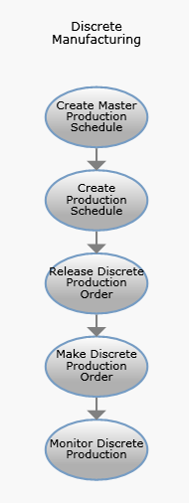
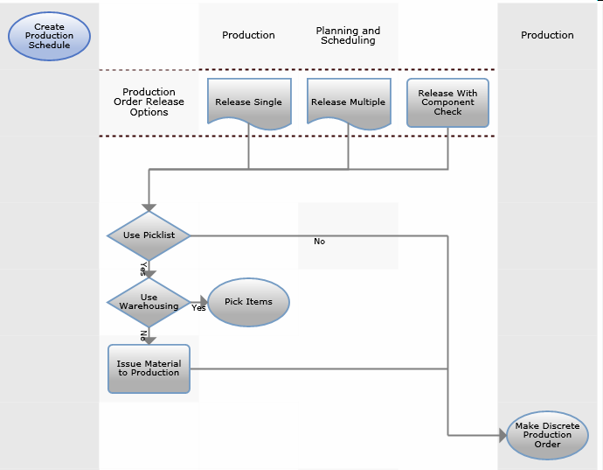
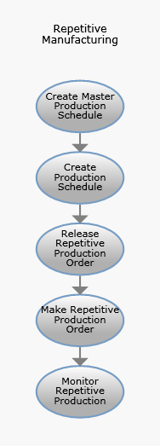
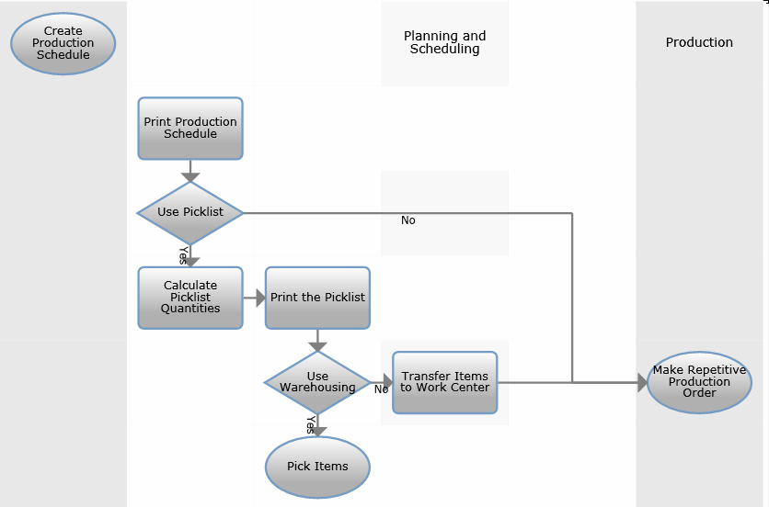
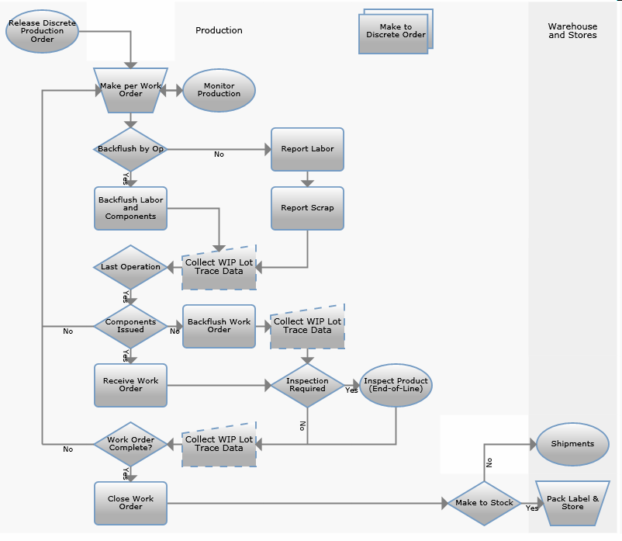
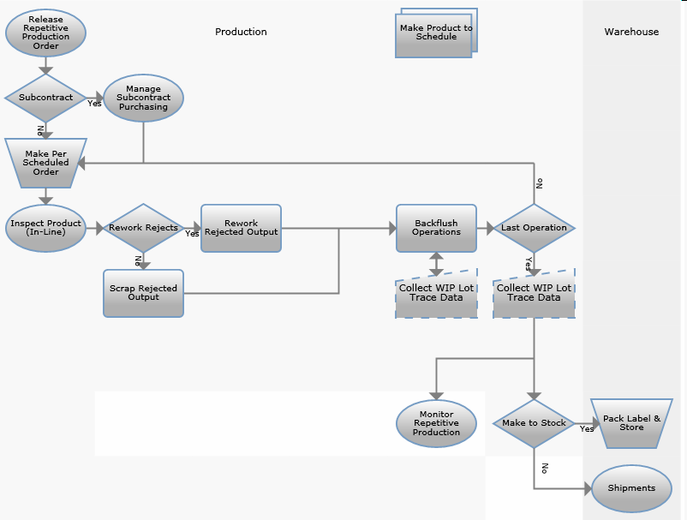
Work Orders and Repetitive Process Flows
6

Slide 7
Unified Production Order Flow
Planning
Scheduling
Report
Labor
Component
Availability
Check
Freeze BOM /
Routing
Allocate
Material
Scrap
Close Order
Print Picklist
Backflush
Produce
Issue Material
Transfer
Material
Receive FG
Production
Accounting
Print Shop
Paper
Subcontract
Processing
Authorize Order
7

Slide 8
QAD Unified Production Orders
Retains existing capabilities to maintain existing business processes and flows
Provides options and more flexibility
Eliminates trade-offs between discrete / repetitive
Simplifies UX / implementation / future roll-out
Provides the foundation for QAD Manufacturing product development
  Eliminates the need for massive upgrades, and enables gradual updates
  Becomes the functional Manufacturing platform for Channel Islands
Notes:
Implement NeoTract – Unified Production Orders platform of the future
Keeping existing functionality
Simplified functionality: unifying production and extending capabilities
Direct involvement of key sub-matter experts R&D in resolving manufacturing implementation challenges
Reap business benefits early on

Slide 9
Selected Key Features for the Release
Unified processes for work orders and repetitive production orders
Consistent application of order status for work orders and repetitive
Quantity to start and expected quantity to complete, with estimated yield
Split production orders for scheduling
Enhancements for allocations, picklists, picking, transfer, issue, and backflush
Production reserved and backflush inventory locations

Slide 10
www.qad.com
© QAD Inc

