Slide 1
Production Activity, Transactions, and Accounting
Production Order Training
2017

Slide 2
Lesson Overview
Introduction
The Transactions
Account Sources
Key Takeaways

Slide 3
Objectives
Understand reference materials for production transactions and General Ledger transactions for production accounting.
  Issue component inventory to production
  Receive quantities from production
  Record labor for production operations
  Record labor for non-production activity
  Receive quantities from subcontract supplier
  Record scrap for an operation
  Revalue work-in-process inventory for material costs
  Close accounting / post variances for production
Understand the account data sources for GL transactions.

Slide 4
Prerequisites
TBD

Slide 5
Primary Audience
  Business analysts
  Implementation managers
  Cost accountants

Slide 6
Introduction

Slide 7
Production Activity and Transactions
Issue component inventory to production
Receive quantities from production
Record labor for production operations
Record labor for non-production activity
Receive quantities from subcontract supplier
Record scrap for an operation
Revalue work-in-process inventory for material costs
Close accounting / post variances for production

Slide 8
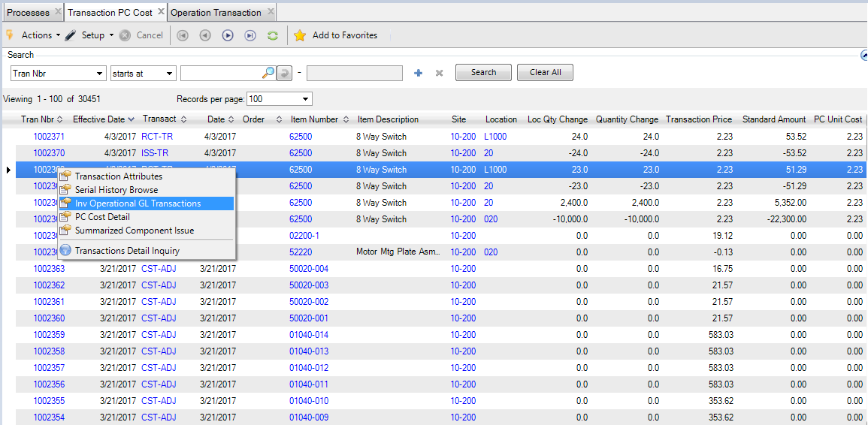
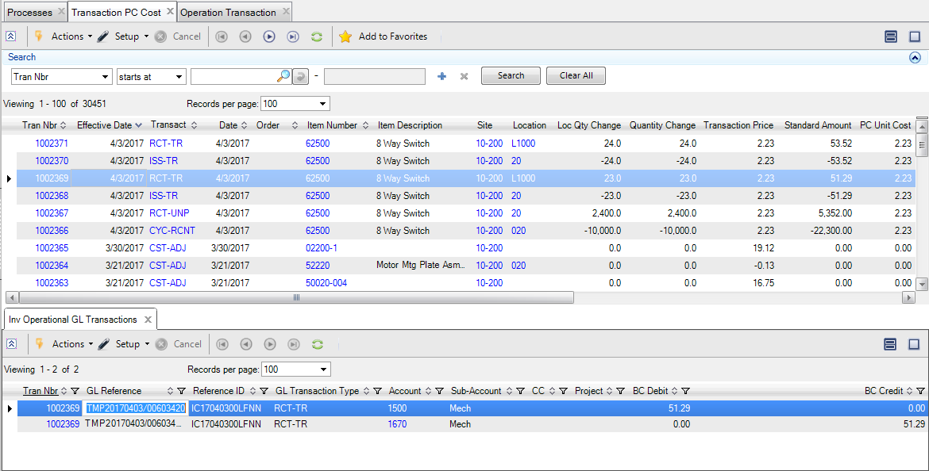
Inventory Transactions and GL Transactions
Transaction PC Cost Browse (30.5.13.18)
  Right-click and select Inv Operational GL Transactions to view transactions that use the Tran Nbr field option for an inventory transaction.

Slide 9
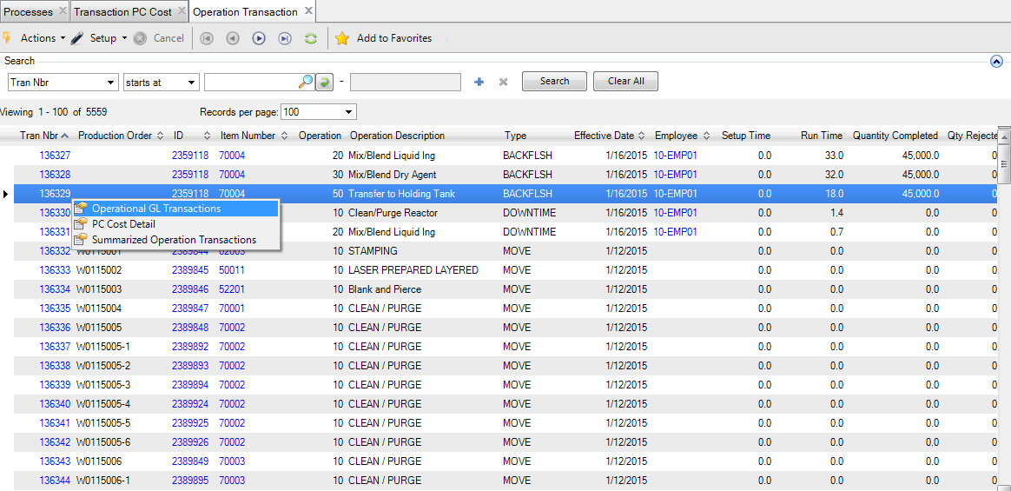
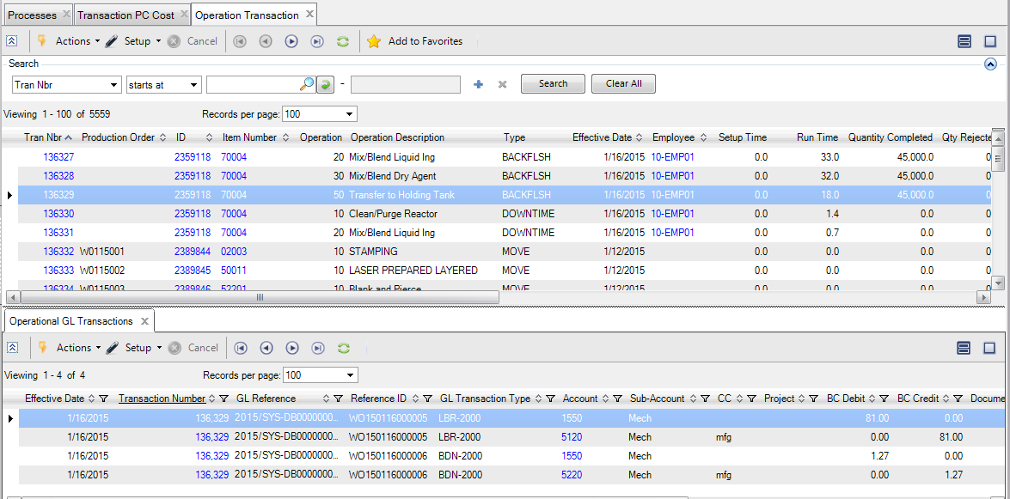
Production Operations and GL Transactions
Operation Transaction (30.5.15.27)
  Right-click and select Operational GL Transactions to view transactions that use the Tran Nbr field option for an operation history transaction.

Slide 10
The Transactions

Slide 11
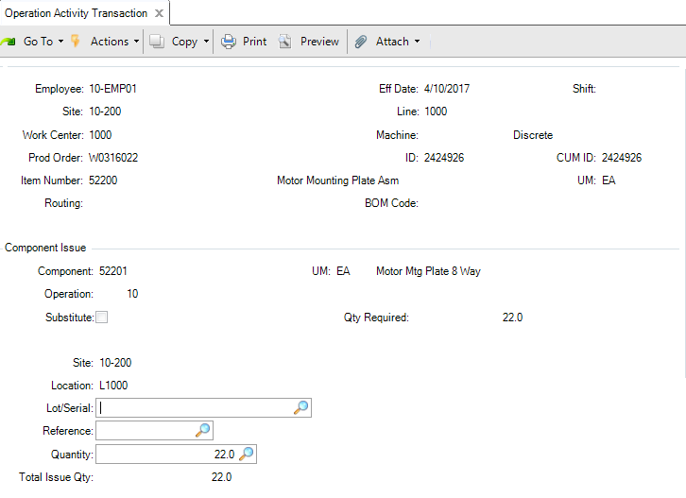
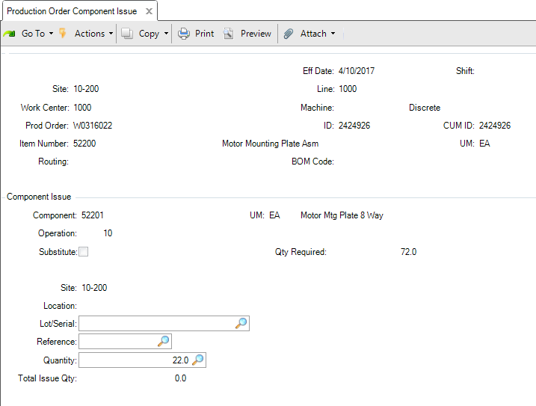
Issue Component Inventory to Production
Issue component quantities from inventory to a production order using Component Issue from:
  Operation Activity Transaction (16.13.13)
  Production Order Component Issue (16.5.12)

Slide 12
Issue Components Transaction Details
Material cost
  For quantities issued to production from inventory.
Material rate variance
  For component quantities issued to a production order, this is determined by calculating the difference between the actual GL transaction cost of the component item and the expected cost for the component item on the production order bill.
Cost | DR | CR | Calculation
Material | Work-in-Process | Inventory | Material Cost = Issue Qty * GL Cost Item
Material rate variance | Material Rate Variance | Work-in-Process | Material Rate Variance = Issue Qty * (GL Cost Item - Item Cost on Production Order Bill of Material)

Slide 13
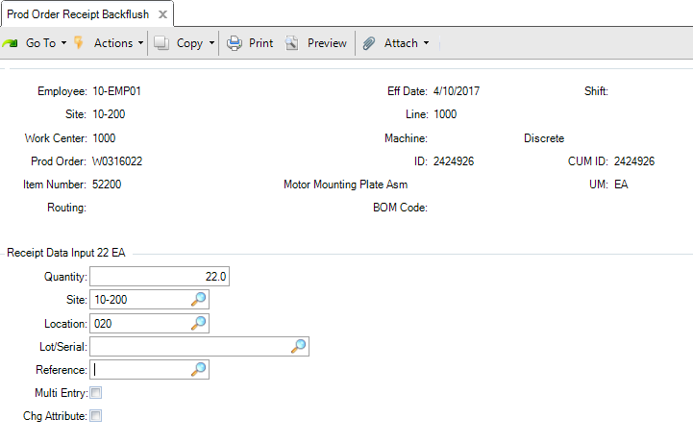
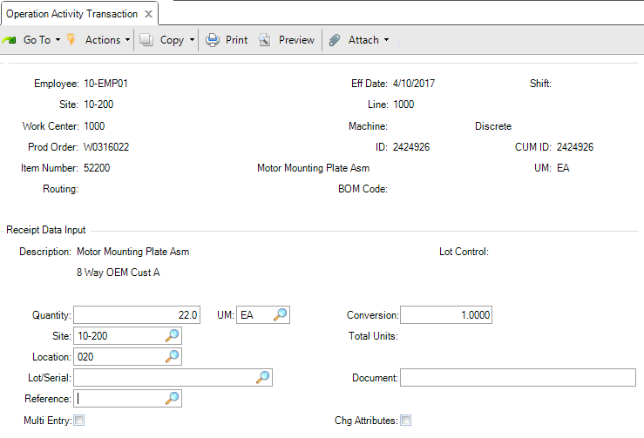
Receive Quantities from Production into Inventory
Use the following programs to receive completed quantities from production into inventory:
  Production Order Receipt Backflush (16.13.1)
  Receipt Data Input frame in Operation Activity Transaction (16.13.13)

Slide 14
Receive Quantities Transaction Details
Material cost
  For quantities received into inventory from production.
Overhead cost
  For quantities received into inventory from production.
Cost | DR | CR | Calculation
Material | Inventory | Work-in-Process | Material Cost = Receipt Qty * GL Cost Item
Overhead | Work-in-Process | Overhead Applied | Overhead = Receipt Qty * GL this level Overhead cost for the item

Slide 15
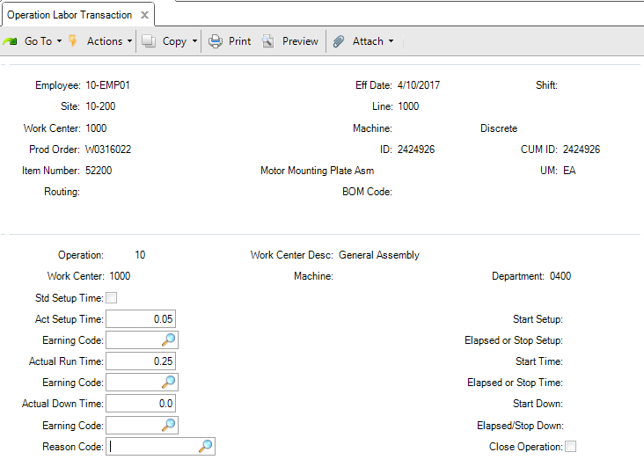
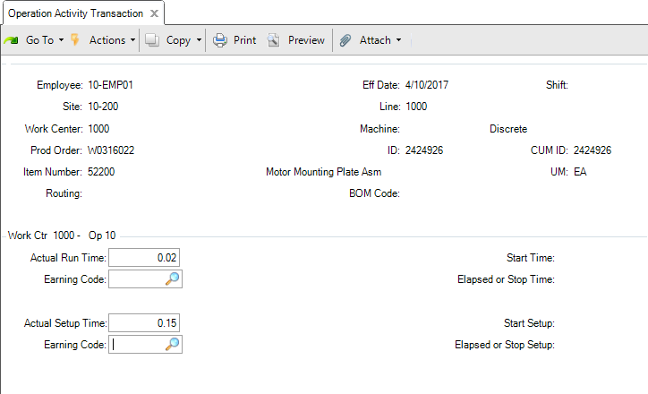
Record Labor for a Production Operations
Use the following programs to report the setup and/or run time hours for a production operation at a work center:
  Operation Labor Transaction (16.13.14)
  Operation Activity Transaction (16.13.13)

Slide 16
Record Labor Transaction – Labor Cost
Labor cost for setup and run hours
  For the setup hours and the run hours reported for the transaction work center using the labor rates.
Cost | DR | CR | Calculation
Setup Labor | Work-in-Process | Setup Labor | Setup Labor = (Actual Setup Hours * Actual Work Center Setup Rate)
Run Labor | Work-in-Process | Run Labor | Run Labor = (Actual Run Hours * Actual Work Center Run Rate)

Slide 17
Record Labor Transaction – Labor Rate Variance
Labor rate variance setup and run hours
  Determined by calculating the difference between the actual pay rate for the employee and the expected work center labor rate for the work center on the production order routing operation.
Cost | DR | CR | Calculation
Setup labor rate variance | Setup Labor Rate Variance | Work-in-Process | Setup Labor Rate Variance = Actual Setup Hours * (Employee Actual pay Rate or Actual Work Center Setup Labor Rate - Frozen Work Center Setup Labor Rate)
Run labor rate variance | Run Labor Rate Variance | Work-in-Process | Run Labor Rate Variance = Actual Run Hours (Employee Actual Pay Rate or Actual Work Center Run Labor Rate - Frozen Work Center Run Labor Rate)

Slide 18
Record Labor Transaction – Burden Cost
Burden cost for setup and run hours
  Calculated using the burden rates and percentages for the transaction work center.
Cost | DR | CR | Calculation
Setup labor burden | Work-in-Process | Setup Burden | Setup Burden Cost = Actual Setup Hours * [(Actual Work Center Setup Rate * Actual Work Center Labor Burden%) + Actual Work Center Labor Burden Rate + (Actual Machine Burden Rate * Machines/Op)]
Run labor burden | Work-in-Process | Run Burden | Run Burden Cost = Actual Run Hours * [(Actual Work Center Run Rate * Actual Work Center Labor Burden%) + Actual Work Center Labor Burden Rate + Actual Machine Burden Rate]

Slide 19
Record Labor Transaction – Burden Rate Variance
Burden rate variance for setup and run hours
  Determined by calculating the difference between the actual machine and labor burden cost for the work center and the expected machine and labor burden cost for the work center on the production order routing operation.
Cost | DR | CR | Calculation
Setup labor burden rate variance | Setup Burden Rate Variance | Work-in-Process | Setup Burden Rate Variance = Actual Setup Hours * [(Employee Actual pay Rate or Actual Work Center Setup Labor Rate * Actual Work Center Labor Burden %) + Actual Work Center Labor Burden Rate + Actual Machine Burden Rate * Machines/Op) - (Frozen Work Center Setup Rate * Frozen Work Center Labor Burden % + Frozen Work Center Labor Burden Rate + Frozen Machine Burden Rate * Machines/Op)]
Run labor burden rate variance | Run Burden Rate Variance | Work-in-Process | Run Burden Rate Variance = Actual Run Hours * ((Employee Actual pay Rate or Actual Work Center Run Labor Rate * Actual Work Center Labor Burden % + Actual Work Center Labor Burden Rate + Machine Burden Rate) - ((Frozen Work Center Run Rate * Frozen Work Center Labor Burden %) + Frozen Work Center Labor Burden Rate + Frozen Machine Burden Rate))

Slide 20
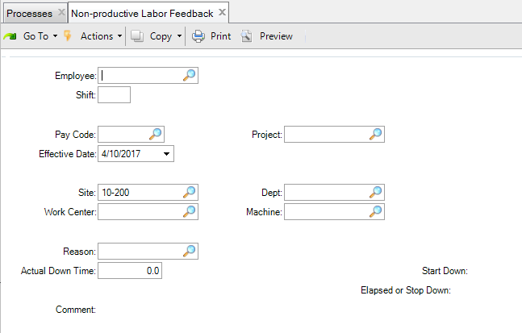
Record Labor for Non-Production Activity
Use Non-Productive Labor Activity (16.13.5) to record labor that is not associated with production for either an employee, a work center, or an employee at a work center.
Enter value for Employee and/or Work Center and Machine

Slide 21
Non-Productive Labor Transaction Details
Labor cost for hours that is not expended on production is calculated using the employee labor rate or the work center labor rate.
Burden cost for hours that is not expended on production is calculated using the work center rates, its burden rate, and burden percent.
Cost | DR | CR | Calculation
Labor | Cost of Production | Labor | Labor Cost = Hours * Employee Labor Rate for Employee (if setup) otherwise the Work Center Labor Rate
Labor burden | Cost of Production | Burden | Burden Cost = Hours * [(Work Center Run Rate * Work Center Labor Burden%) + Work Center Labor Burden Rate + Machine Burden Rate]

Slide 22
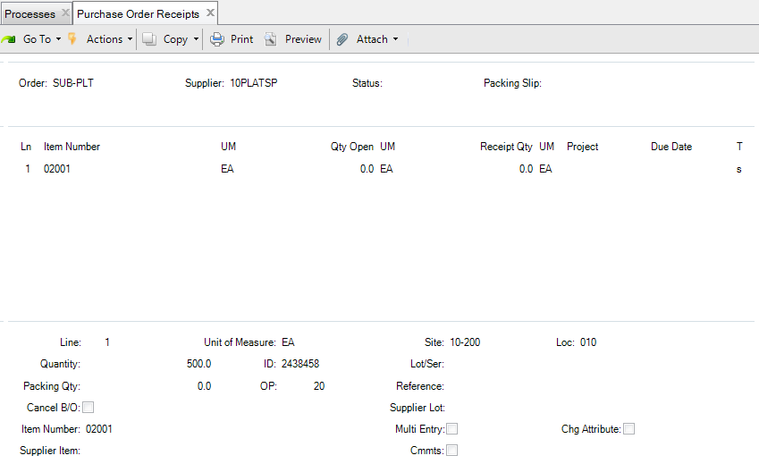
Receive Quantities from Subcontract Supplier
Use the following programs to receive a quantity on a purchase order line that is for subcontract processing for a production order operation:
  Purchase Order Receipts (5.13.1)
  PO Shipper Receipt (5.13.20)

Slide 23
Subcontract Receipt Transaction Details
Subcontract cost is determined by the quantity received and the work center subcontract cost.
Subcontract rate variance is determined from the difference between the purchase order line subcontract cost and the work center subcontract cost.
Cost | DR | CR | Calculation
Subcontract cost | Work-in-Process | Cost of Production | Subcontract Cost = PO line Cost * Transaction Qty
Subcontract rate variance | Subcontract Rate Variance | Work-in-Process | Subcontract Rate Variance = (PO line Cost - Work Center Subcontract Cost from Production Order Routing Op) * Transaction Qty

Slide 24
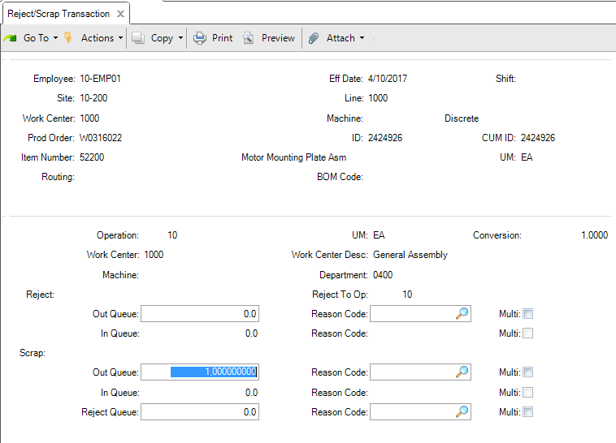
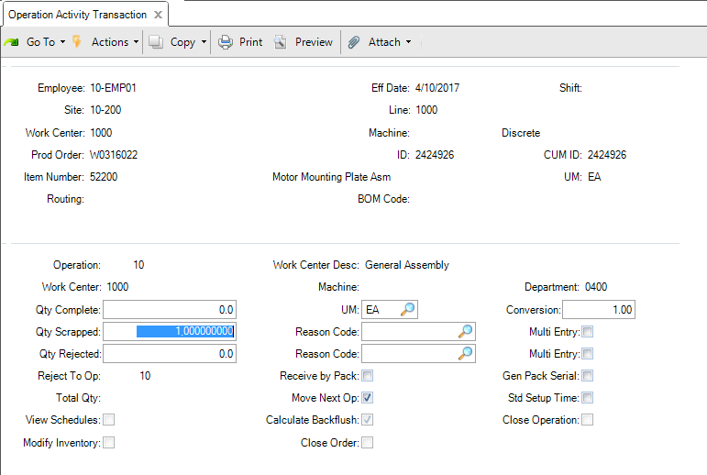
Record Scrap for an Operation
Use the following programs to scrap or reject quantities at an operation (no GL transactions are created):
  Reject Scrap Transaction (16.13.15)
  Operation Activity Transaction (16.13.13)

Slide 25
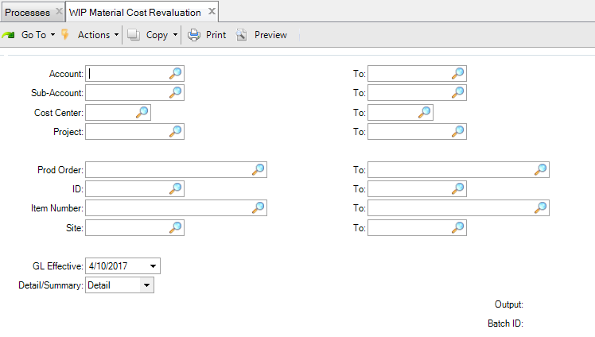
Revalue Work-In-Process Inventory for Material Costs
Use WIP Material Cost Revaluation (16.20.22) to adjust the work-in-process value for a production order because the material costs of the component quantities that were issued to the order changed.

Slide 26
Revalue Work-In-Process Inventory for Material Costs
When the material cost changes for items issued to a purchase order, use WIP Material Cost Revaluation (16.20.22) to adjust the work-in-process value for the order.

Slide 27
Revalue Work-In-Process Transaction Details
Material cost
  For quantities received into inventory from production.
Overhead cost
  For quantities received into inventory from production.
Cost | DR | CR | Calculation
Material cost change | Work-in-Process | Cost Reval | Material Cost Change = Total Qty Issued * (GL Cost Item - Prod Order BOM Item Cost)

Slide 28
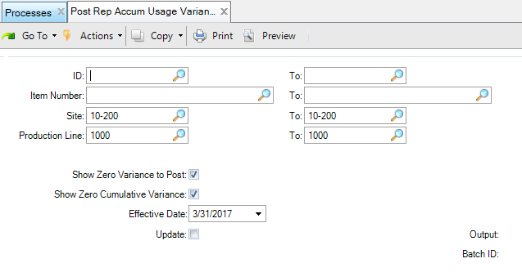
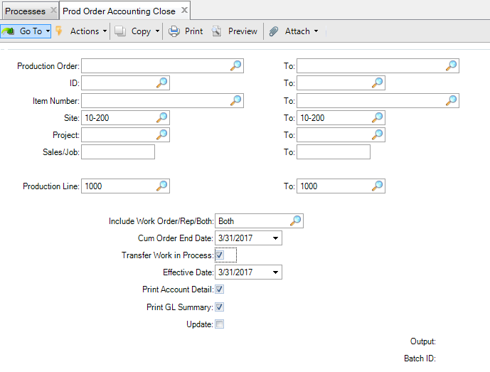
Close Accounting or Post Variances for Production
Use Production Order Accounting Close (16.20.10) and Post Repetitive Usage Variances Calculate (16.20.7) to post the following variances:
  Material Usage Variance
  Labor Usage Variance
  Burden Usage Variance
  Subcontract Usage Variance
  Mix Variance
  Method (Change) Variance
    Only calculated using
    Production Order Accounting Close.

Slide 29
Material Usage Variance
Material usage variance is determined by calculating the difference between the total quantity issued for a component and the expected quantity on the production order bill and the general ledger cost for the item.
Cost | DR | CR | Calculation
Material usage variance | Material Usage Variance | Work-in-Process | Material Usage Variance = (Actual Qty Issued - (Op Qty Processed + Op Qty Scrapped) * WO BOM Qty per) * WO BOM Item Cost

Slide 30
Labor Usage Variance
Labor usage variance for setup and run hours
  Labor usage variances for the reported setup hours and reported run hours is determined by calculating the difference between the total actual setup and run labor hours and the expected setup and run labor hours for the production operation, using the expected labor rates for the work center on the production order routing operation.
Cost | DR | CR | Calculation
Setup labor usage variance | Setup Labor Usage Variance | Work-in-Process | Setup Labor Usage Variance = (Actual Setup Hours - Operation Standard Setup Hours) * Frozen Work Center Setup Rate
Run labor usage variance | Run Labor Usage Variance | Work-in-Process | Run Labor Usage Variance = [Actual Run Hours - (Operation Standard Run Hours per Unit * (Op Qty Completed + Op Qty Scrapped))] * Frozen Work Center Labor Rate

Slide 31
Burden Usage Variance
Burden usage variance for setup and run hours
  Labor usage variances for the reported setup hours and run hours is determined by calculating the difference between the total actual setup and run labor hours and the expected setup and run labor hours for the production operation, using the expected labor rates for the work center on the production order routing operation.
Cost | DR | CR | Calculation
Setup labor burden usage variance | Setup Burden Usage Variance | Work-in-Process | Setup Burden Usage Variance = (Actual Setup Hours - Operation Standard Setup Hours) * [(Frozen Work Center Run Rate * Frozen Work Center Labor Burden %) + Frozen Work Center Labor Burden Rate + Frozen Machines Burden Rate]
Run labor burden usage variance | Run Burden Usage Variance | Work-in-Process | Run Burden Usage Variance = [Actual Run Hours - (Operation Standard Run Hours per Unit * (Op Qty Completed + Op Qty Scrapped))] * [(Frozen Work Center Run Rate * Frozen Work Center Labor Burden %) + Frozen Work Center Labor Burden Rate + Frozen Machines Burden Rate]

Slide 32
Subcontract Usage Variance
Subcontract usage variance is determined by calculating the difference between the total quantity received and the expected operation quantity, and the work center subcontract cost.
Cost | DR | CR | Calculation
Subcontract usage variance | Subcontract Usage Variance | Work-in-Process | Subcontract Usage Variance = (PO receipt Qty - Operation Complete Qty + Operation Scrap Qty) * Operation Standard Subcontract Cost from Production Order Routing Op

Slide 33
Mix Variance
Mix variance for co- and by-product production is determined by calculating the difference between the expected and the actual quantities received for co- and by-product items.
Cost | DR | CR | Calculation
Mix variance | Mix Variance | Work-in-Process | Mix Variance = Co-/By-Product (Expected Receipt Quantity - Actual Receipt Qty) * GL Cost

Slide 34
Method Change Variance
Post method change variance to clear the remaining WIP cost for the production order when processing Production Order Accounting Close.
Cost | DR | CR | Calculation
Method change variance | Method Variance | Work-in-Process | Remaining cost in Work-in-Process for the production order

Slide 35
Close Accounting and Floor Stock
Recognize the costs for floor stock, components with Issue Policy = None”
  Production Order Accounting Close (16.20.10)

Slide 36
Floor Stock
Material cost is calculated from the issue quantity on the production order bill and the general ledger cost for the item.
No inventory transactions are created.
Cost | DR | CR | Calculation
Material Cost | Work-in-Process | Floor Stock | Material Cost = Issue Qty * GL Cost Item

Slide 37
Account Sources

Slide 38
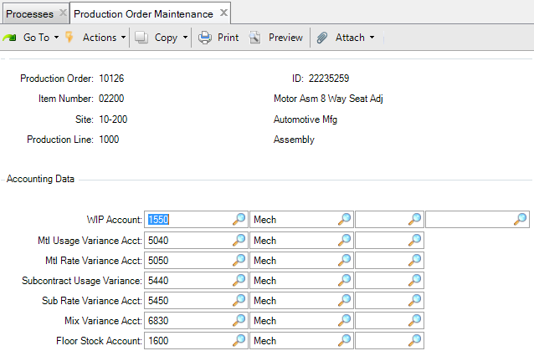
Production Order Accounts
Production order accounts (default values from the product line):
  Work-in-Process (WIP)
  Material usage variance
  Material rate variance
  Subcontract usage variance
  Subcontract rate variance
  Mix variance
  Floor stock

Slide 39
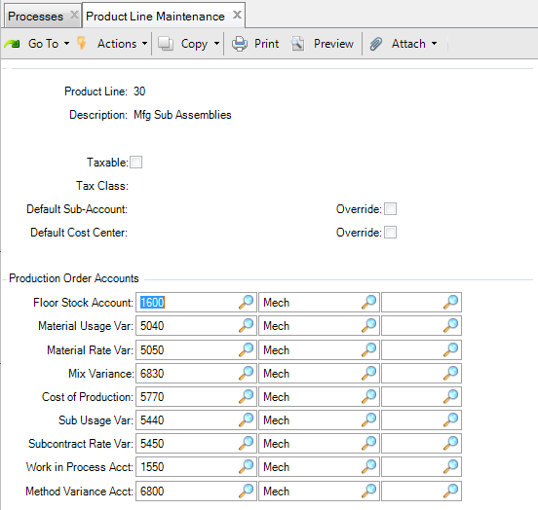
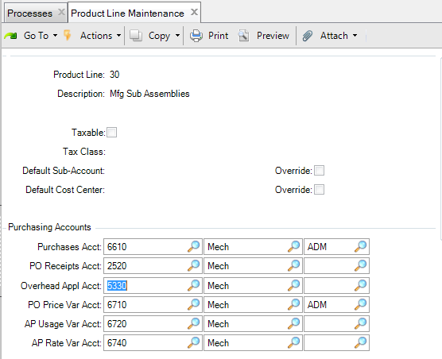
Product Line Accounts
Overhead Applied
Cost of Production
Method [Change] Variance

Slide 40
Key Takeaways

Slide 41
Summary
Understand reference materials for production transactions and General Ledger transactions for production accounting.
  Issue component inventory to production
  Receive quantities from production
  Record labor for production operations
  Record labor for non-production activity
  Receive quantities from subcontract supplier
  Record scrap for an operation
  Revalue work-in-process inventory for material costs
  Close accounting / post variances for production
Understand the account data sources for GL transactions.

Slide 42
Questions
Production Scheduling and Management

Slide 43
www.qad.com
© QAD Inc

