Slide 1
Manage Production Control Parameters
Production Order Training
2017

Slide 2
Lesson Overview
Introduction
Manage Production Control Parameters
Key Takeaways

Slide 3
Learning Objectives
Understand the general types of parameters and how they apply to:
  Production Orders
  Production Picklists
  Production Schedules
  Production Reporting
  Production Accounting
Notes:
Process backflush of materials for a production order, typically off the shop floor in a back officeT
Production Orders (collection)
Prod Order Receipt Backflush (16.13.1)
Process the backflush of materials for a production operation on the shop floor
Production Operation Activity (collection)
Operation Activity Transaction (16.13.13)
Collections to support the reporting of receipt and backflush of quantities
Processing on the shop floor at a work center
Setup items, routings, and product structures for backflush
Priorities for the selection of inventory for processing

Slide 4
Prerequisites
Basic understanding of work orders and or repetitive scheduled order.

Slide 5
Primary Audience
  Business analysts
  Implementation managers
  Production schedulers
  Production managers
  Materials managers

Slide 6
Introduction

Slide 7
Introduction to Control Parameters
Manage the parameters values for functional areas:
  Determine system generated field values
  Default field values when adding new records
  System controlled processes
Detailed information available using online help and user guides

Slide 8
Production Order Control Overview
Parameters are organized into three sections:
  General control parameters for production orders
  Work order and repetitive control parameters
  Site specific control parameters for production

Slide 9
Production Order Control

Slide 10
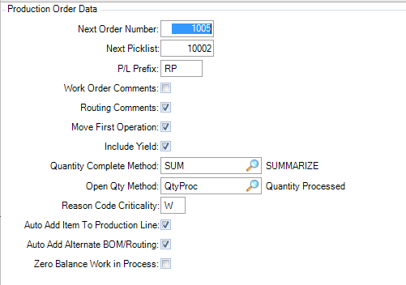
General Production Order Control Parameters
Process control parameters for maintaining production orders
Default parameter values for maintaining production orders

Slide 11
General Production Order Control Parameters
Default value for Production Order Release/Print
Process control parameters to determine the quantity open for production orders
Notes:
Open Qty Method determines how the system calculates the open quantity on a production order. Decide if the quantity open should be calculated from the quantity to complete for a production order and the actual quantity to completed, or the quantity to start for a production order and the actual quantity completed and scrapped - the total quantity processed. In the first case the focus is on the quantity completed, and in the second case the focus is on the quantity processed, as determined by the quantities started, completed, and scrapped.
QtyComp: Quantity completed. The open quantity on a production order is calculated as the quantity to complete for a production order minus the quantity completed.
QtyProc: Quantity processed. The open quantity on a production order is calculated as the quantity to start for a production order minus the quantity processed. The quantity processed is the quantity completed plus the quantity scrapped.

Slide 12
General Production Order Control Parameters
Production Picklist Parameters
Control parameters for reporting production activity and updating work-in-process

Slide 13
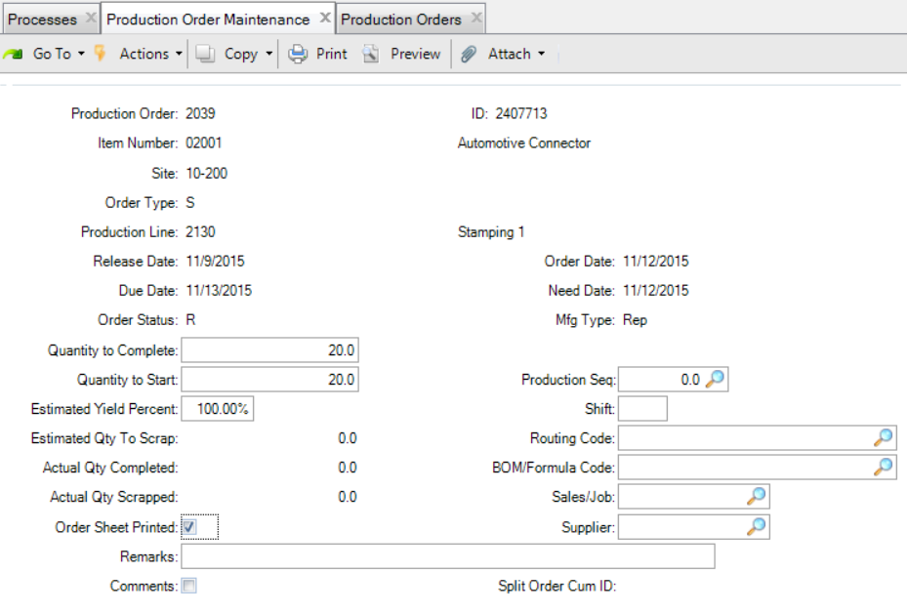
Application for Production Order Maintenance

Slide 14
Application for Production Order Maintenance

Slide 15
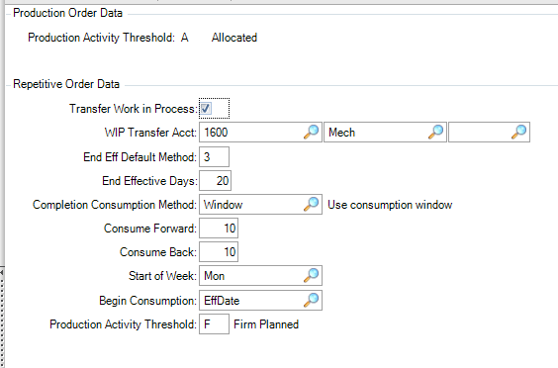
Work Order and Repetitive Parameters
Minimum order status for reporting production activity
Work Order Data
Control parameters for production accounting
Control parameters for consumption of repetitive schedules

Slide 16
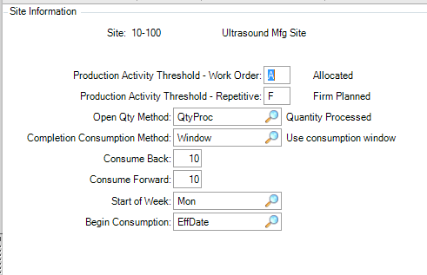
Control Parameters for Sites
Site
Minimum order status for reporting production activity
Process control parameters to determine the quantity open for production orders

Slide 17
Key Takeaways

Slide 18
Summary
Understand the general types of parameters and how they apply to:
  Production Orders
  Production Picklists
  Production Schedules
  Production Reporting
  Production Accounting
Notes:
Production Orders (collection)
Process routine shop floor events for operations
Operation Activity Transaction (16.13.13)
Process component issue of materials, typically from shop floor inventory
Production Order Component Issue (16.5.12)
Process backflush of materials for a production order, typically off the shop floor in a back office
Prod Order Receipt Backflush (16.13.1)

Slide 19
Questions?

Slide 20
www.qad.com
© QAD Inc

