Slide 1
Production Line Calendars
Production Order Training
2017

Slide 2
Lesson Overview
Maintain a Calendar for a Production Line
Key Takeaways

Slide 3
Objectives
Understand production line calendars:
  Understand when it is necessary to set up a production line calendar.
  Understand the relationship between a site (or domain) calendar and a production line calendar.
Create and maintain production line.
Create and maintain a production line calendar, production line calendar exceptions, and non-workdays and holidays.

Slide 4
Prerequisites
Completed the training for:
  Introduction to Production Calendars

Slide 5
Primary Audience
  Business analysts
  Implementation managers

Slide 6
Maintain a Calendar for a Production Line

Slide 7
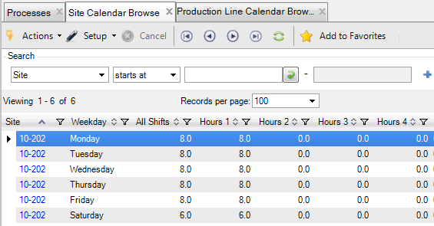
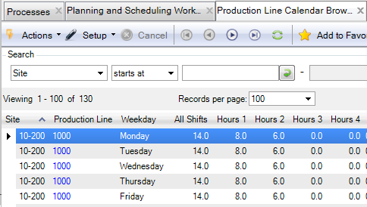
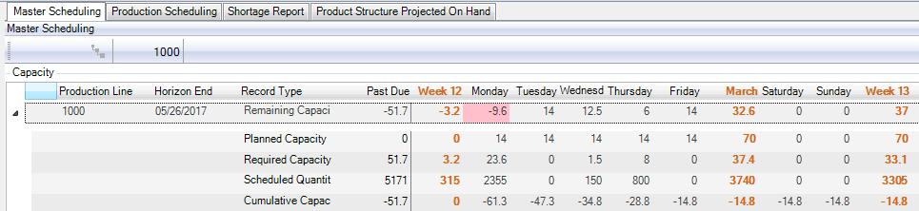
Production Line Calendars and Workbenches
Create and maintain a production line calendar for the Planning and Scheduling Workbenches to calculate capacity for production on that production line.
Hours for shifts 1-4
Hours for shifts 1-4

Slide 8
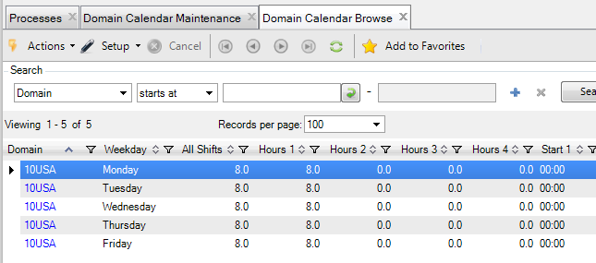
Set Up Production Line Calendar
Review the Domain and Site calendar.

Slide 9
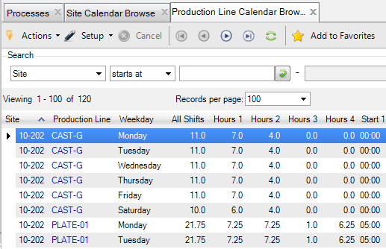
Set Up Production Line Calendar
Define a production line calendar using Production Line Cal Maint (16.1.13.1).
Hours for shifts 1-4

Slide 10
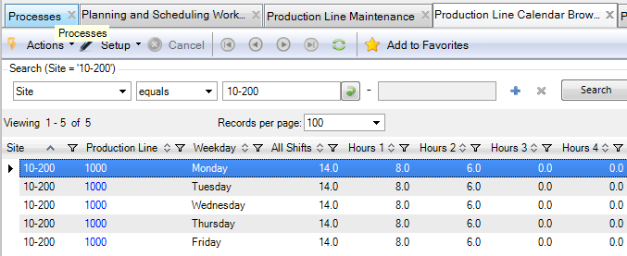
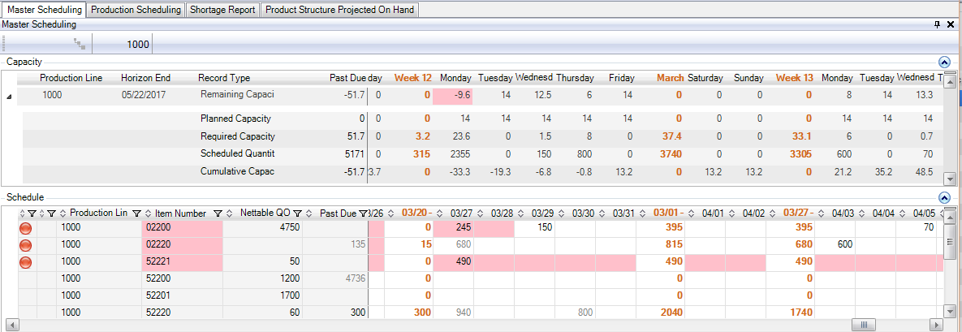
Calendar Hours, Shifts, Workdays and Capacity
Scheduled capacity hours are calculated from the total hours for all shifts for a work day from the production line calendar.
Hours for shifts 1-2
Hours for shifts 1-2

Slide 11
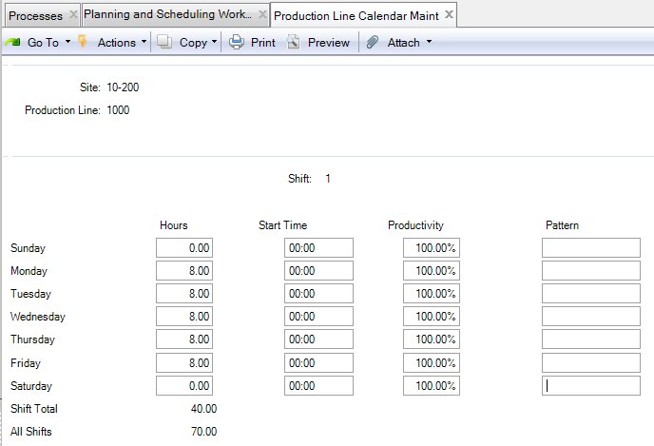
Maintain a Production Line Calendar
Maintain a the workweek calendar for a site.
Specify work hours and productivity for shifts 1 – 4.

Slide 12
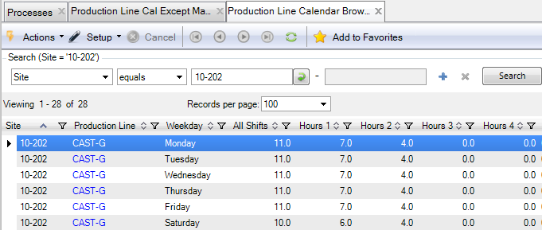
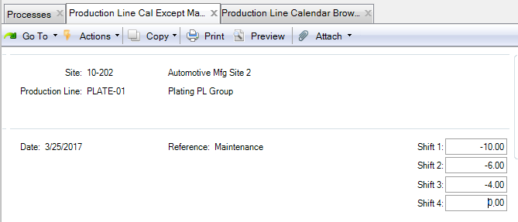
Maintain Work Hour and Work Day Exceptions
Define exceptions for specific dates to either add or delete hours from shifts on a particular date:
  Add work hours for shifts on non-workday such as a Saturday
  Add or reduce work hours for shifts on a workday
  Prod Line Cal Except Maint (16.13.1.3)
Shutdown on a Saturday for
planned maintenance

Slide 13
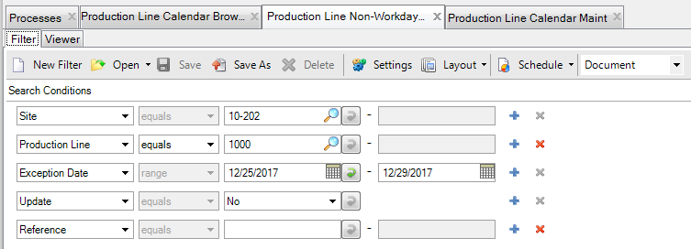
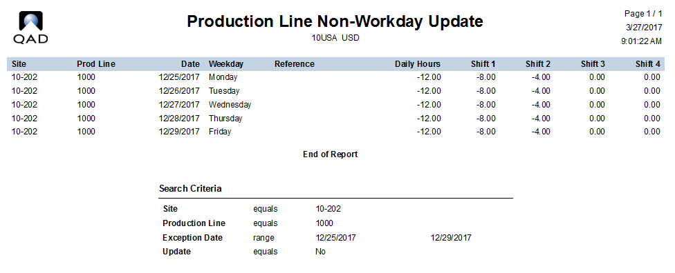
Maintain Non-Workdays
Create non-workdays for one or more consecutive days.
Production Line Non-Workday Update (16.1.13.5)
Example for end-of-year shutdown

Slide 14
Calendar Exceptions and Non-Workdays
Calendar Exceptions
Non-Workdays
Defined using Site Calendar Exceptions Maint (1.1.22.4) or Prod Line Cal Except Maint (16.13.1.5)
Use to either increase or decrease the number of hours for shifts for one specific date.
Defined using Production Line Non-Workday Update (16.1.13.5)
Creates calendar exceptions to reverse the hours for each shift and work day for the production line for a range of dates.

Slide 15
Non-Work Days and Holidays
Non-Workdays and Exceptions
Holidays
Defined using Production Line Non-Workday Update (16.1.13.5)
Can be overridden by a calendar exception for a production line, work center, or process.
Defined using Holiday Maintenance (36.2.1)
Cannot be overridden by a calendar exception for a site, production line, work center or process.
Cannot be made into a workday for a production line, work center, or process.

Slide 16
Key Takeaways

Slide 17
Summary
Understand production line calendars:
  Understand when it is necessary to set up a production line calendar.
  Understand the relationship between a site (or domain) calendar and a production line calendar.
Create and maintain production line.
Create and maintain a production line calendar, production line calendar exceptions, and non-workdays and holidays.

Slide 18
Questions

Slide 19
www.qad.com
© QAD Inc

