Slide 1
Reporting Production Activity Exceptions
Production Order Training
2017

Slide 2
Lesson Overview
Introduction
Exceptions at Production Operations
Key Takeaways

Slide 3
Objectives
Report exceptions to production activity from either the shop floor or from the back office using:
  Production Operation Activity Collection
  Production Order Collection
Use functions in the collections for reporting exceptions at production operations, including:
  Unreported setup and run labor time
  Downtime
  Scrap, reject, and rework quantities
  Move quantities between work centers
Notes:
Process backflush of materials for a production order, typically off the shop floor in a back office
Production Orders (collection)
Prod Order Receipt Backflush (16.13.1)
Process the backflush of materials for a production operation on the shop floor
Production Operation Activity (collection)
Operation Activity Transaction (16.13.13)
Collections to support the reporting of receipt and backflush of quantities
Processing on the shop floor at a work center
Setup items, routings, and product structures for backflush
Priorities for the selection of inventory for processing

Slide 4
Prerequisites
Basic understanding of work orders and or repetitive scheduled orders.
Understand how to authorize production for work orders and for repetitive production.
Understand the basic scenarios for reporting production activity.

Slide 5
Primary Audience
  Business analysts
  Implementation managers
  Production schedulers
  Production managers
  Materials managers

Slide 6
Introduction

Slide 7

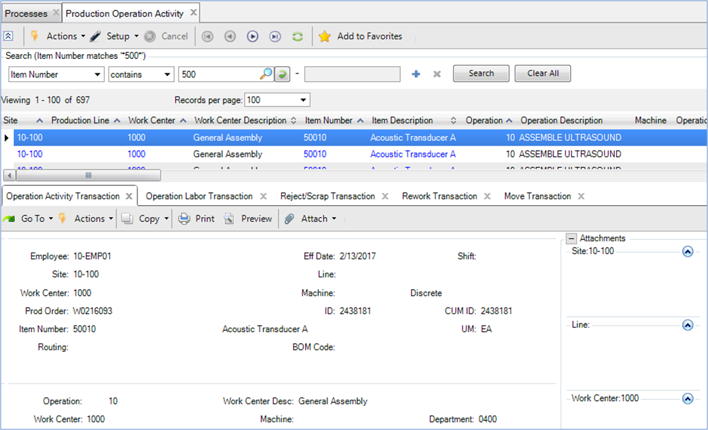

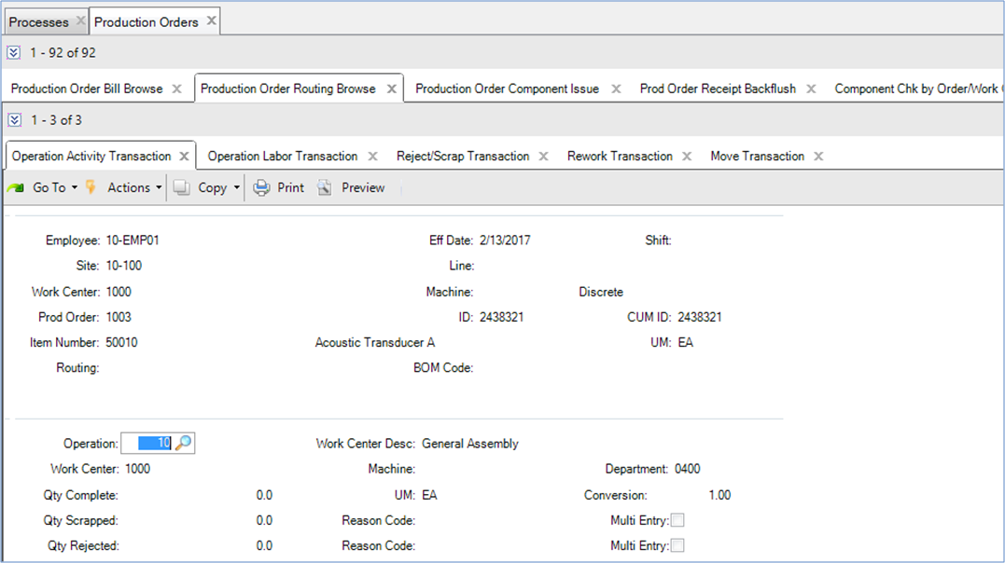
Routine Reporting of Production Activity
Use the Production Operation Activity collection to record activity on the shop floor.
Use the Production Order collection to record activity from back office.
Use the Operation Activity Transaction for recording routine activities.
Notes:
On the shop floor at a line-side location
At or near real time
Possibly assisted with automation solutions
In a back office
From paper-based records
In batch
Not in sequence
End of shift, day, or after completion of the order
Possibly hours and even days after an event

Slide 8
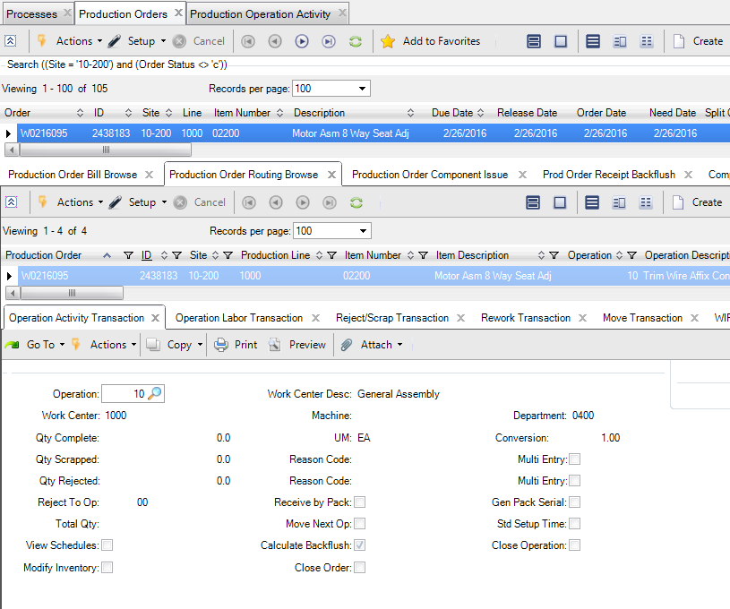
Production Order Collection
Contains functions to process activity for:
  Production order operations
  Production orders as a whole
Operation Activity Transaction
Production Order Component Issue
Prod Order Receipt Backflush
Notes:
The Production Orders (collection) provides access to functions for reporting
Operation activity
Component issues
Receipts and for processing the backflush of inventory

Slide 9
Functions for Exception Reporting

Slide 10
Work-In-Process and Operation Queues
Operation 10
Operation 20
Operation 30
Input
Queue
25
Output
Queue
25
Output
Queue
25
Input
Queue
Output
Queue
Input
Queue
Output
Queue
Input
Queue
Output
Queue
Input
Queue
20
Output
Queue
24
Input
Queue
24
Input
Queue
25
Input
Queue
25
Reject
Queue
Reject
Queue
Reject
Queue
Reject
Queue
5
Move 25 to first operation
Op 10: Rework 5 to Op 20 input
Op 10: Complete 25
Op 20: Complete 25
Op 10: Move 25 to next operation
Op 20: Scrap 1 from output
Op 20: Reject 5 from input to Op 10
Op 20: Move 24 to next operation

Slide 11
Exceptions at Production Operations

Slide 12
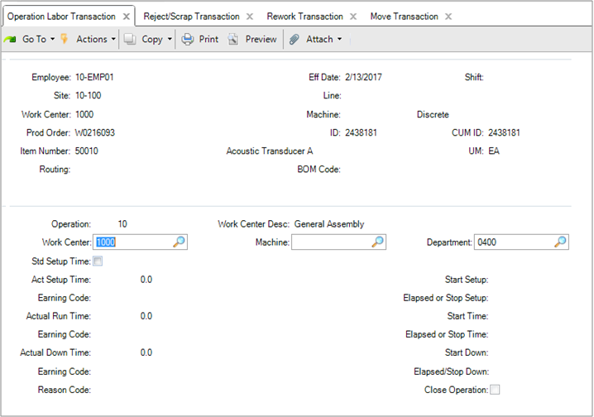
Operation Labor Transaction
Enter unreported setup time.
Enter unreported run time.
Report down time.

Slide 13
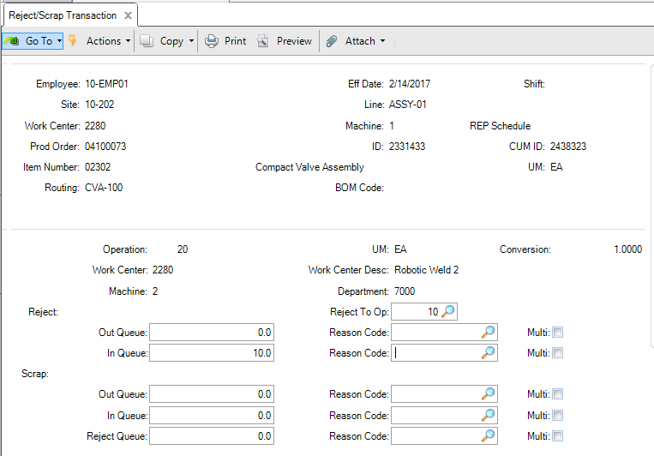
Reject/Scrap Transaction
Operation from where quantities rejected or scrapped
Move reject quantity to reject queue of this operation.
Reject quantities and sources
Scrap quantities and sources
Notes:
Scrap
Quantity is deducted from a specified queue for an operation, removed from WIP. It can be removed from the input, output, or reject queue.
Reject
Quantity is deducted from a specified queue for an operation and added to the reject queue of a specified operation.
Quantities are rejected from an operation
Quantities can be rejected from the output queue or input queue for an operation (except the input queue for the first operation)
Reject quantities are moved to the reject queue to the same operation or to a specified operation
Reject quantities are retained in work-in-process
Reject quantities can be processed by a rework transaction
Quantities can be scrapped from the output queue , input queue, or reject queue for an operation for an (except the input queue for the first operation)
Scrap quantities are written-off to Scrap Expense and removed from work-in-process
The total quantity processed for an operation is the quantity completed for an operation plus and the quantity scrapped at an operation

Slide 14
Reject Quantity to an Operation Reject Queue
From the input queue of an operation to the reject queue to a previous operation.
From the output queue to the reject queue for the same operation.
Operation 10
Operation 20
Operation 30
Input
Queue
Output
Queue
Input
Queue
Output
Queue
Input
Queue
Output
Queue
Reject
Queue
Reject
Queue
Reject
Queue

Slide 15
Scrap Quantity from an Operation Queue
A scrap quantity can be reported from any operation queue, except from the input queue for the first operation.
Operation 10
Operation 20
Operation 30
Input
Queue
Output
Queue
Input
Queue
Output
Queue
Input
Queue
Output
Queue
Reject
Queue
Reject
Queue
Reject
Queue
Scrap Transaction

Slide 16
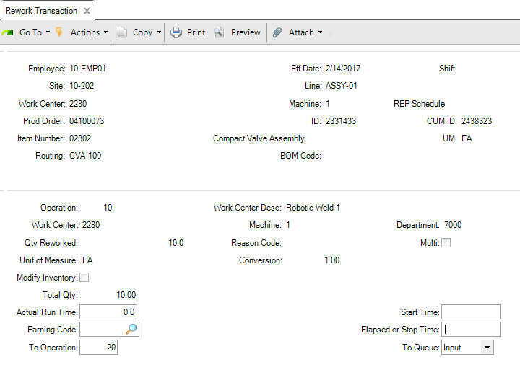
Rework Transaction
Report quantity reworked.
Specify destination operation and queue (input or output) for rework quantity.
Notes:
Rework
Quantity is deducted from the reject queue for an operation and added to a specified queue for a specified operation.

Slide 17
Move the Rework Quantity to an Operation Queue
From the reject queue to the input queue of the subsequent operation.
From the reject queue to the output queue for the same operation.
Operation 10
Operation 20
Operation 30
Input
Queue
Output
Queue
Input
Queue
Output
Queue
Input
Queue
Output
Queue
Reject
Queue
Reject
Queue
Reject
Queue

Slide 18
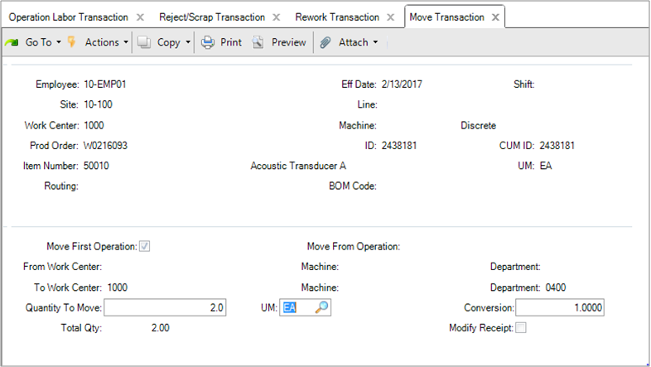
Move Transaction
Move quantity to first operation.
Move quantity from operation to the next operation (possibly a different work center).
Notes:
Move
Quantity is moved from the output queue for an operation to the input queue of the next operation.

Slide 19
Key Takeaways

Slide 20
Summary
Report exceptions to production activity from either the shop floor or from the back office using:
  Production Operation Activity Collection
  Production Order Collection
Use functions in the collections for reporting exceptions at production operations:
  Unreported setup and run labor time
  Downtime
  Scrap, reject, and rework quantities
  Move quantities between work centers
Notes:
Production Orders (collection)
Process routine shop floor events for operations
Operation Activity Transaction (16.13.13)
Process component issue of materials, typically from shop floor inventory
Production Order Component Issue (16.5.12)
Process backflush of materials for a production order, typically off the shop floor in a back office
Prod Order Receipt Backflush (16.13.1)

Slide 21
Questions?

Slide 22
www.qad.com
© QAD Inc

