Slide 1
Scenarios for Reporting Production Activity
Production Order Training
2017

Slide 2
Lesson Overview
Introduction and requirements
Basic scenarios
Considerations and decision factors
Recommended practices
Milestone and non-milestone operations
Key Takeaways

Slide 3
Learning Objectives
Requirements for reporting production activity differ by role
  Records for production orders
  Records for work-in-process activity and production operations
Basic scenarios and considerations
  Reporting from the shop floor or from the back office
  Reporting with manual entry or with automation
  Use of milestone and non-milestone operations
  Actual (reported) or calculated labor for accounting
Recommended practices
  Report milestone operations for production
  Report production order activity

Slide 4
Primary Audience
  Business analysts
  Implementation managers
  Stockroom and warehouse managers
  Materials managers
  Operations managers
  Production managers

Slide 5
Introduction and Requirements
Notes:
Objective is to maintain a master schedule for items to drive material requirements planning for production and purchasing

Slide 6


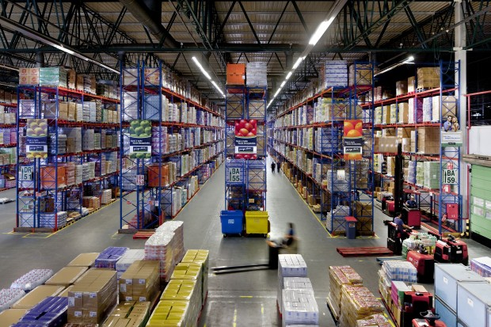


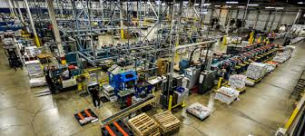
Scenarios for Reporting Production Activity
Production Scheduling
and Management
Master Scheduling Production Planning
Production Materials Management
Cost Accounting
Shop Floor Activity
and Operations

Slide 7
Introduction
Production activity reporting can consist of:
  Recording high-level activities for production orders, such as the consumption of component materials, scrap, and receipts from production into inventory.
  Recording operation-level work-in-process activities for production orders, such as completions, scrap, and labor hour.
Notes:
Production order level activities include
Component quantities issued and backflushed to a production order
Quantities completed and received into inventory
Quantities scrapped
Operation level activities may include
Quantities completed and scrapped for an operation
Quantities reworked
Labor hours for setup and run

Slide 8
Requirements for Information Differ by Role
Production schedulers
  Status for production orders and material requirements
  Status for work-in-process production
Operations managers
  Production performance and metrics for production orders
  Detailed production performance and metrics production at work-in-process operations
Cost accountants
  Work-in-process valuation and determination of cost of production
Notes:
Cost accountants
Work-in-process valuation and determination of cost of production from either
Reported (actual) labor for operations or
Labor calculated from quantities reported for either the production order or a production operation

Slide 9
Reporting at the Order Level
Reporting at the Order Level provides information to determine:
  Quantity to complete, quantity completed, quantity scrapped, and quantity open.
  Component material quantity required, quantity issued, and quantity short.
  Valuation of work-in-process and determining cost of production.
  Variances for cost accounting.
Notes:
Production Scheduler
Schedule and reschedule production for items on production lines for shifts to meet demand
Expedite or reschedule supply to meet demand for component requirements
Operations Manager
Performance reporting and metrics including material usage variances, scrap variances, and method change variances
Performance reporting for production on production lines

Slide 10
Reporting at the Operation Level
Reporting at the Operation Level provides information to determine:
  Operation status, quantity required, quantity completed, and quantity scrapped.
  Operation quantities for input, rework, and output queues.
  Expected and actual labor hours.
  Valuation of work-in-process and determination of cost of production.
  Variances of cost accounting.
Notes:
Production Scheduler
Schedule and reschedule production for items on production lines for shifts and at work centers to meet demand
Schedule work at multiple constrained / bottleneck resources
Operations Manager
Performance reporting and metrics including scrap and yield by operation, labor rate and usage variances
Performance reporting for production, with details down to the work centers and operations

Slide 11
Basic Scenarios

Slide 12
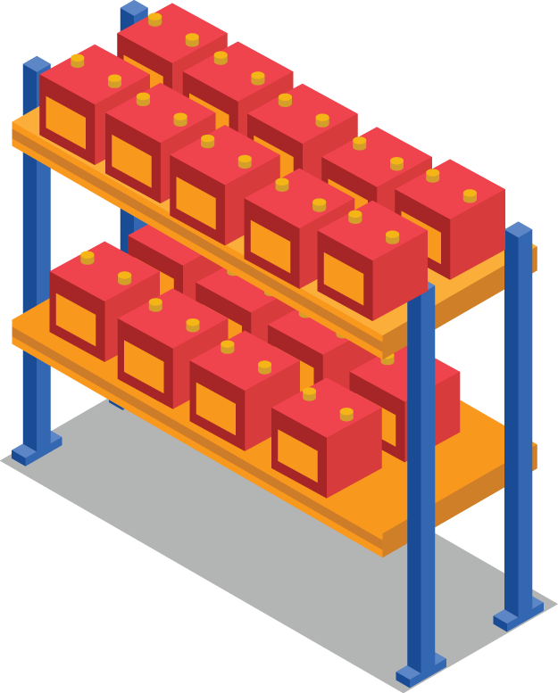
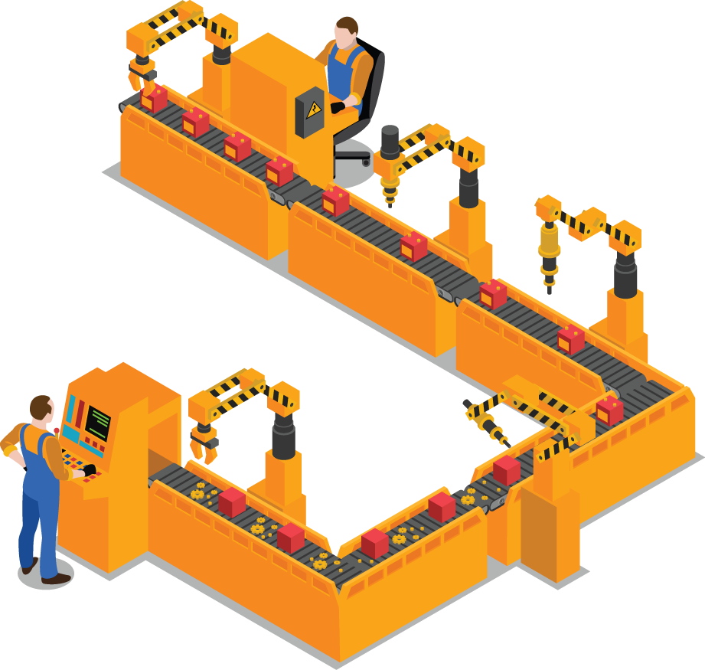




Example for Production Activity Scenarios
Shop Floor
Completed batteries from production orders are received into the shop floor inventory location.
Operation 30
Test
Operation 10
Insert Plates
Operation 20
Assembly

Slide 13


Scenario Overview
Record activity from the shop floor for production operations
  At or near real-time
Record activity from the back office from paper-based records
  For production order or for the order and its operations
  At the end of a shift, end of day, or after a production order has been completed
  Not in sequence
  Possibly hours or days later
Shop Floor
Operation 30
Test
Operation 10
Insert Plates
Operation 20
Assembly
Notes:
On the shop floor at a line-side location
At or near real time
Possibly assisted with automation solutions
In a back office
From paper-based records
In batch
Not in sequence
End of shift, day, or after completion of the order
Possibly hours and even days after an event

Slide 14
Reporting Activity from the Shop Floor
Report activity near real time
  Suitable for scheduling work-in-process production
  Better planning and more accurate production reporting
Shop Floor
Operation 30
Test
Operation 10
Insert Plates
Operation 20
Assembly
1
Operation 10
Installing plates into the container
3
Operation 30
Completed quantities after test
2
Operation 20
Assembling components

Slide 15
Production Operation Activity from the Back Office
Report activity for production orders and their operations
  Generally suitable for compliance and cost accounting
  Limits suitability for planning and scheduling
Shop Floor
Operation 30
Test
Operation 10
Insert Plates
Operation 20
Assembly
1
Operation 10
Installing plates into the container
3
Operation 30
Completed quantities after test
2
Operation 20
Assembling components

Slide 16
Production Order Activity for an Order from the Back Office
Report activity for production orders
  Generally suitable for compliance and cost accounting
  Limits suitability for planning and scheduling
  Use for planning and scheduling depends delay
Shop Floor
Completed batteries are received from a production order.
Back office processes the receipt and backflushes the materials not previously issued to the production order.
1
2

Slide 17
Production Order Activity for Last Operation from the Back Office
Report activity for the last operation
  With backflush of previous operations and the automatic, calculated completion of previous operations
Shop Floor
Operation 30
Test
Operation 10
Insert Plates
Operation 20
Assembly
Completed batteries are received from a production order at Operation 30.
Back office processes the receipt and backflushes the materials used and work performed at previous operations.
1
2

Slide 18
Considerations and Decision Factors

Slide 19
Considerations
Perform cost accounting using actual (reported) labor hours or calculated labor hours.
Reporting with milestone operations with backflush of previous operations.
Paper-based records and automation.
Report from the shop floor or back office.

Slide 20
Cost Accounting Factors
Actual (reported) labor hours
  Labor and machine hours are subject to significant variances.
  Labor contributes significantly to the cost of production for an item.
Calculated labor hours
  Costs are calculated for production operations using the quantities completed and scrapped for a production order.
  Labor and machine hours are consistent with little or no variance.
  Labor does not contribute significantly to the cost of production for an item.
Notes:
Determination of cost of production and work-in-process
Actual (reported) labor hours
Labor and machine hours are subject to significant variances
Labor contributes significantly to the cost of production for an item
Calculated labor hours
Costs are calculated for production operations using the quantities completed and scrapped for a production order
Labor and machine hours are consistent with little or no variance
Labor does not contribute significantly to the cost of production for an item
Information for production costs and metrics
Production yield and scrap variance
Operation yield and scrap variance
Operation rework
Setup usage variance
Labor usage variance
Material usage variance
Machine usage variance
Work center, production line, plant utilization and efficiency

Slide 21
Reporting with Milestone Operations
A milestone operation is simply an operation where quantities and labor hours are reported.
Use milestone operations to backflush quantities and labor for all previous non-milestone operations – automatic calculation of labor.
Notes:
Definition and use of a milestone operation
An operation where quantities and labor hours are reported
Always the last operation
Can also be an intermediate operation
Quantities reported for a milestone operation can automatically result in a backflush of quantities and labor for all previous non-milestone operations (back to but not including a previous milestone
Use for the automatic reporting of previous non-milestone operations
Use with preceding non-milestone operations for the automatic calculation and reporting of labor, burden, and subcontract costs (and material costs too???)
Non-milestone operations
Are not required for production scheduling or performance reporting
Can have backflush of labor, burden, subcontract cost and material(?) for the operation

Slide 22
Paper-Based Records and Automation
Reporting production operation activity using paper-based records is more feasible when there are:
  Manageable data volumes
  Low production volumes, few operations, longer lead times, and/or low velocity
  Use of milestone operations to backflush work at
  non-milestone operations
Reporting using automation is required when there are:
  High data volumes
  High production volumes, many operations, short lead times, and/or high velocity
Notes:
Reporting of production operation activity is using paper-based records is more feasible when there are
Low production volumes and relatively small number of production orders
Relatively few production operations
Longer operation lead times, possibly measured in hours or even days
Longer production lead times
Reporting using automated solutions is required when there are
High production volumes and large number of production orders
Higher number of production operations
Short operation lead times, possibly measured in seconds or minutes
Short production lead times

Slide 23
Recommended Practices

Slide 24
Report Production Operations
Report activity for milestone production operations and production orders
  Report quantities and optionally report labor for all milestone operations, preferably in sequence for a production order.
  Report quantities and optionally report labor for the last milestone operation with all preceding operations being non-milestone operations with Auto Labor Report = yes.

Slide 25
Report Only Production Order
Report production order quantities
  Report quantities completed and scrapped for a production order .
  Accounting close automatically processes backflush production operations for the order.

Slide 26
Milestone and Non-Milestone Operations

Slide 27
Setup of Milestone and Non-Milestone Operations
Functions
  Routing Maintenance (14.13.1)
  Routing Maintenance Rate Based (14.13.2)
  Process Definition Maintenance (15.13)
  Process/Formula Maintenance (15.18)
Parameters
  Defined for a routing operation or process operation using the Milestone parameter
  Set Auto Labor Report = Yes for all non-milestone operations and optionally set it to yes for milestone operation.

Slide 28
Key Takeaways

Slide 29
Summary
Requirements for reporting production activity differ by role
  Records for production orders
  Records for work-in-process activity and production operations
Basic scenarios and considerations
  Reporting from the shop floor or from the back office
  Reporting with manual entry or with automation
  Use of milestone and non-milestone operations
  Actual (reported) or calculated labor for accounting
Recommended practices
  Report milestone operations for production
  Report production order activity

Slide 30
Questions

Slide 31
www.qad.com
© QAD Inc

