Slide 1
Sequence Production for a Production Line
Production Order Training
2017

Slide 2
Lesson Overview
Introduction
Production Scheduling and Sequencing
Additional Tools for Sequencing
Key Takeaways

Slide 3
Objectives
Sequence production for a release date and optionally shift using the Production Scheduling panel in the Production Scheduling Workbench.
Maintain the shift and/or sequence for individual production orders using the Production Orders collection and Production Order Maintenance.

Slide 4
Prerequisites
Basic understanding of:
  Work orders and or repetitive scheduled orders.
  QAD Planning and Scheduling Workbenches.

Slide 5
Primary Audience
  Business analysts
  Implementation managers
  Production schedulers
  Operations managers
  Production managers
  Materials managers

Slide 6
Introduction

Slide 7
Production Sequencing
What is sequencing?
  Determines the order that production orders will be processed through a production line.
Why sequence production?
  Assures the smooth flow of production within a time period, considering the capacity of that resource.
  Minimizes changeover times.
  Supports the production of every part at every interval (EPEI).
What are the time periods?
  Sequencing is performed for either a day, or day and shift.

Slide 8
Production Scheduling with Sequencing

Slide 9
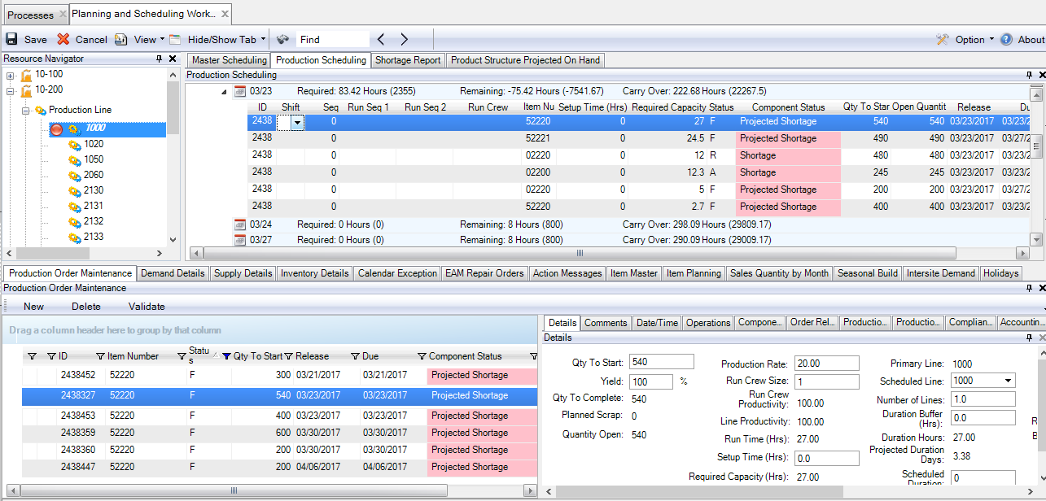
Production Scheduling Workbench
Goal is to sequence orders for production line 1000 on 03/23.
Notes:
Capability to sequence all kinds of production orders: repetitive orders and work orders
Process Steps
Maintain shift when more than one shift
To move an order to the end, enter an integer value for the sequence
Drag orders into the desired sequence or continue to update sequence for the remaining orders

Slide 10
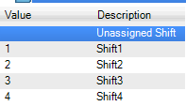
Scheduling Multiple Shifts
When scheduling for a shift, enter a value from 1-4, otherwise leave shift unassigned.

Slide 11
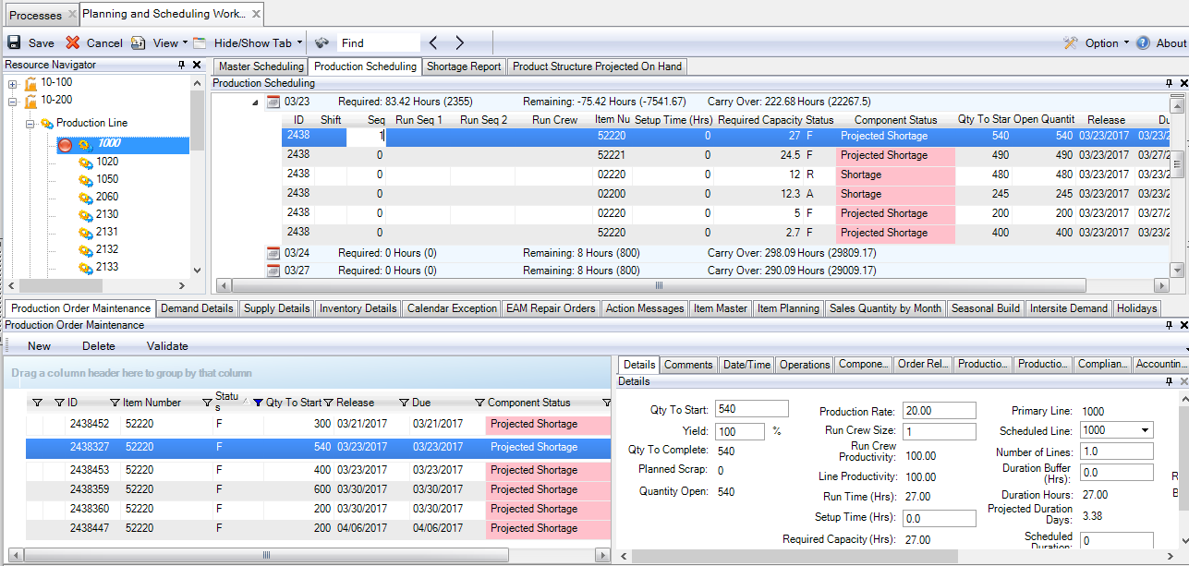
Enter Sequence for One Order
Begin sequencing by entering a number for any order.

Slide 12
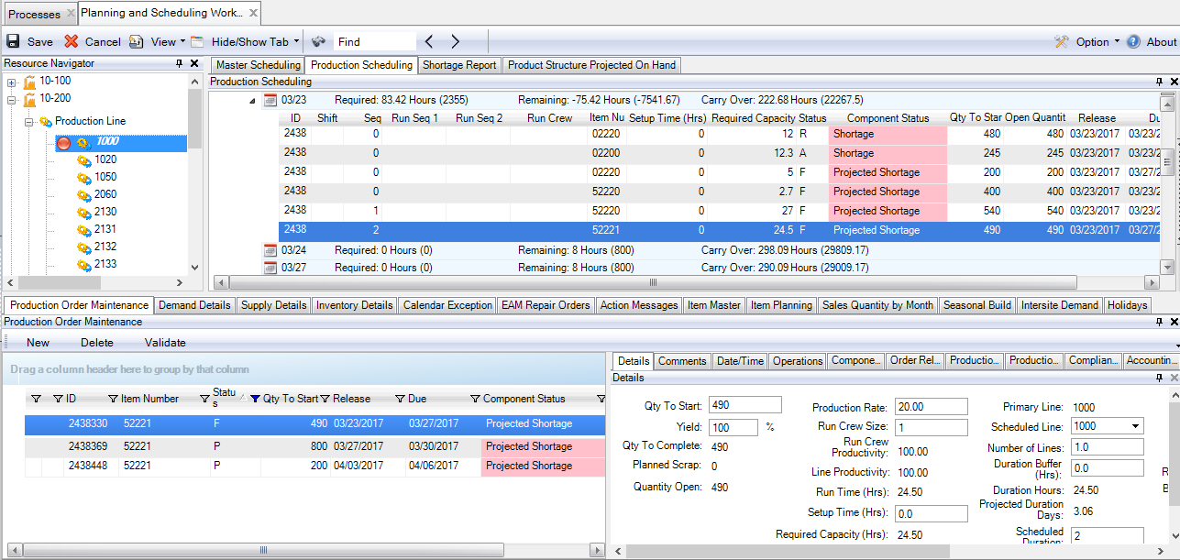
Drag orders vertically or update Sequence
Continue by either dragging orders into the sequence or manually updating sequence.

Slide 13
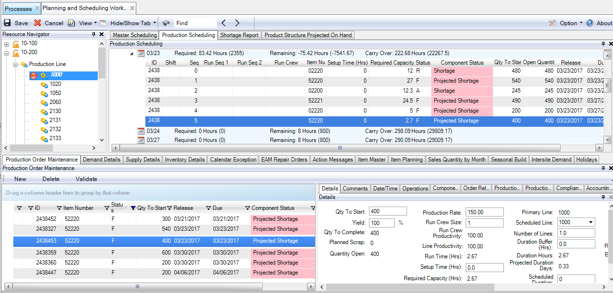
Continue sequencing then Save
Continue positioning orders or updating sequence. Click save to commit changes.

Slide 14
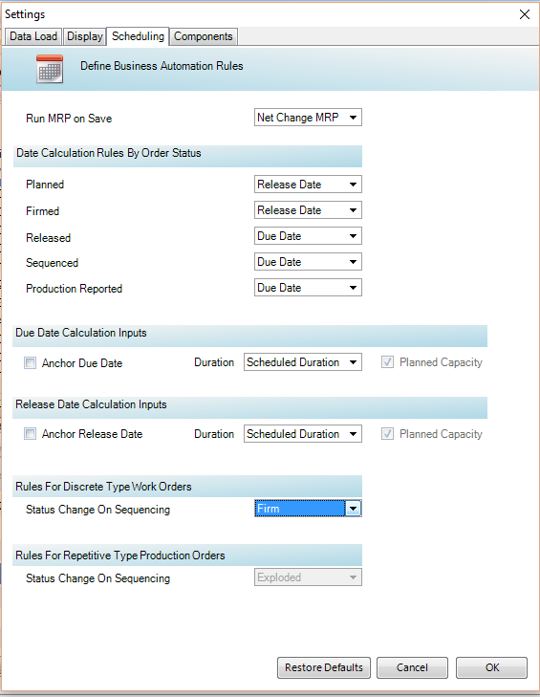
Production Order Status and Sequencing
The status of the order may be advanced to what is defined in:
  Option|Preferences|Scheduling| Status Change on Sequences

Slide 15
Production Order Status and Sequencing
Option | Preferences | Scheduling | Status Change on Sequences
Advance the status of the order.

Slide 16
Additional Tools for Sequencing

Slide 17
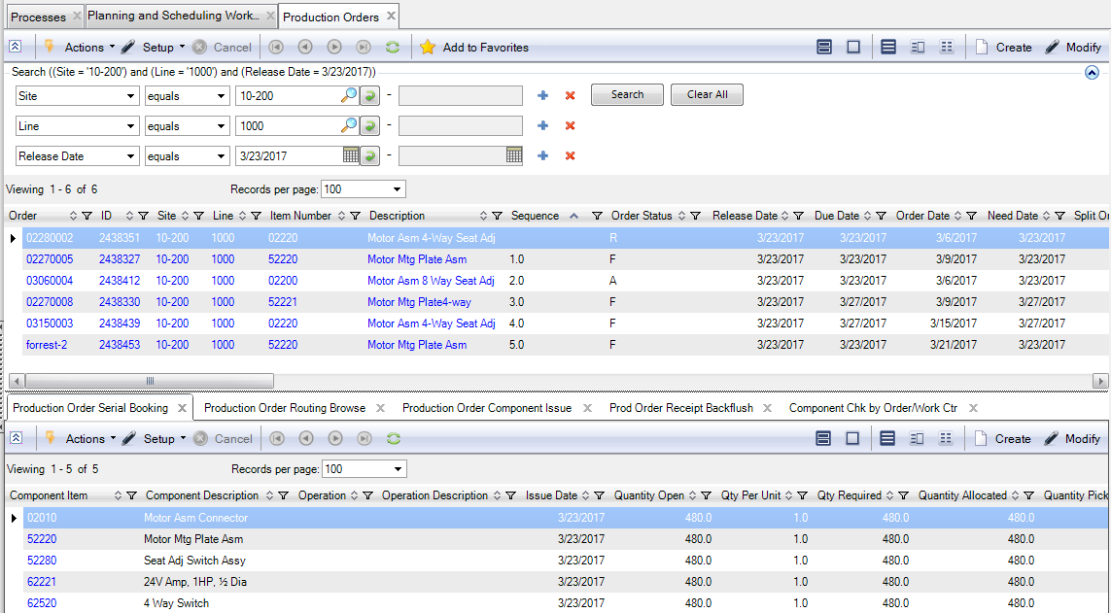
Sequence using Production Order collection
Update the values for shift and sequence for production orders.

Slide 18
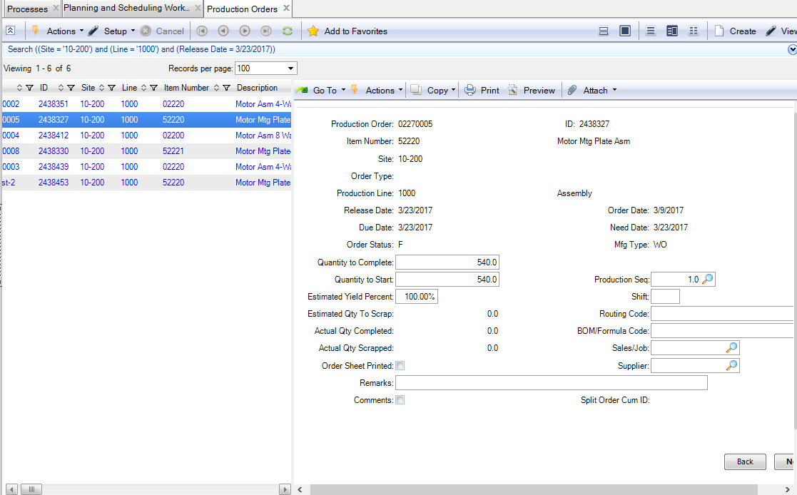
Modify or Create from Production Orders
Update directly using Production Order Maintenance or from the collection.

Slide 19
Key Takeaways

Slide 20
Summary
Sequence production for a release date and optionally shift using the Production Scheduling panel in the Production Scheduling Workbench.
Maintain the shift and/or sequence for individual production orders using the Production Orders collection and Production Order Maintenance.

Slide 21
Questions

Slide 22
www.qad.com
© QAD Inc

