Slide 1
Site Calendars
Production Order Training
2017

Slide 2
Lesson Overview
Maintain a Calendar for a Site
Key Takeaways

Slide 3
Objectives
Understand site calendars:
  Understand when to set up a site calendar.
  Understand the relationship between site (or domain) calendars and production line calendars.
Create and maintain site
Create and maintain a site calendar, calendar exceptions, and holidays

Slide 4
Prerequisites
Completed the training for:
  Introduction to Production Calendars

Slide 5
Primary Audience
  Business analysts
  Implementation managers

Slide 6
Maintain a Calendar for a Site

Slide 7
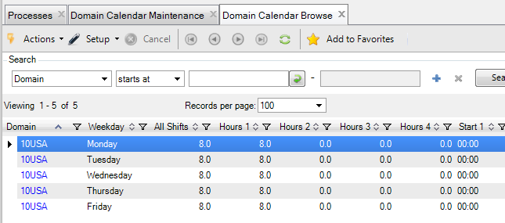
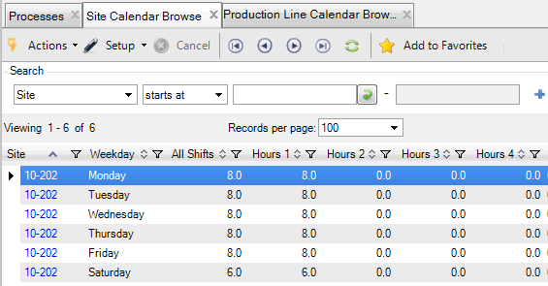
Domain and Site Calendars
Review the Domain calendar.
Define a Site calendar if necessary using Site Calendar Maintenance (1.1.22.1).

Slide 8
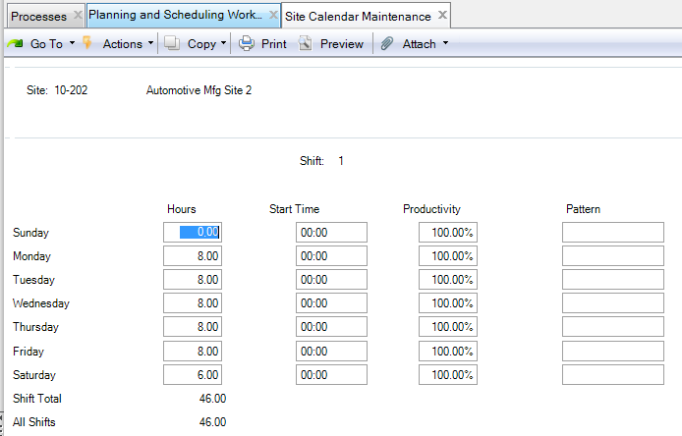
Maintain a Site Calendar
Maintain a the workweek calendar for a site
Specify work hours and productivity for shifts 1 – 4

Slide 9
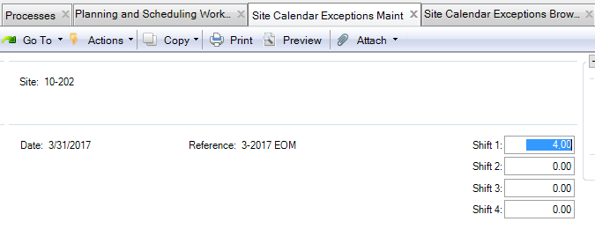
Set Up Work Hour and Work Day Exceptions
Define exception for specific dates to either add or delete hours from shifts on a particular date
  Add work hours for shifts on non-workday such as a Saturday
  Add or reduce work hours for shifts on a workday
  Site Calendar Exceptions Maint (1.1.22.4)
Adjustment to work additional 4 hours on Friday 3/31/2017

Slide 10
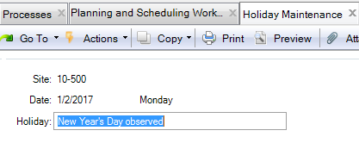
Site Holidays
Non-workdays that apply across an entire site can be easily defined using Holiday Maintenance (36.2.1).

Slide 11
Non-Work Day Exceptions and Site Holidays
Non-Workday Exception
Site Holiday
Defined using Site Calendar Exceptions Maint (1.1.22.4) entering negative hours for a date.
Can be overridden by a calendar exception for a production line, work center or process.
Defined using Holiday Maintenance (36.2.1)
Cannot be overridden by a calendar exception for a site, production line, work center or process.
Cannot be made into a workday for any production line, work center, or process.

Slide 12
Key Takeaways

Slide 13
Summary
Understand site calendars:
  Understand when to set up a site calendar.
  Understand the relationship between site (or domain) calendars and production line calendars.
Create and maintain site
Create and maintain a site calendar, calendar exceptions, and holidays

Slide 14
Questions

Slide 15
www.qad.com
© QAD Inc

