Slide 1
Work Center Calendars
Production Order Training
2017

Slide 2
Lesson Overview
Maintain a Calendars for a Work Center
Key Takeaways

Slide 3
Objectives
Understand work center calendars:
  Understand when it is necessary to set up a work center calendar.
  Understand the relationship between a site (or domain) calendar, a work center calendar, and a production line calendar.
Create and maintain a work center.
Create and maintain a work center calendar, work center calendar exceptions, and non-workdays and holidays.

Slide 4
Prerequisites
Completed the training for:
  Introduction to Production Calendars

Slide 5
Primary Audience
  Business analysts
  Implementation managers

Slide 6
Maintain a Calendar for a Work Center

Slide 7
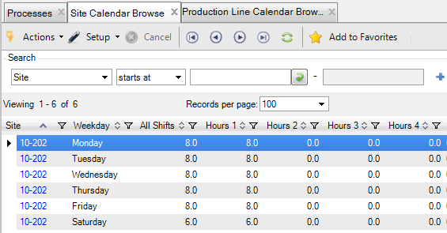
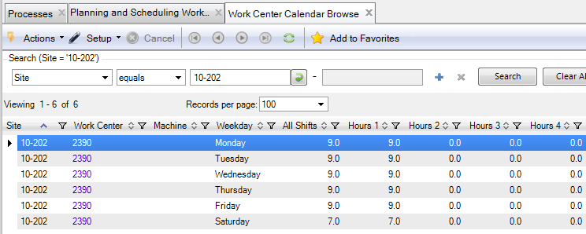
Site and Work Center Calendars
The calendar that is applied to a site also applies to work centers within that site (unless it has not been defined for that work center).
Set up a work center calendar only when the work days, shifts, and/or hours are different for the work center than its site.
Greater number of hours for Shift 1
Notes:
Set up work center calendars when necessary.
Set up a work center calendar only when the work days, shifts, and/or hours are different for a work center than for the calendar that applies to the site.

Slide 8
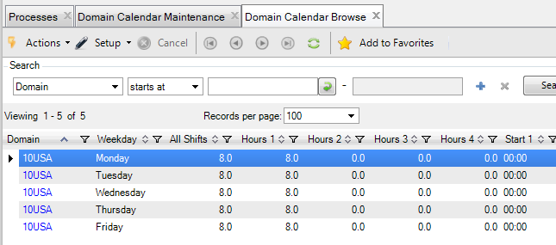
Set Up Work Center Calendar
Review the Domain and Site calendars.
Notes:
The calendar that applies to a site, is applied to a work centers within that site, unless a calendar has not been defined for that work center.
Set up a work center calendar only when the work days, shifts, and/or hours are different for a work center than its site.

Slide 9
Set Up Work Center Calendar
Define a work center calendar if necessary using Work Center Calendar Maintenance (14.18.1).
Greater number of hours for Shift 1
Notes:
The calendar that applies to a site, is applied to a work centers within that site, unless a calendar has not been defined for that work center.
Set up a work center calendar only when the work days, shifts, and/or hours are different for a work center than its site.

Slide 10
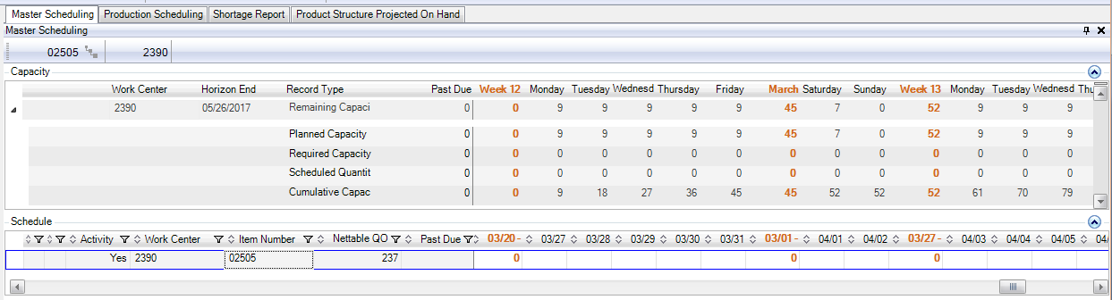
Hours, Shifts, Workdays and Work Center Capacity
Scheduled capacity hours for a work center are calculated from the total hours for all shifts for a work day from the work center calendar or site calendar (when a work center calendar has not been set up).
Hours for all shifts
Hours for all shifts

Slide 11
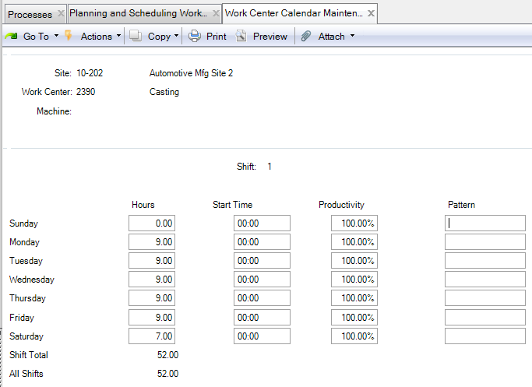
Maintain a Work Center Calendar
Maintain a the workweek calendar for a site.
Specify work hours and productivity for shifts 1 – 4.

Slide 12
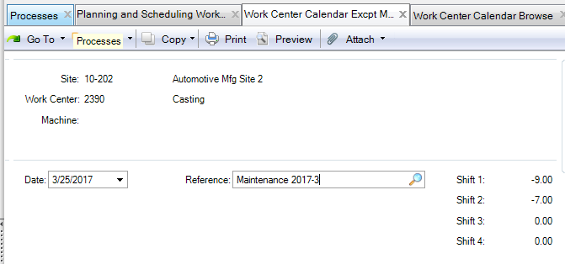
Set Up Work Hour and Work Day Exceptions
Define exceptions for specific dates to either add or delete hours from shifts on a particular date:
  Add work hours for shifts on non-workday such as a Saturday
  Add or reduce work hours for shifts on a workday
  Work Center Calendar Excpt Maint (14.18.4)
Shutdown on a Saturday for
planned maintenance

Slide 13
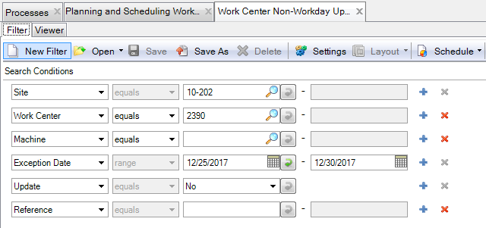
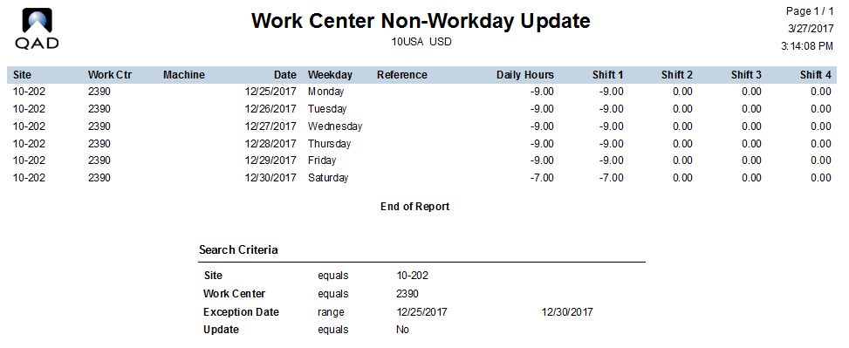
Non-Workdays
Create non-workdays for one or more consecutive days
Work Center Non-Workday Update (14.18.25)
Example for end-of-year shutdown

Slide 14
Calendar Exceptions and Non-Workdays
Calendar Exceptions
Non-Workdays
Defined using Site Calendar Exceptions Maint (1.1.22.4) or Work Center Calendar Excpt Maint (14.18.4)
Use to either increase or decrease the number of hours for shifts for one specific date.
Defined using Work Center Non-Workday Update (14.18.25)
Creates calendar exceptions to reverse the hours for each shift and work day for the production line for a range of dates.

Slide 15
Non-Work Days and Holidays
Non-Workdays and Exceptions
Holidays
Defined using Production Line Non-Workday Update (16.1.13.5)
Can be overridden by a calendar exception for a production line, work center, or process.
Defined using Holiday Maintenance (36.2.1)
Cannot be overridden by a calendar exception for a site, production line, work center or process.
Cannot be made into a workday for a production line, work center, or process.

Slide 16
Key Takeaways

Slide 17
Summary
Understand work center calendars:
  Understand when it is necessary to set up a work center calendar.
  Understand the relationship between a site (or domain) calendar, a work center calendar, and a production line calendar.
Create and maintain a work center.
Create and maintain a work center calendar, work center calendar exceptions, and non-workdays and holidays.

Slide 18
Questions

Slide 19
www.qad.com
© QAD Inc

